Slide 1

From Vision to Reality: A Healthcare Interoperability Project Story
Dr. Mike Muin
MedProjects

Slide 2
About Me
Healthcare IT Professional for 20+ Years
CEO/Founder, MedProjects Inc.
Relevant Work Experience:
  (Vendor) Project Manager, Asian Hospital
  Postdoctoral Research Fellow, US National Library of Medicine
  Health IT Consultant, St. Luke’s Medical Center
  Chief Information Officer, The Medical City
  Chief Information Officer, Healthway Medical Clinics
  CIO/CTO, Metro Pacific Health Tech (mWell)

Slide 3
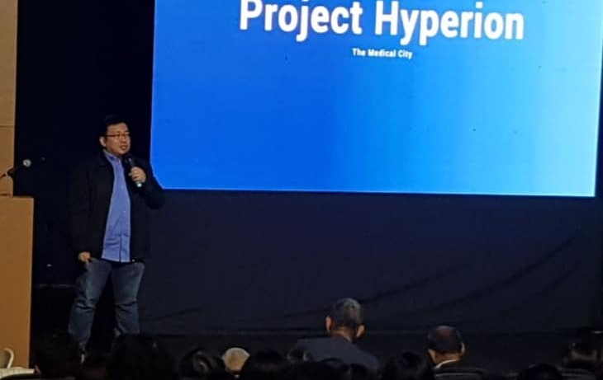
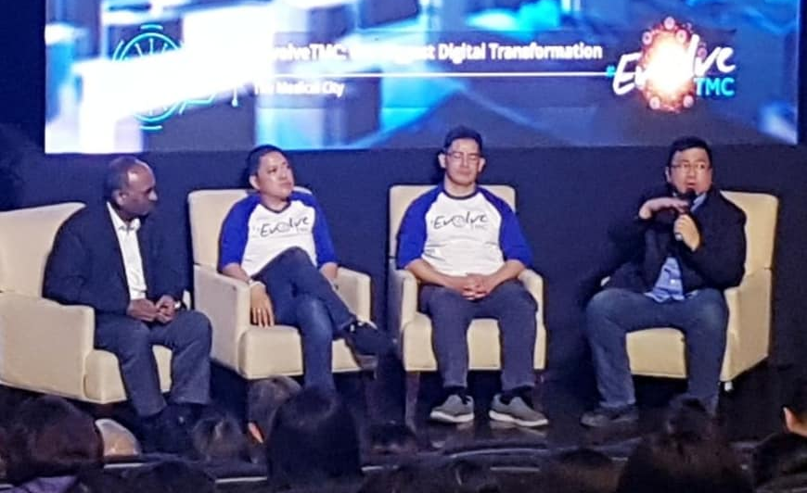
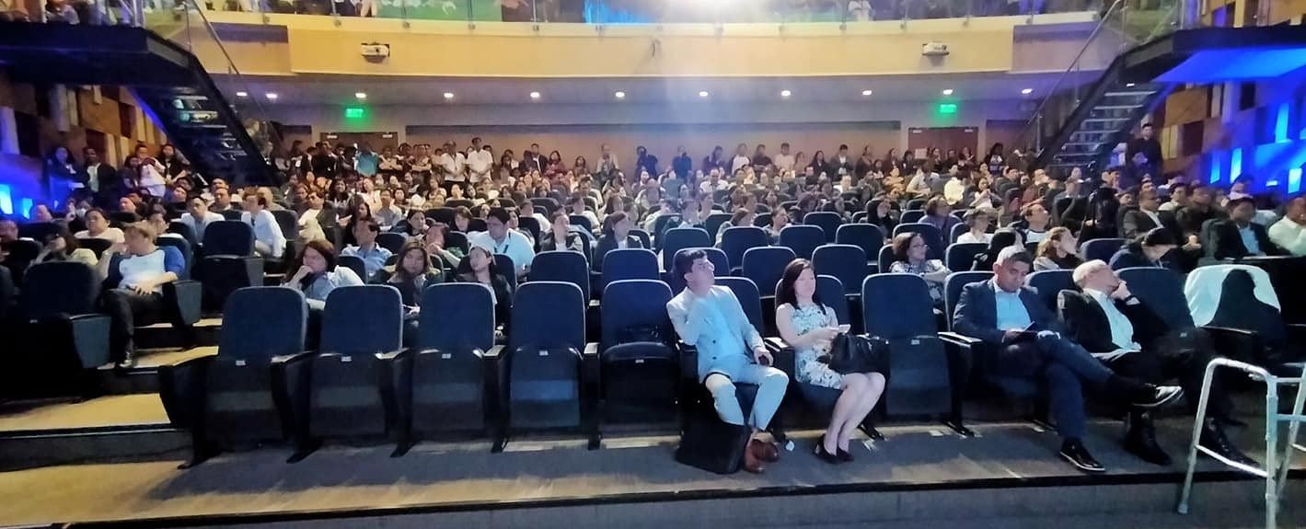
TMC Hospitalwide HIS/EMR Replacement Project

Slide 4
Project Goals and Objectives
Replace the Hospital Information System (HIS)
Replace the Electronic Medical Records (EMR) System
Replace the Radiology Information System (RIS)
Replace the Financial (ERP) System
Upgrade the Laboratory Information System (LIS)
Integrate everything!

Slide 5
First Step: Get Ready, Get Organized
Do an Inventory of the Systems
Identify the vendor partners
Get all connection sheets / integration guides
Identify integration protocols
Identify internal team coordinators
Assess integration skills

Slide 6
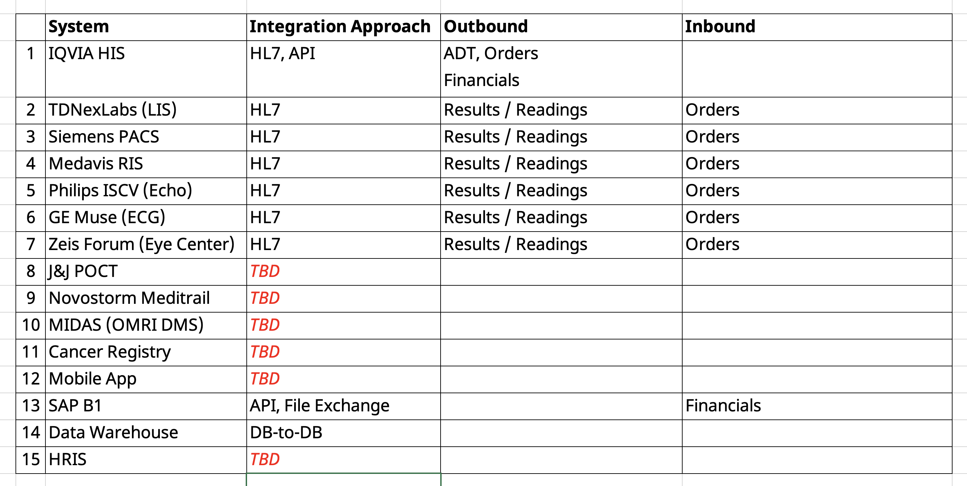

Slide 7
Guiding Principle:
No IT System Left Behind

Slide 8
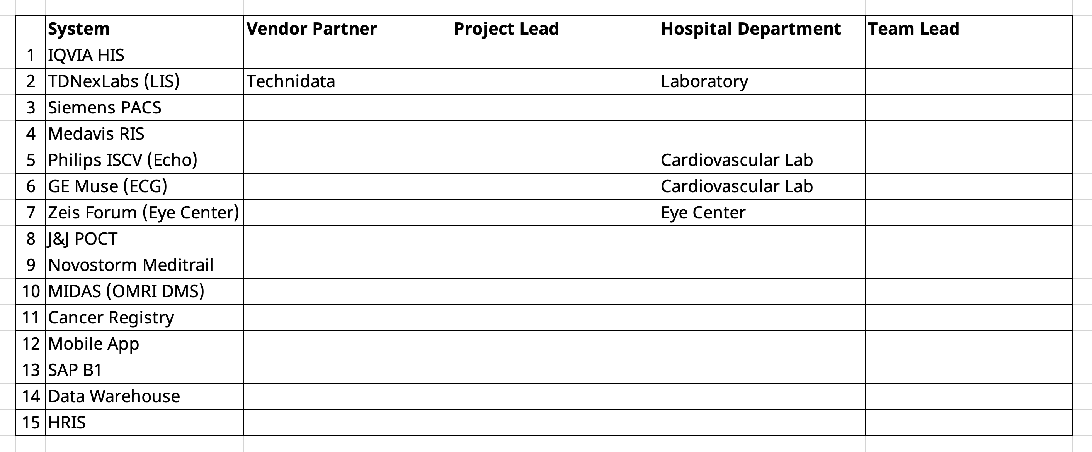

Slide 9
Design and Planning
Map out and draw the big picture
Categorize to organize

Slide 10
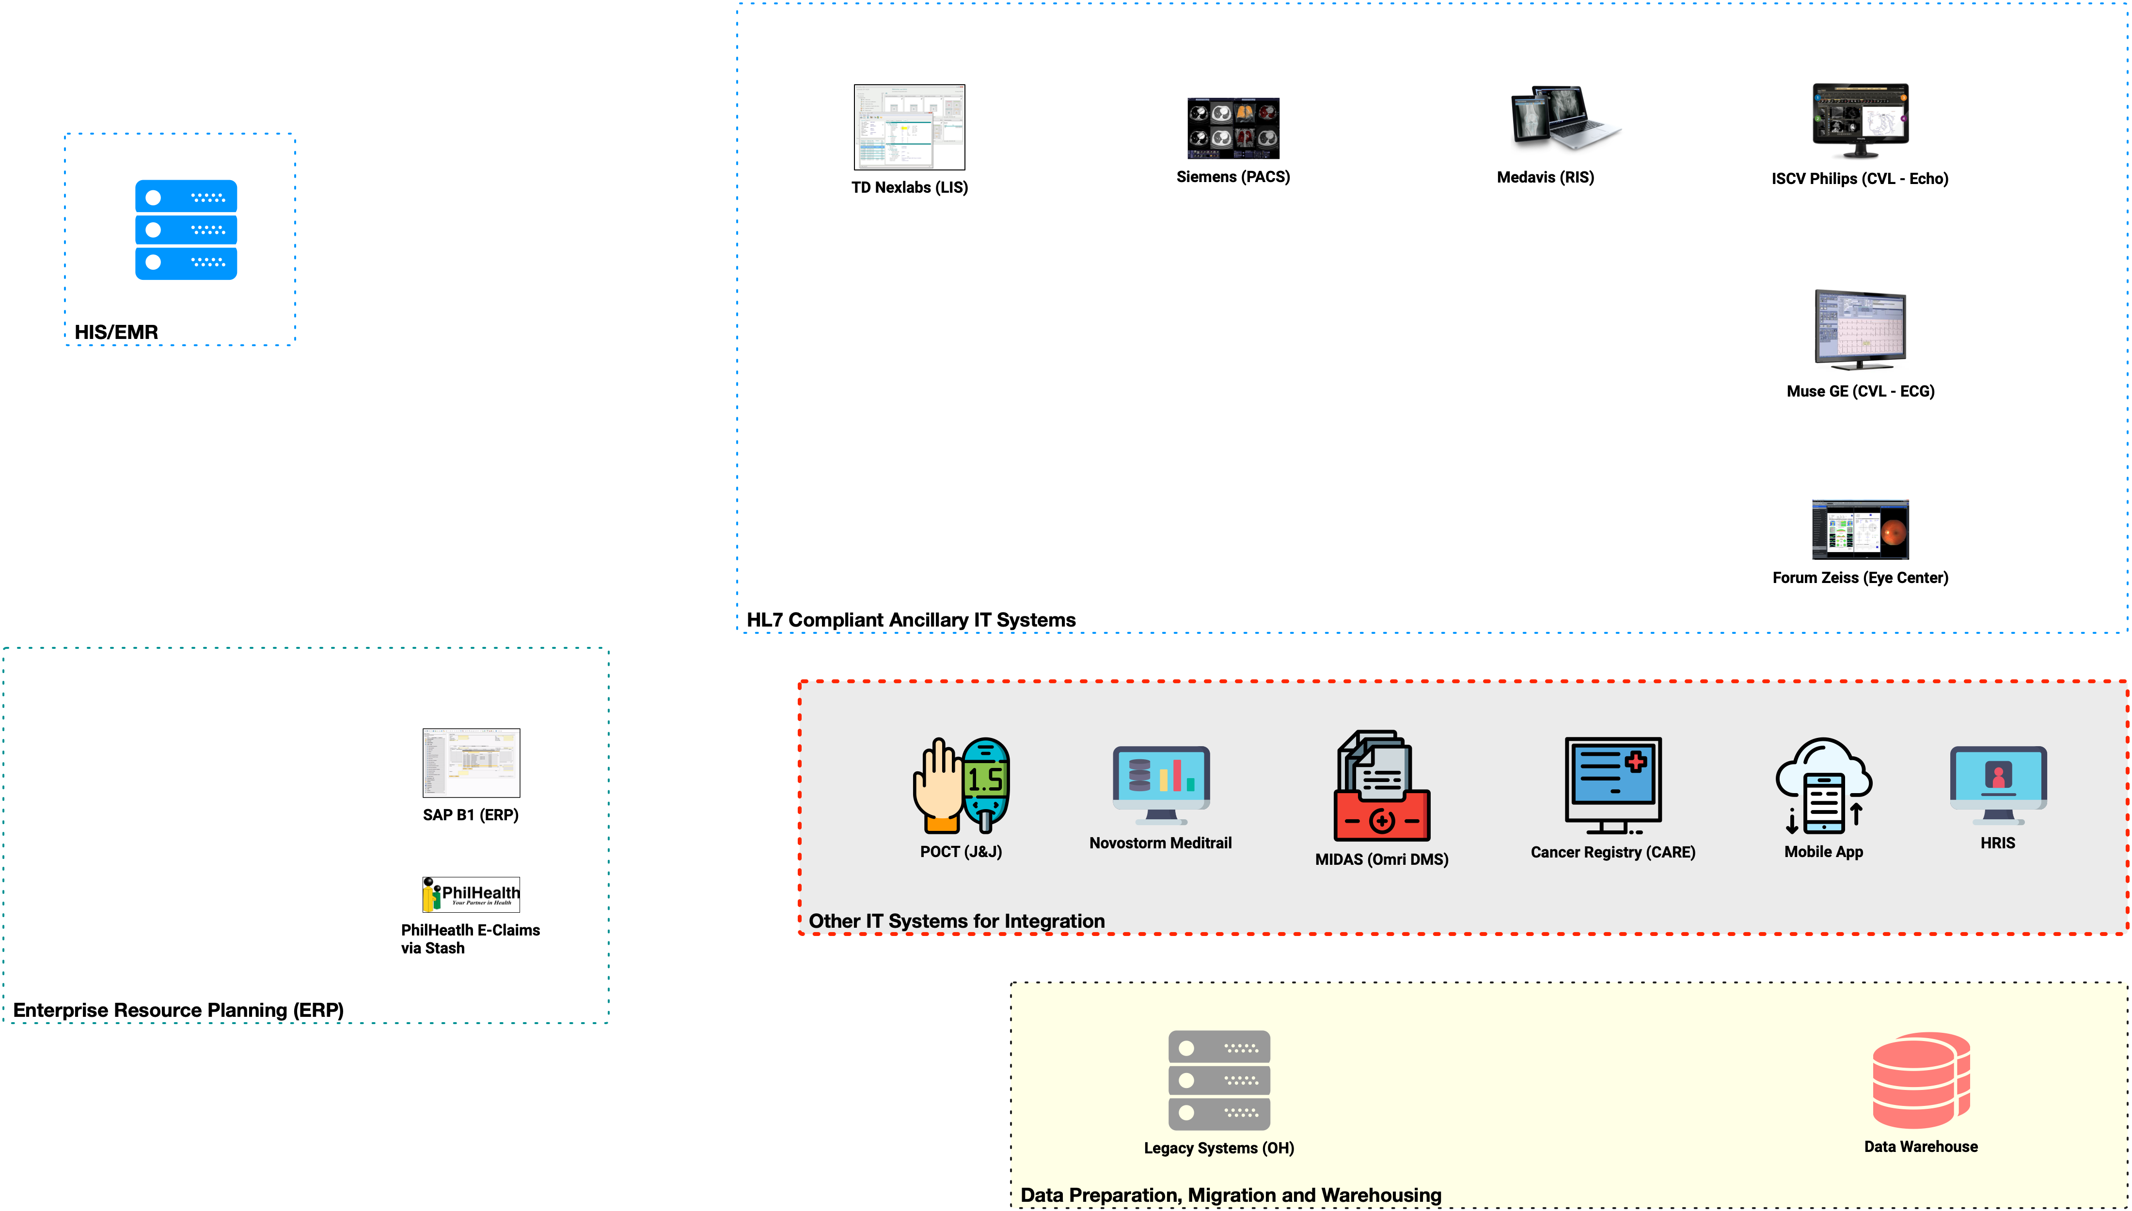

Slide 11
The main source/system

Slide 12
HL7-compliant systems can be the most straightforward to integrate

Slide 13
Financial systems are a different breed of integration

Slide 14
The unique/outlier systems – usually non-HL7 compliant

Slide 15
What do we do with legacy systems and data analytics requirements?

Slide 16
Second Step: Document Data Flows
Identify inbound and outbound for each system
  One system’s outbound is another system’s inbound
Go beyond HL7

Slide 17
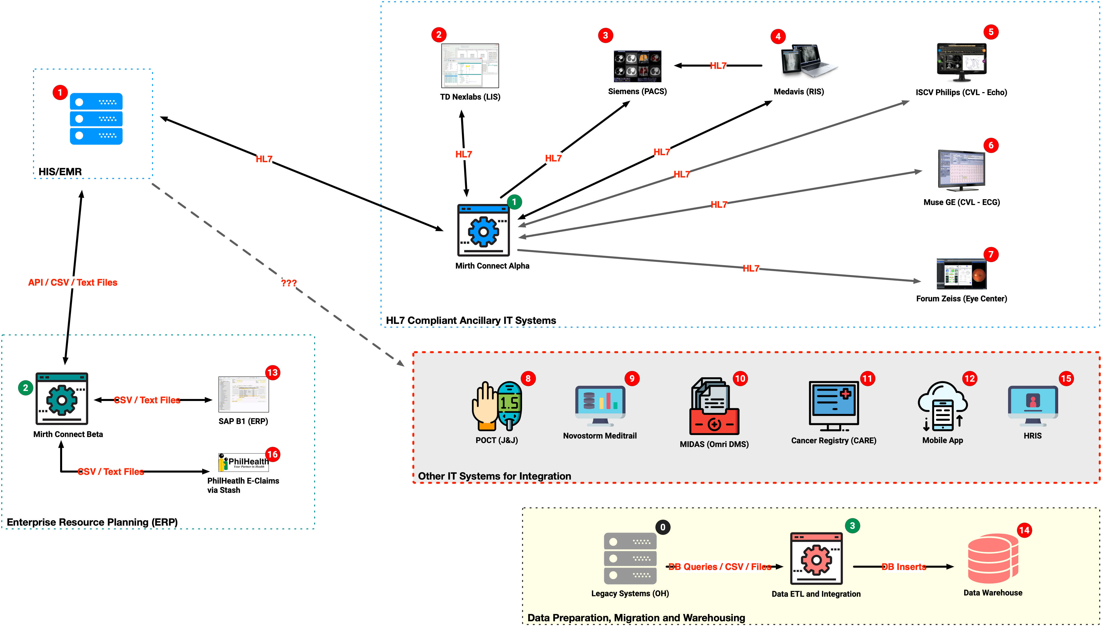

Slide 18
HL7 Integration Team

Slide 19
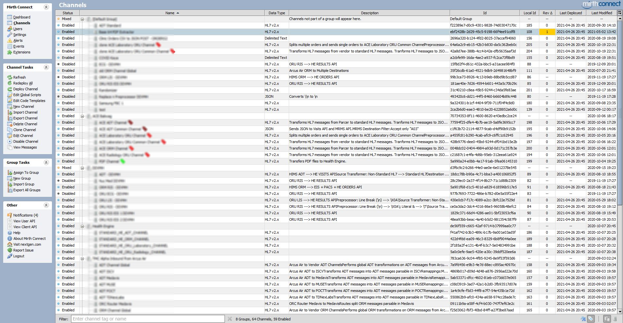

Slide 20
Vendor-to-vendor coordination
(Project Management)

Slide 21
Deferred and de-prioritized
(for now)

Slide 22
Business Intelligence and Data Analytics team

Slide 23
Integration Implementation Process
Treat each flow as a mini-project with its own WBS and timelines
  Helps with tracking
  Helps with accountability
  Helps manage resources

Slide 24
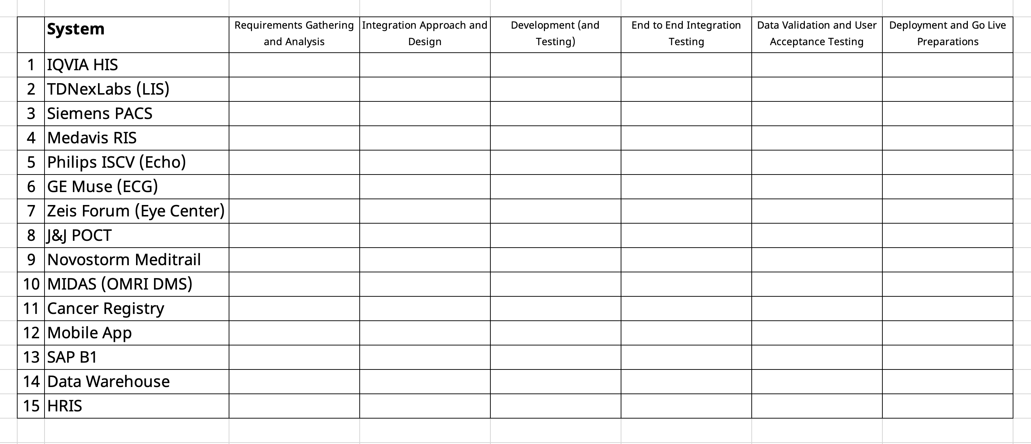

Slide 25
Challenges Faced
Data Standardization (Internal / Operational)

Slide 26
Terminologies, data dictionaries, vocabularies, and codes will be different

Slide 27
Challenges Faced
Data Standardization (Internal / Operational)
  Data mapping and transformations
Existing situation: Not everything is integrated
Multiple standards and protocols
  Not everything is HL7, some are customized

Slide 28
Interoperability Protocols and Standards
HL7 v2 (ADT, ORM, ORU)
API (JSON)
CSV file exchange
File Uploads
DB-to-DB

Slide 29
Challenges Faced
Data Standardization (Internal / Operational)
  Data mapping and transformations
Existing situation: Not everything is integrated
Multiple standards and protocols
  Not everything is HL7, some are customized
Availability of integration skills and competencies
Impact to hardware requirements

Slide 30
Outcome
Implementation
  Jan-2020 to Jul-2021 (18 months)
  100% integration of clinical data and results
  Paperless patient care
  Financials and other systems were continued by TMC team

Slide 31
Lessons Learned
Integrate and innovate
  Do not impose
Be realistic with:
  Success criteria
  Resources and timelines
  Technical capabilities
Be agile – iterate
Test, test, test! Test everything!

Slide 32

Thank you! Questions?
For more information, questions and feedback, please email me at mikemuin@medprojects.com.

