Slide 1

FHIRING UP UHC: USING HL7 FHIR FOR HEALTHCARE INTEROPERABILITY AT THE LGU LEVEL
PHILIP CHRISTIAN C. ZUNIGA
pczuniga@up.edu.ph

Slide 2

Philippines on FHIR

Slide 3
Developments since 2017
MANDANAS GARCIA RULING
UHC LAW
COVID 19
NHDR

Slide 4
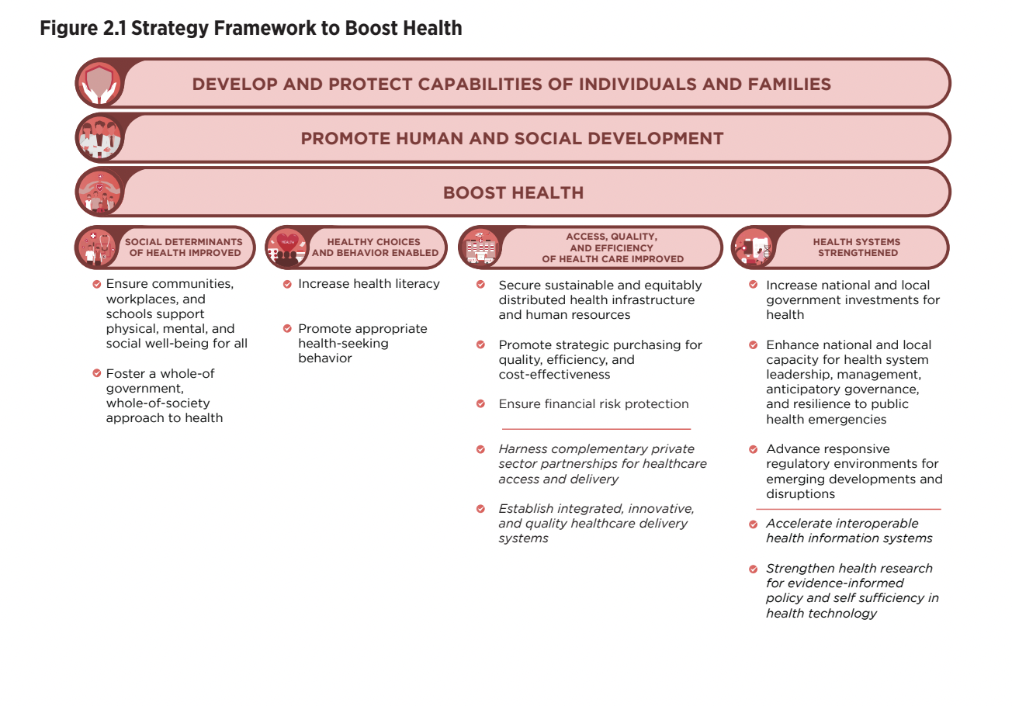

Slide 5
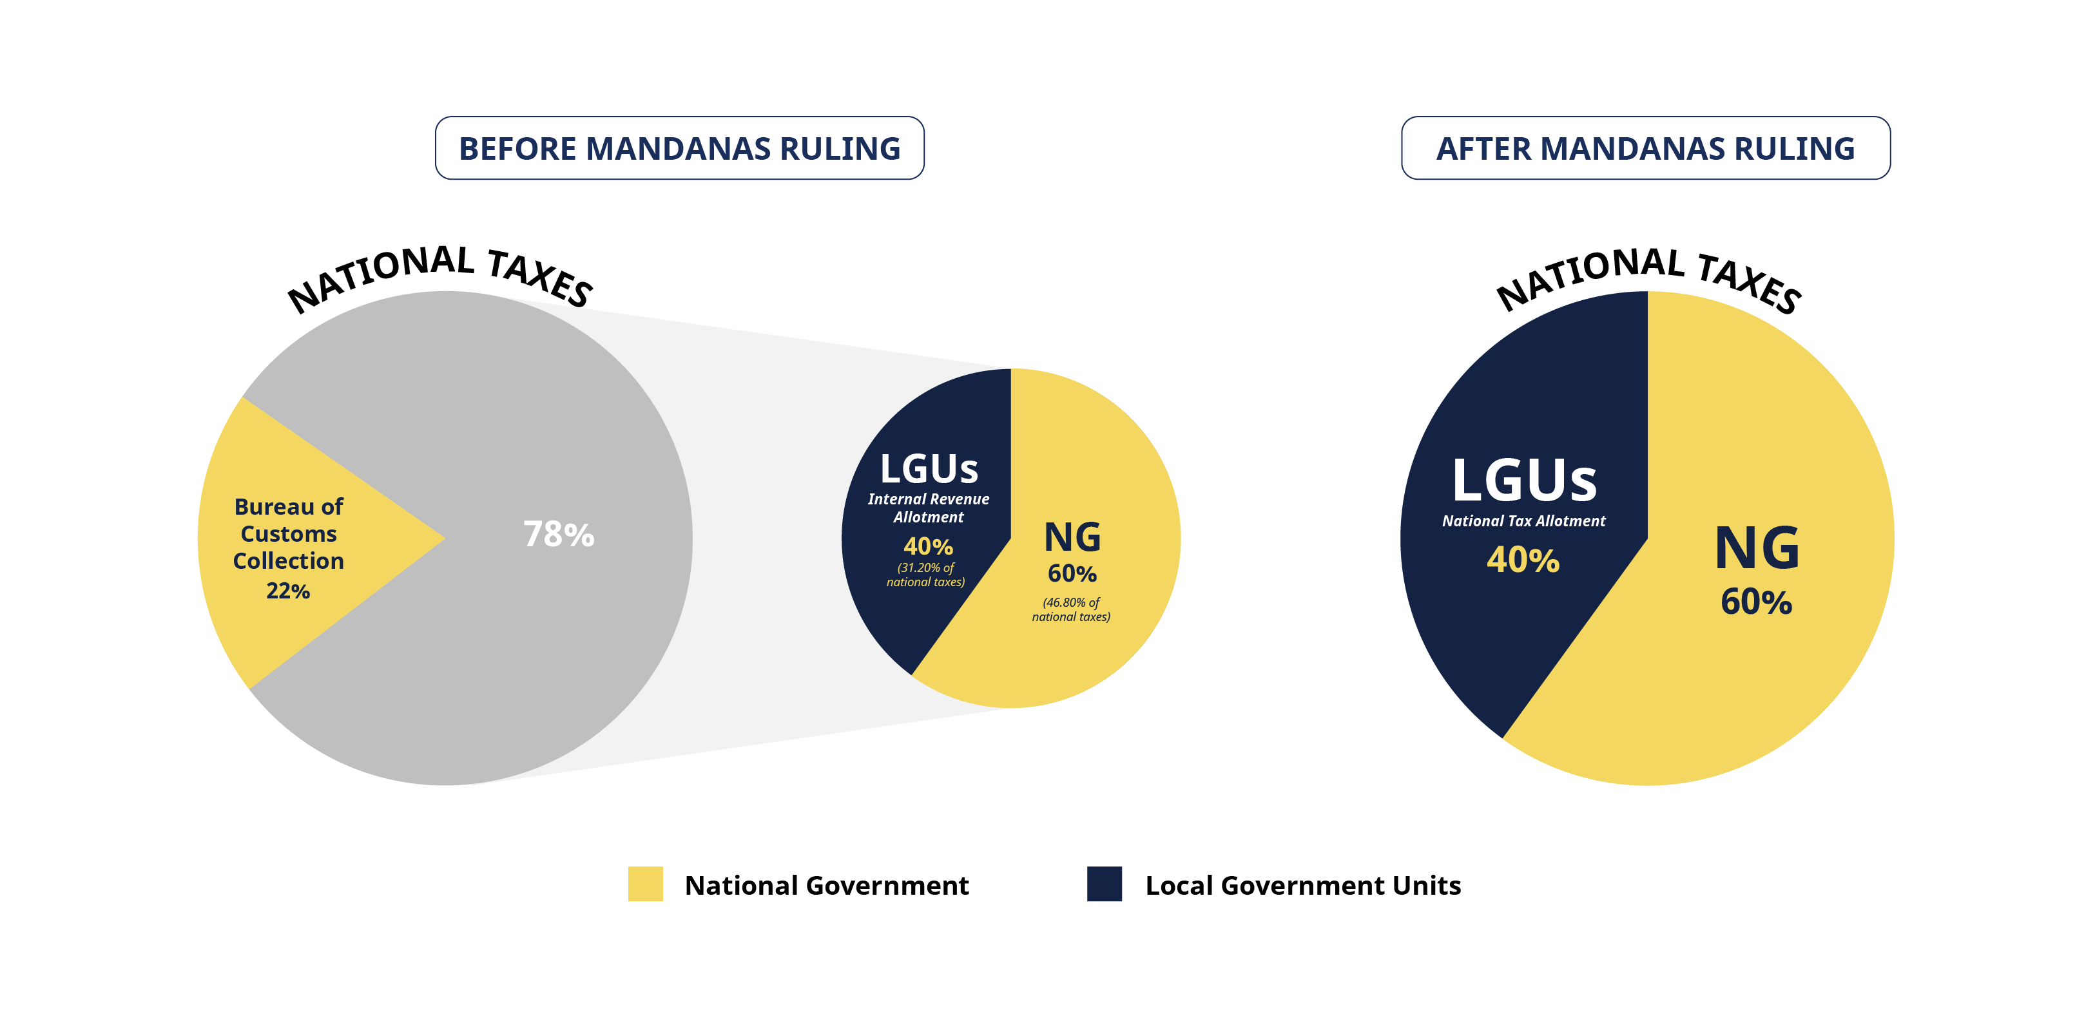
MANDANAS GARCIA RULING

Slide 6
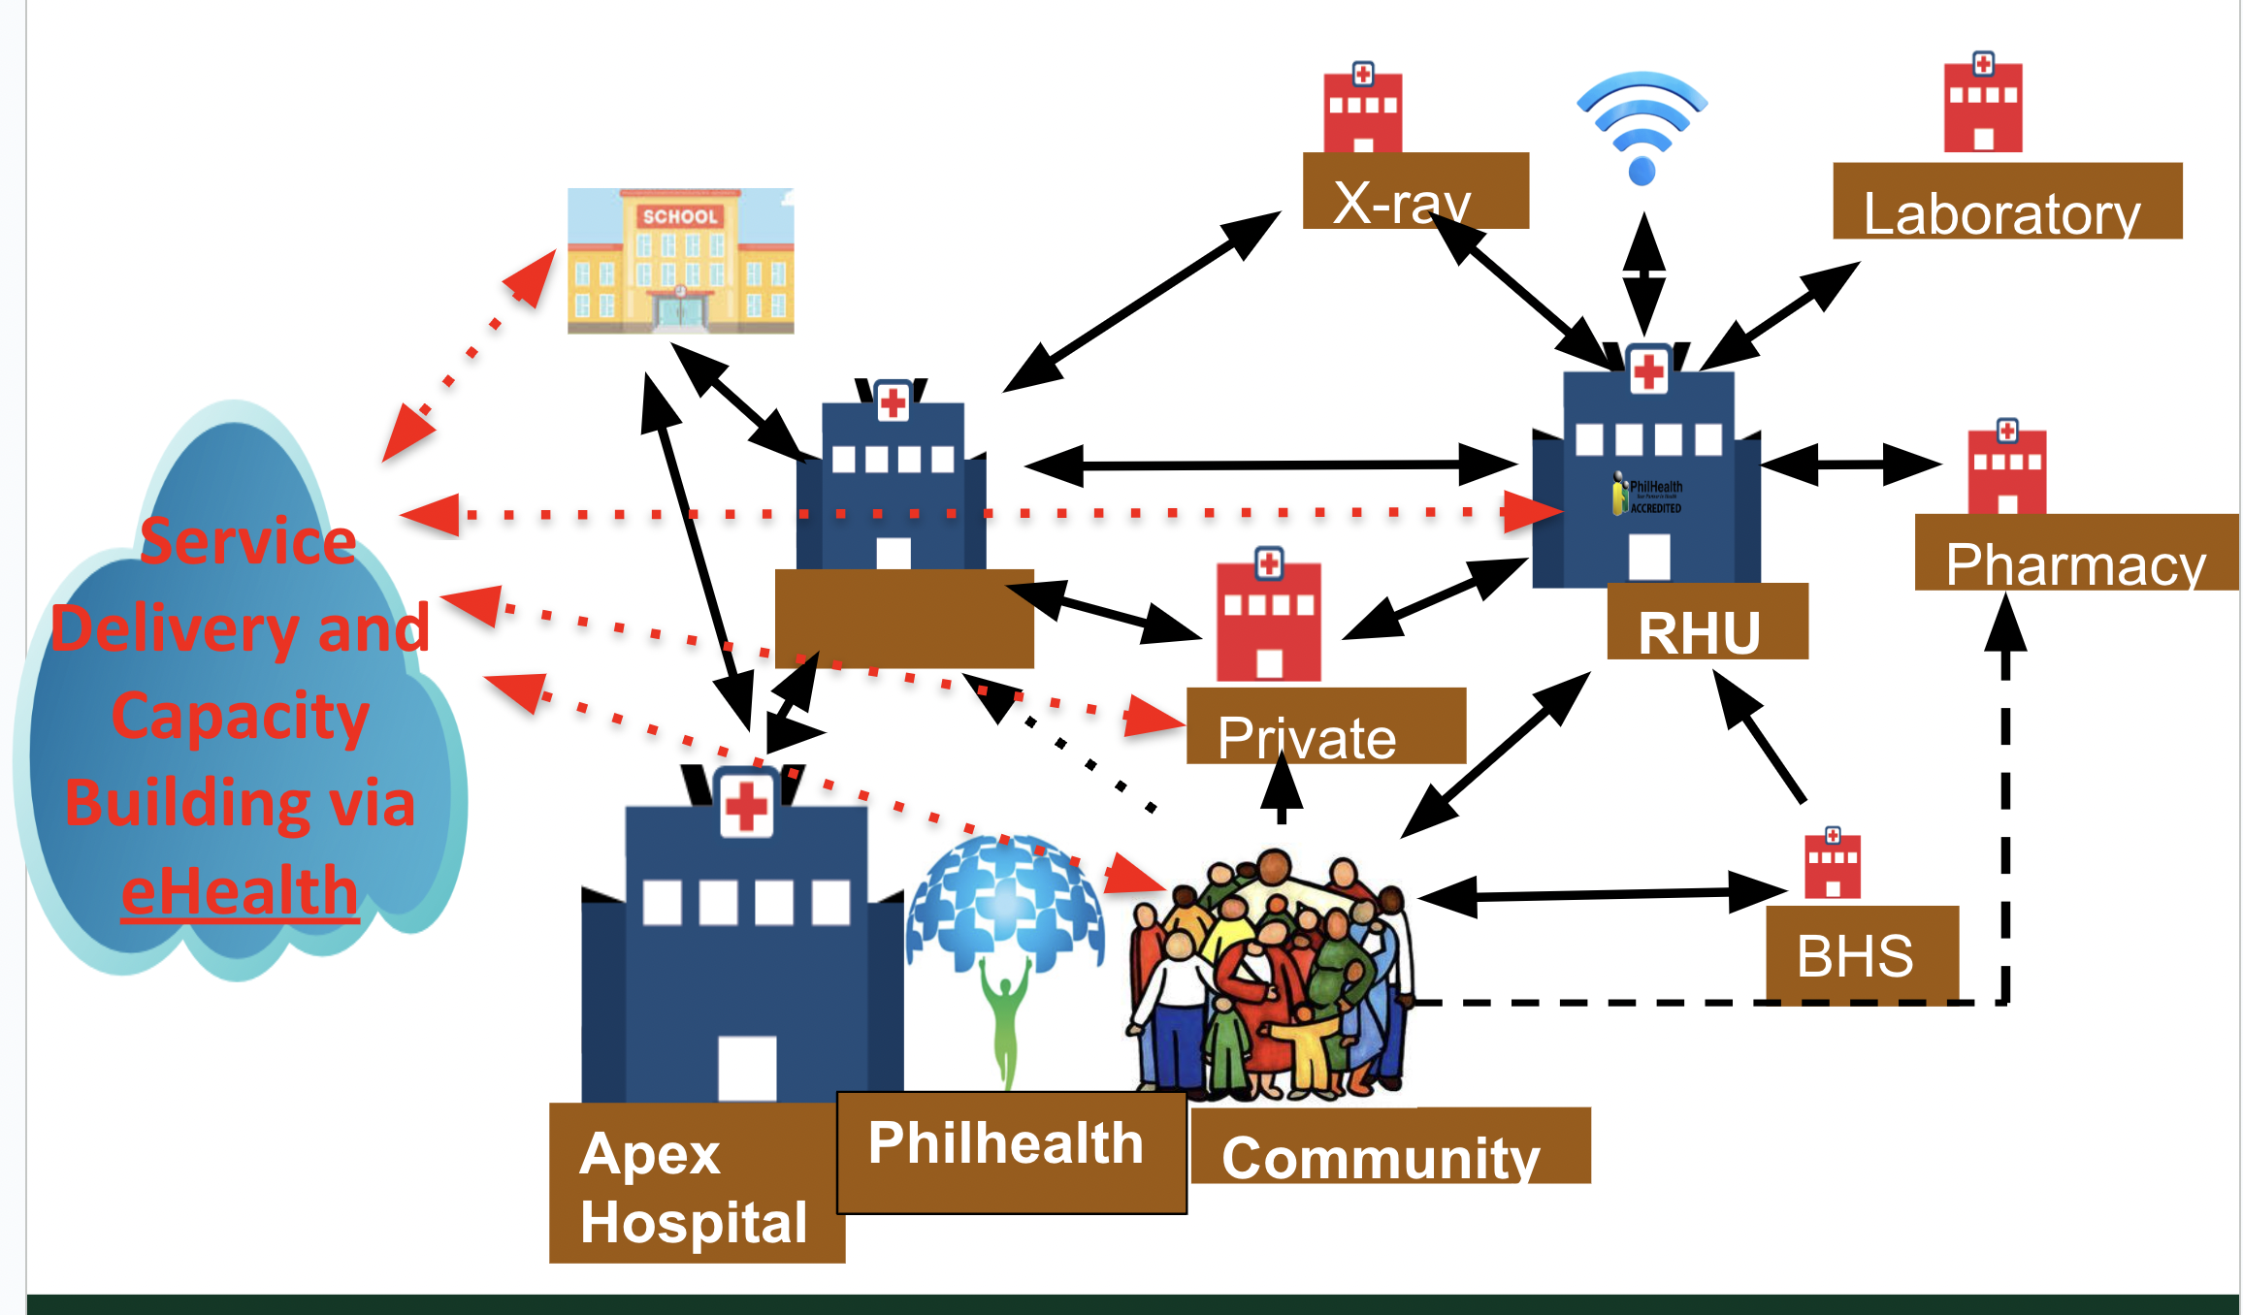
UHC

Slide 7
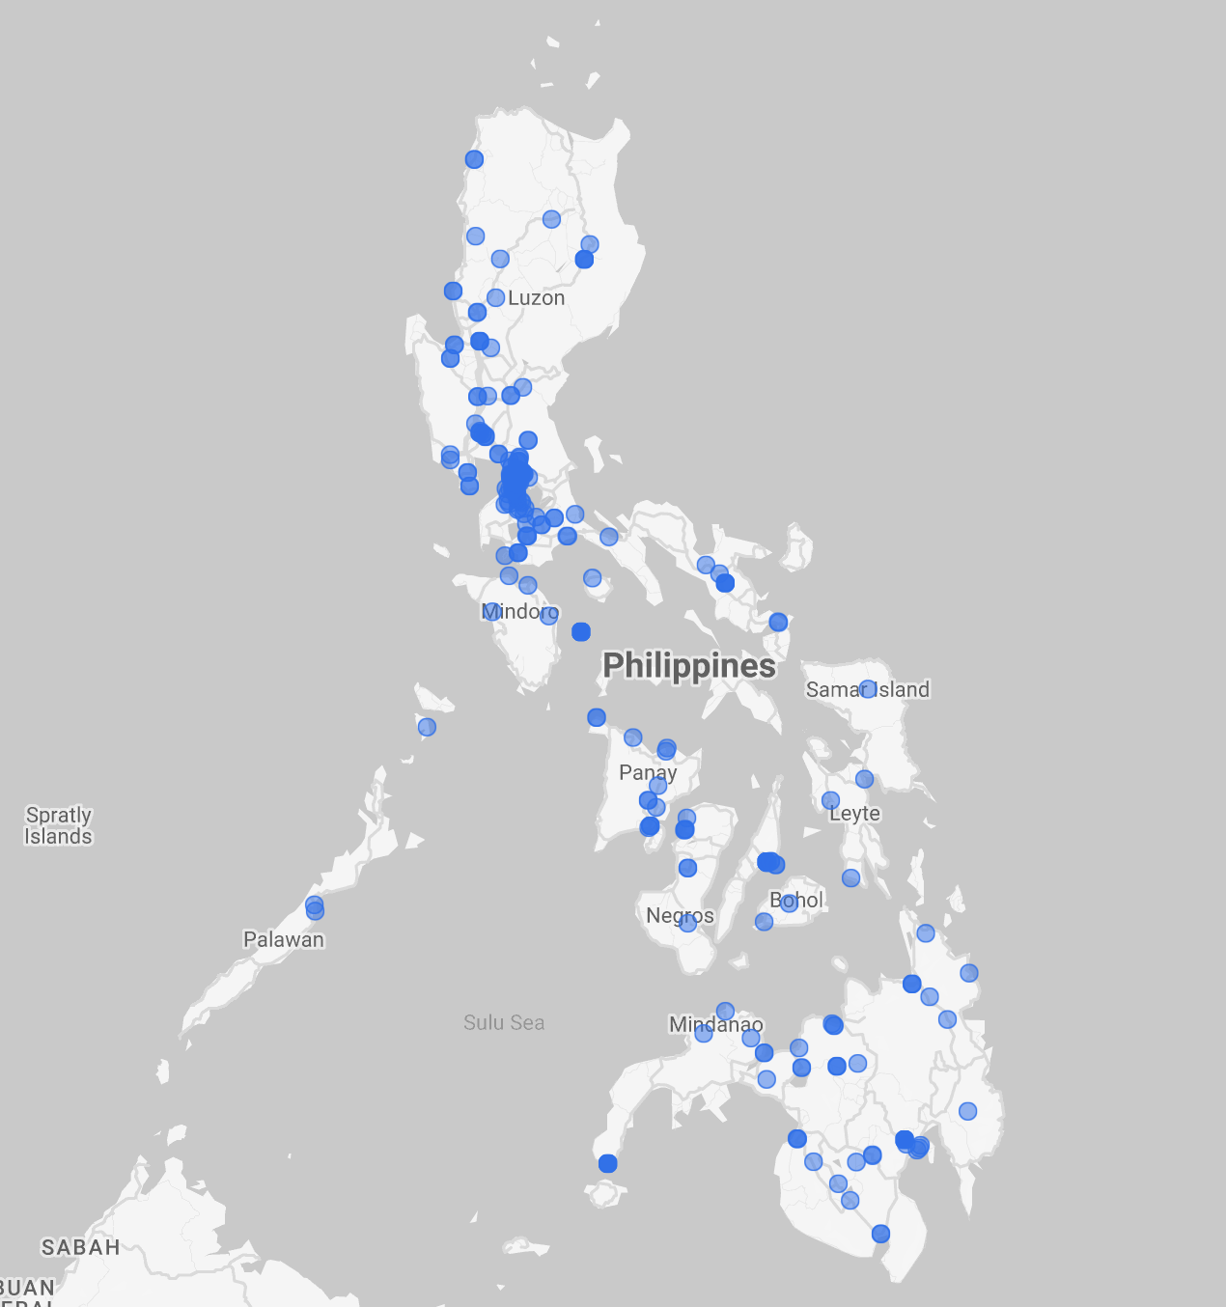
COVID 19
CDRS

Slide 8
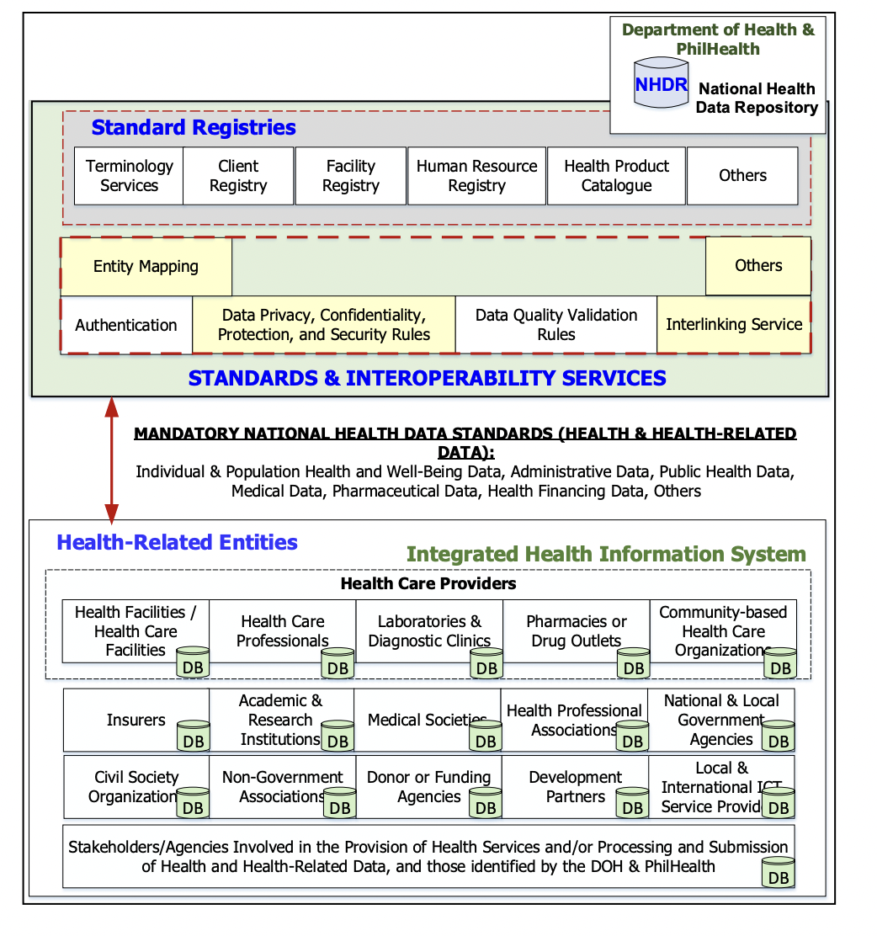
NHDR

Slide 9
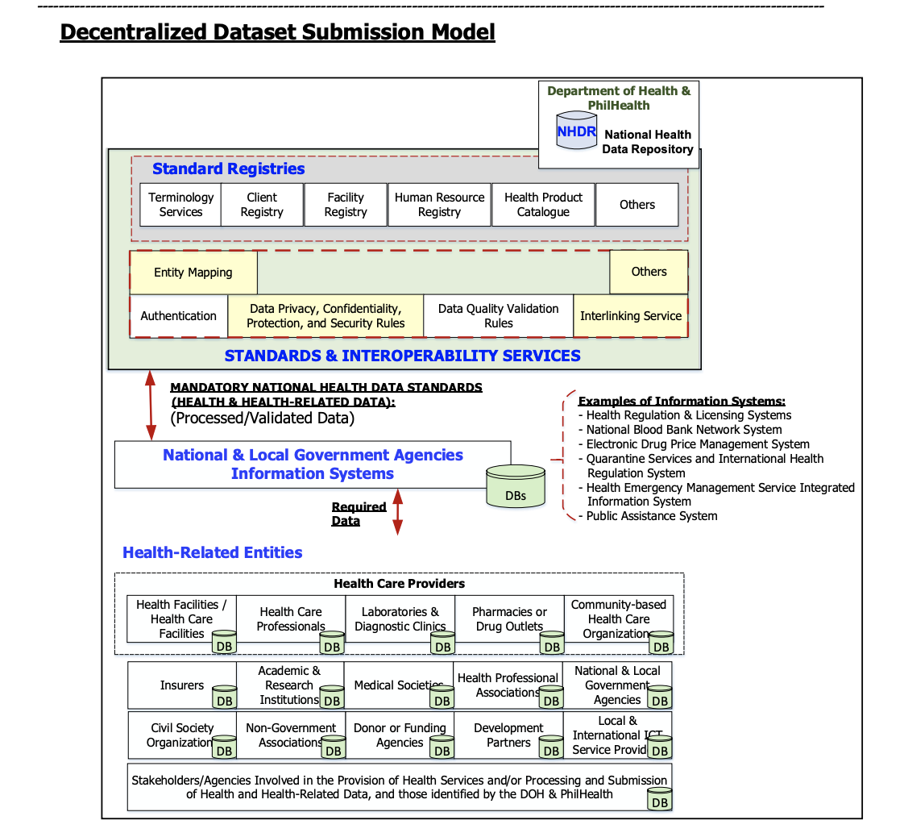
NHDR

Slide 10
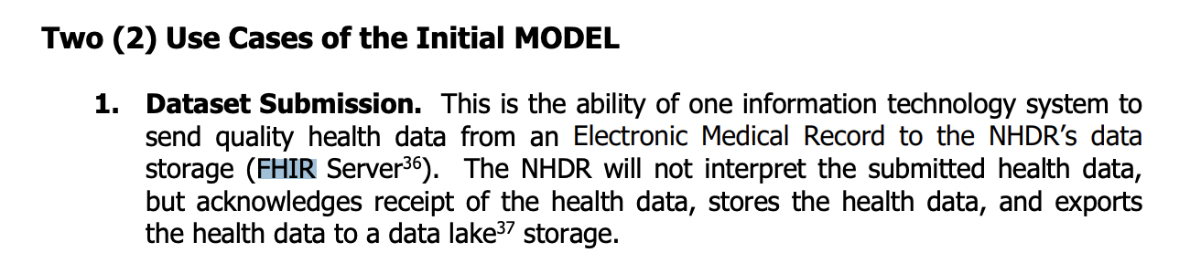
NHDR

Slide 11
Why FHIR?
APIs are readily available
Data models are established already
Servers/technology stack is mature

Slide 12

Setting Up
Deployment
LGU engagement is crucial at this point.

Slide 13
LGU Trends
Health as a front and center sector
People Centric Governance

Slide 14
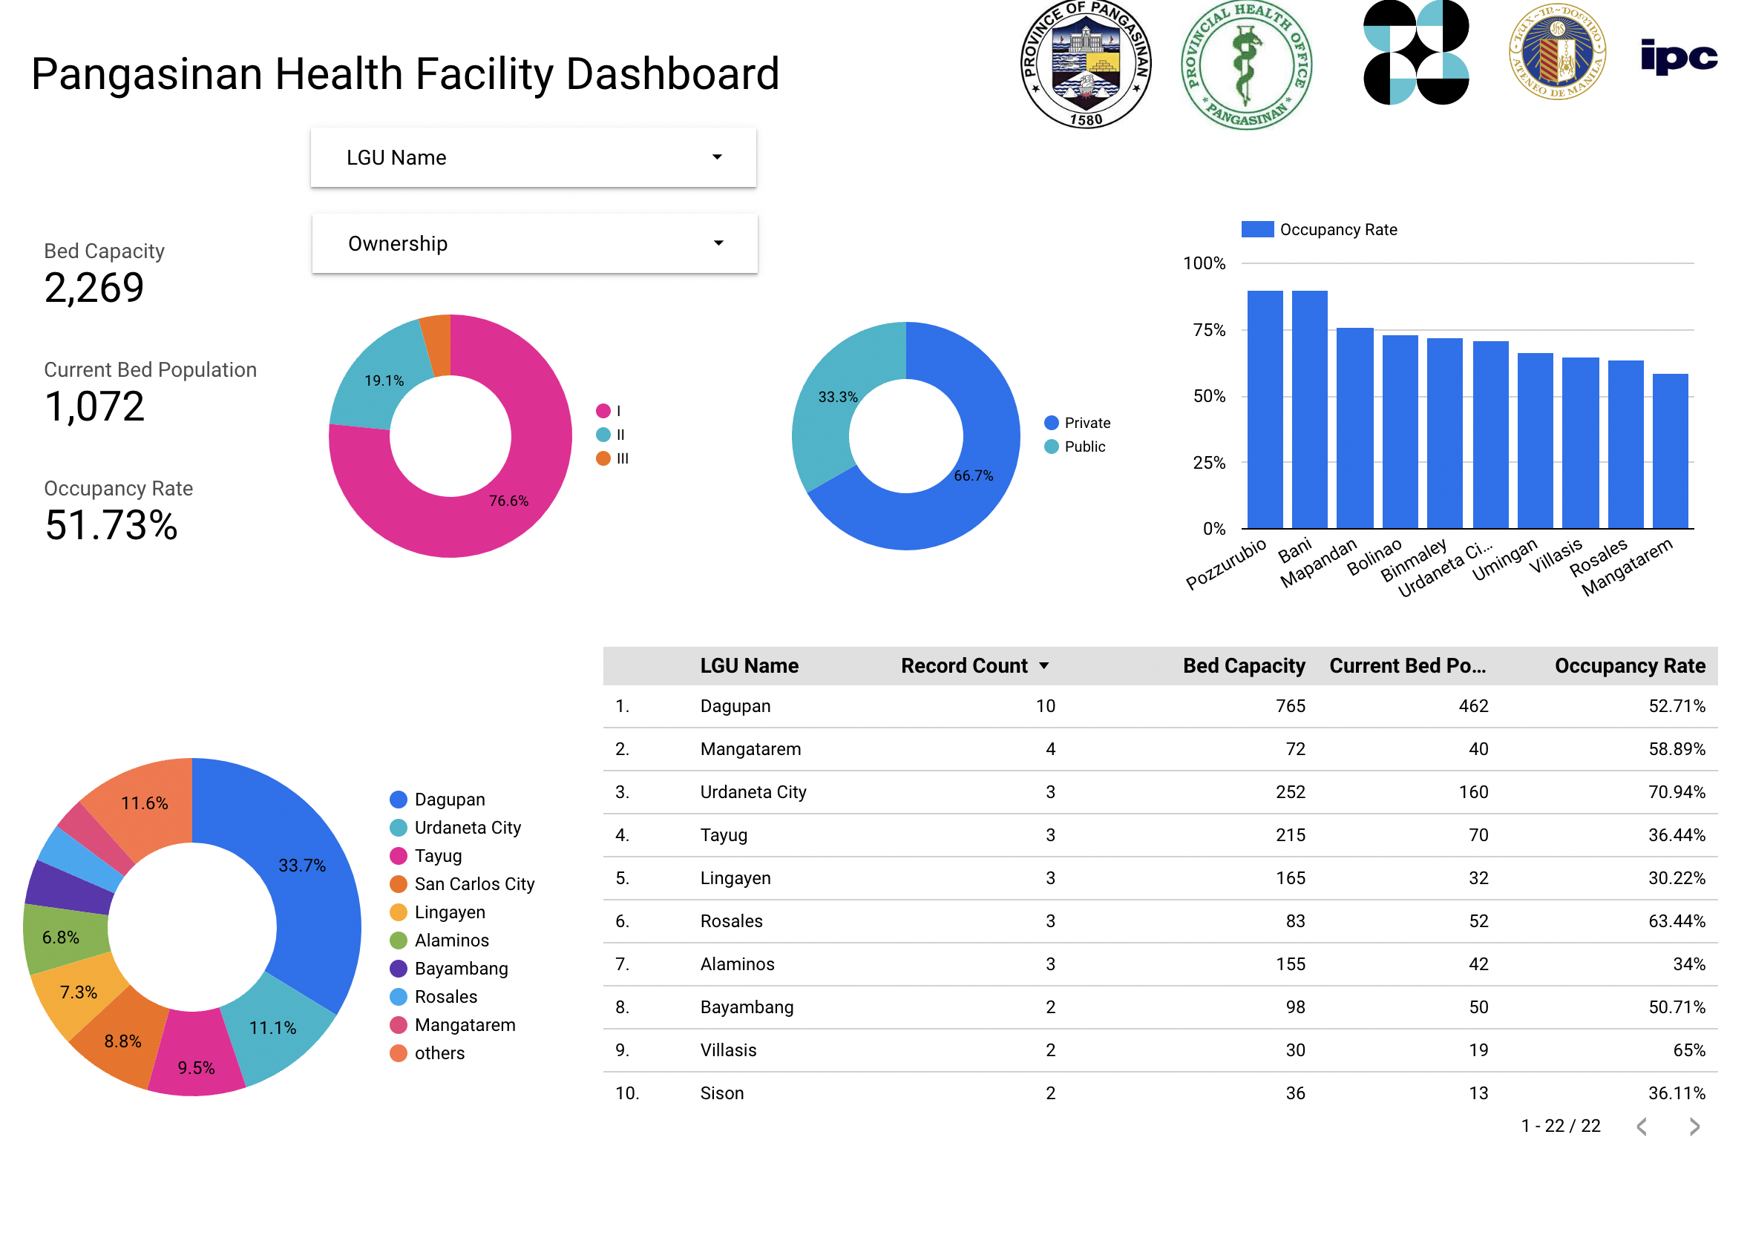
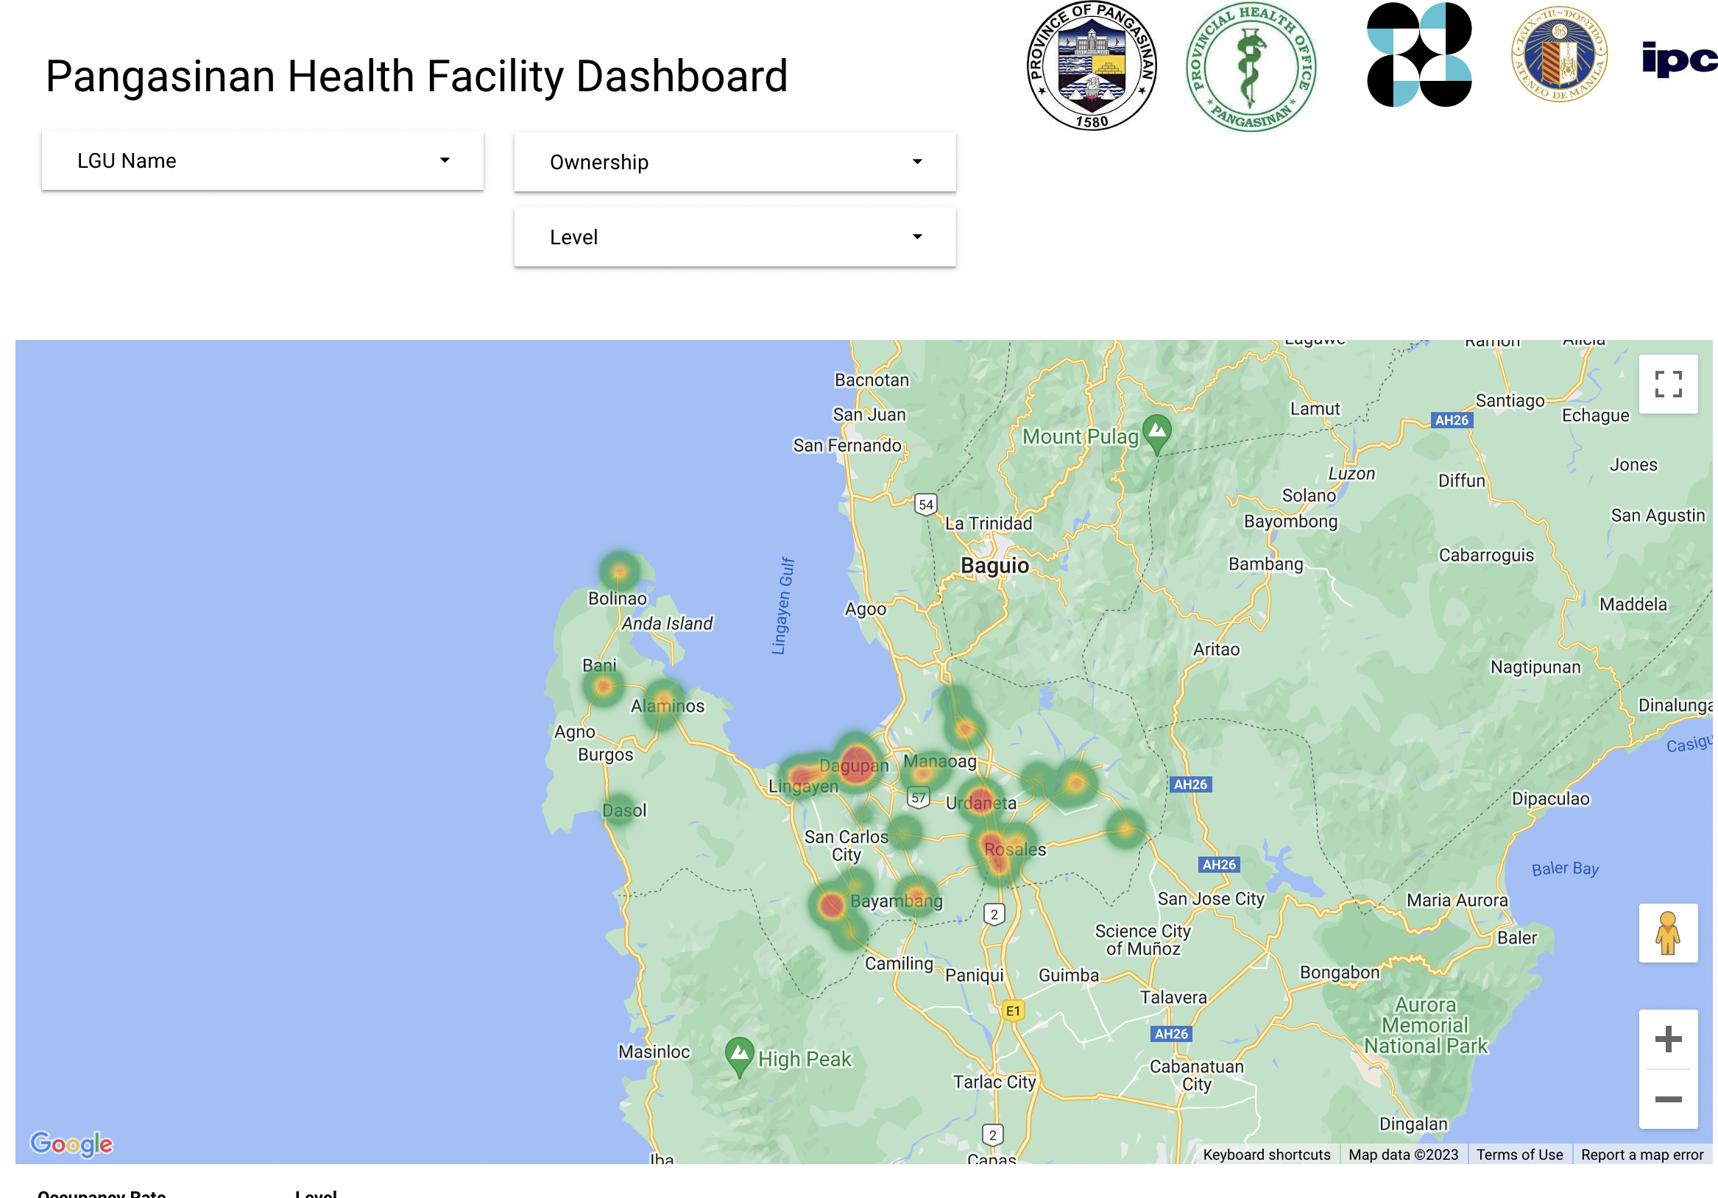
The bigger challenge
Can the health data being collected by EMRs be utilized for governance?

Slide 15
What’s next?

Slide 16
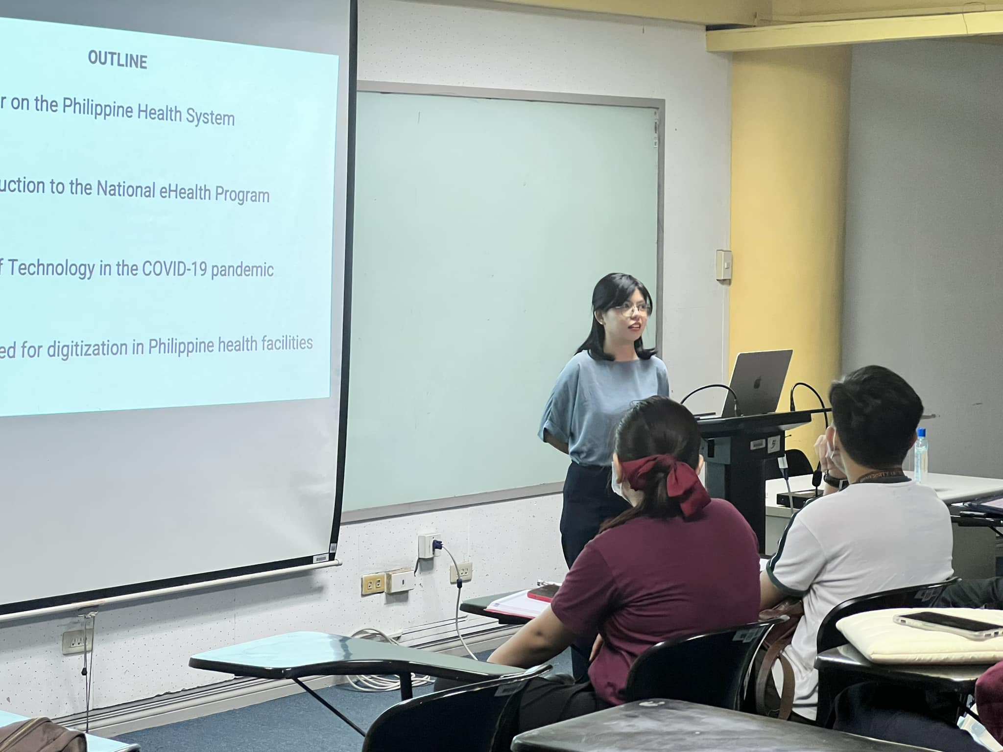
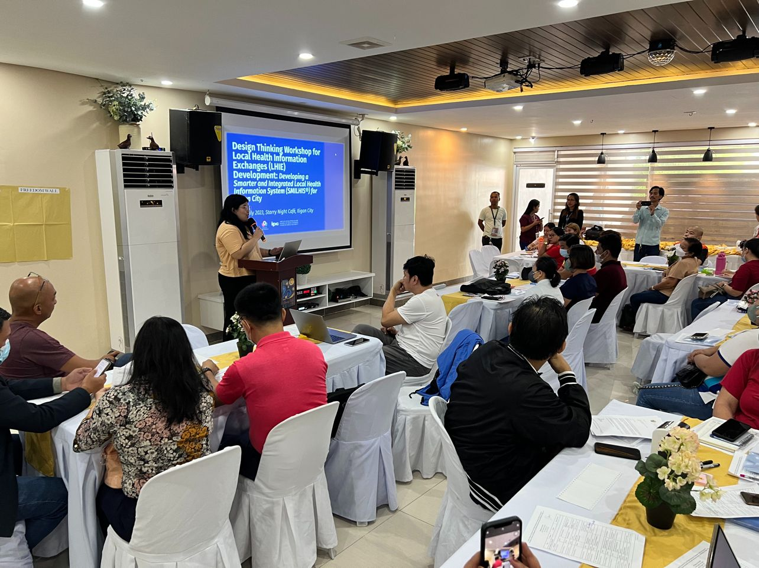
Capacity Building

Slide 17
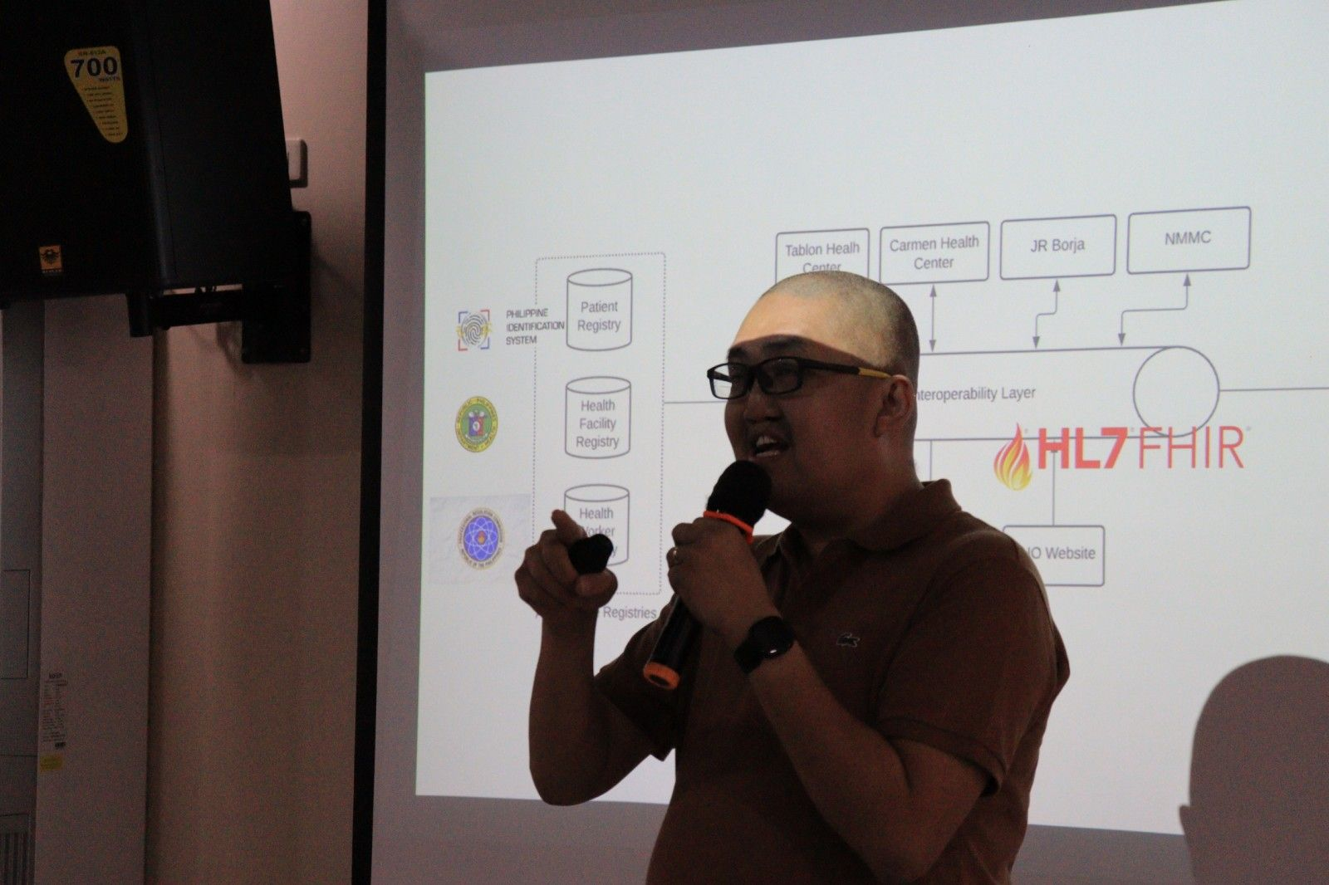
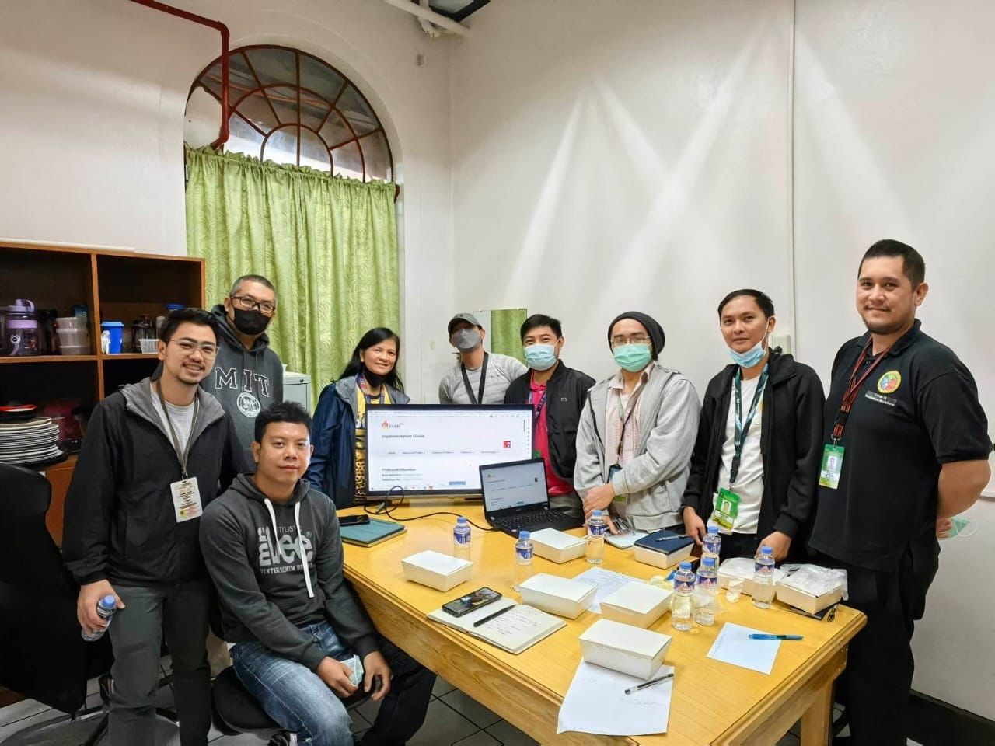
LGU Led Implementations

Slide 18
Thank You Very Much

