Slide 1

Implementation of Electronic Medical Records in a Government Hospital
Gerardo S Manzo MD
First HL7 Summit 26 Aug 2023

Slide 2
Disclosures
No commercial interests in Health IT industry
Founding member HL7 Philippines as clinical expert
Referenced previous personal presentations and from PHL Health Informatics gurus Dr Eloy Marcelo Dr Mike Muin

Slide 3
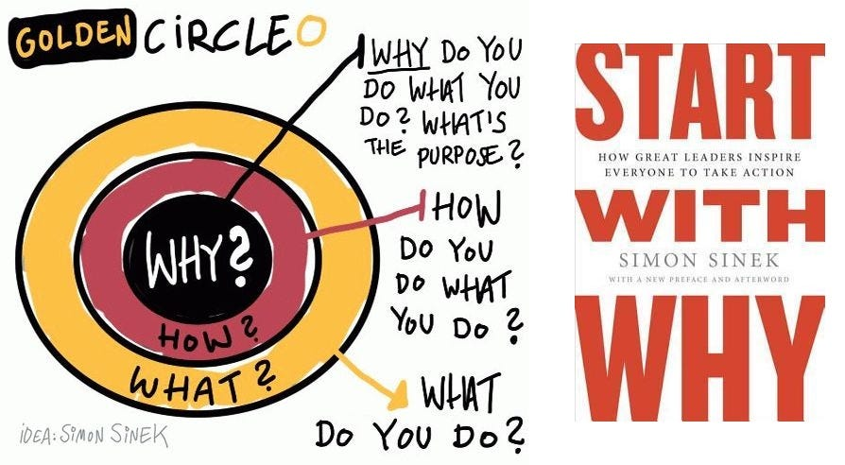

Slide 4
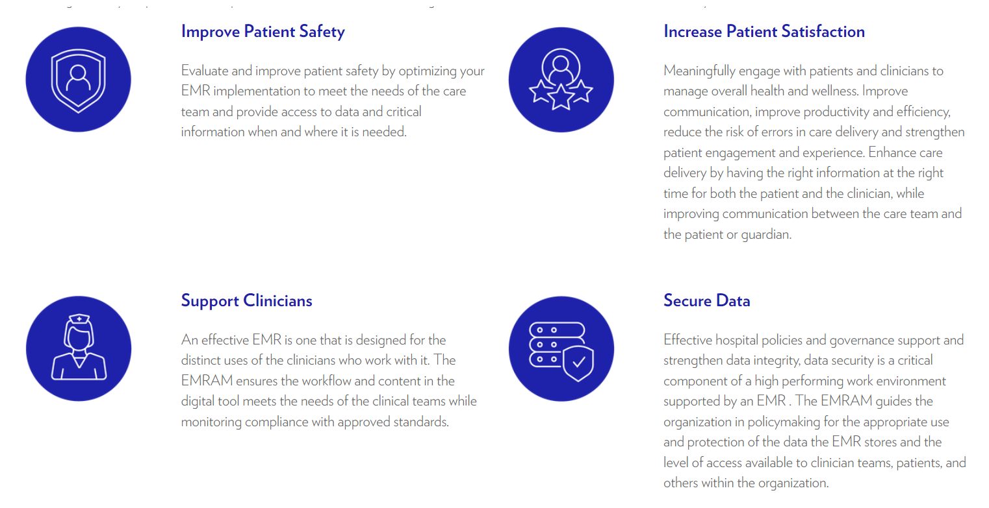

Common Goals of eHealth

Slide 5

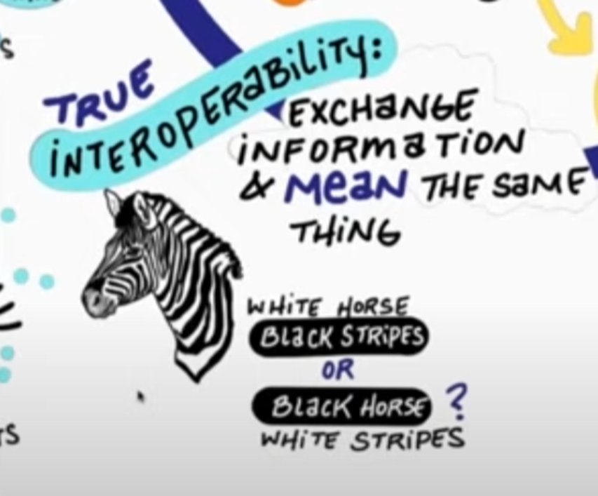
Goal for HL7 : INTEROPERABILTY

Slide 6
Lessons Learned from
Hospital IT Implementation:
Philippine Heart Center Experience
GERARDO S. MANZO, MD
2014 HEALTH IT SUMMIT
CROWNE PLAZA MANILA

Slide 7
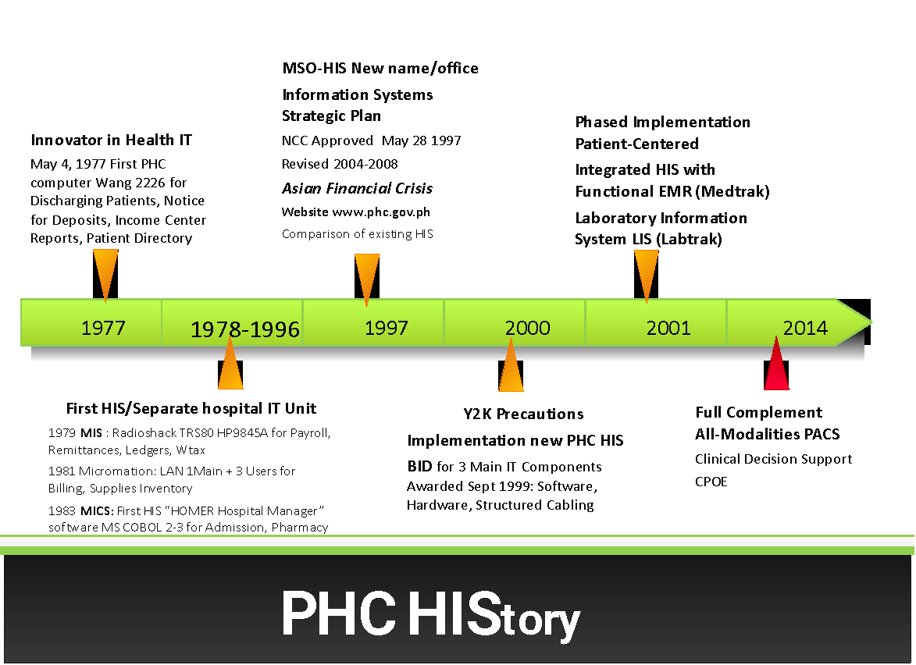
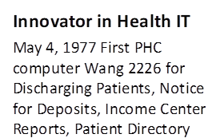
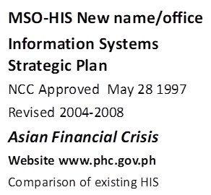
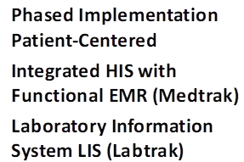
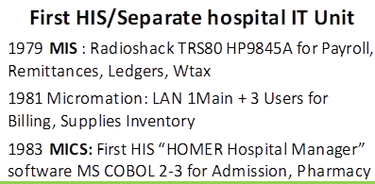
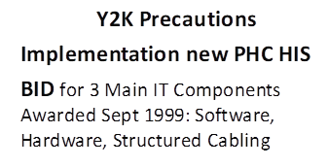
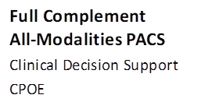
GSManzo Health IT Philippines 22 May 2014

Slide 8
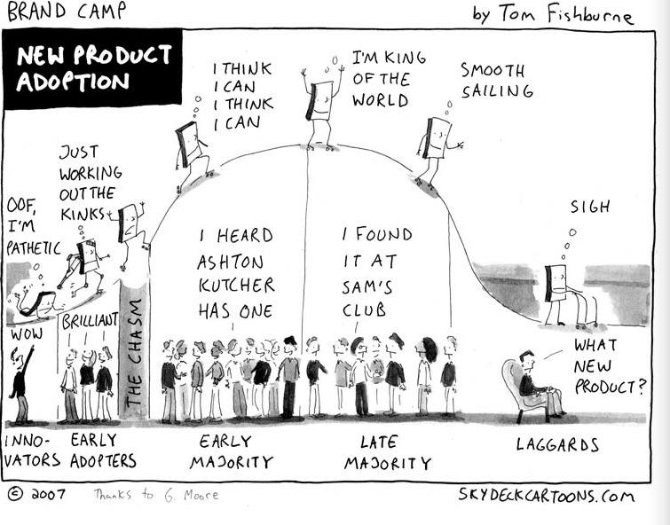
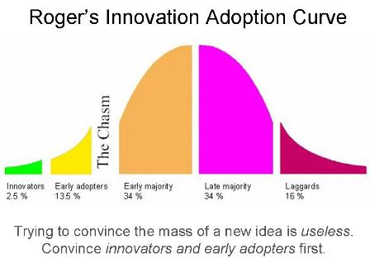
GSManzo Health IT Philippines 22 May 2014

Slide 9
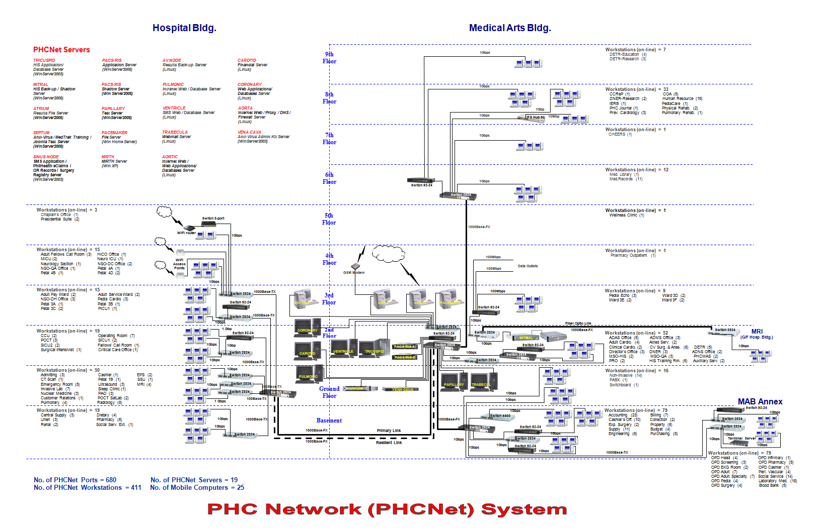
411 Workstations
352
Beds
1.2 Workstations: Bed
As of May 2014

Slide 10
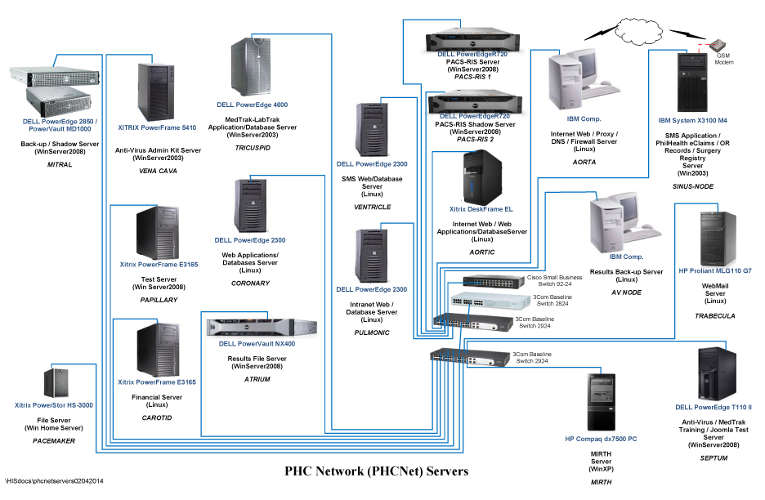
20
Branded Servers
with unique server names after different parts of the heart
(aortic, mitral, tricuspid…)

Slide 11
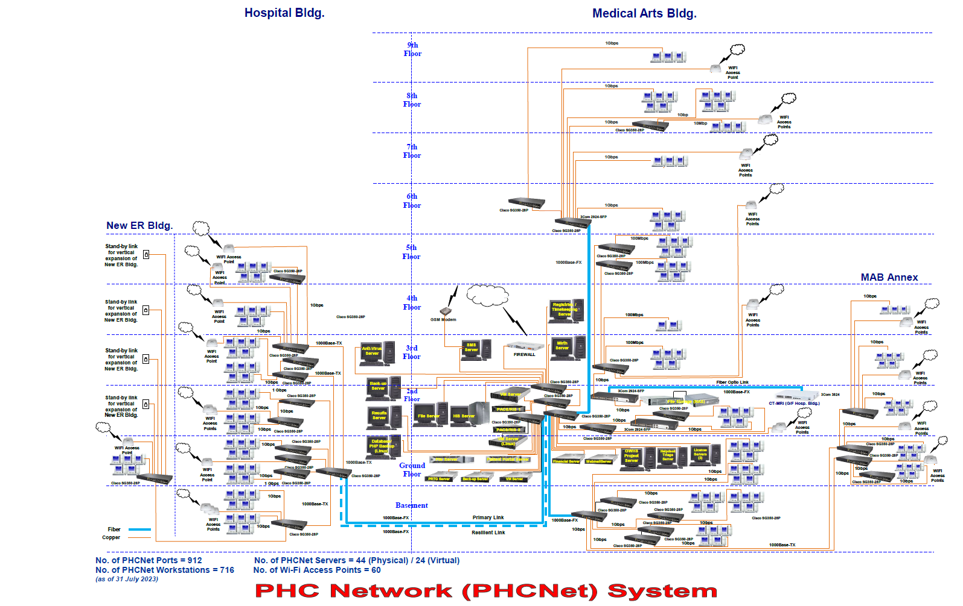
PHC Net As of August 2023
PHC Workstations 731
PHC Functional Beds 500
Ratio per Patient 1.46
Physical Servers 44
Virtual Servers 24

Slide 12
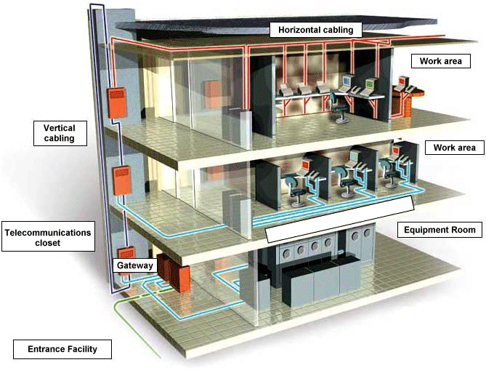
Lessons Learned
Hardware & Structured Cabling
Fiber-optic backbones – Cat5
Future-proof. Anticipate expansion and obsolescence.
Label connections.
Monitor need for expansion.

Slide 13
Early Lessons on eHealth Implementation
Exercise due diligence. Perform comparative reviews. Take note of performance track records. Whenever possible do primary verification of reference sites.
Avoid analysis paralysis.
Consult vendor-neutral experts. Develop friendships.
Consider as valued partners solution providers, not hard-sell vendors.
Scope what end-users really need, not just what they want. Auto replace frontliners.
Standardize specifications.
Schedule procurements. Added value with volume orders. Easier to monitor maintenance.
Train your trainors and end-users well.

Slide 14



PHC Hospital Information System PATIENT CENTRIC
■Post Relational DB
■Object technology
■MUMPS / M-language
■Originally designed for healthcare industry
■Unified HIS
■More hospital sites outside the US than other HIS
■National / Regional EHRs
GSManzo Health IT Philippines 22 May 2014

Slide 15
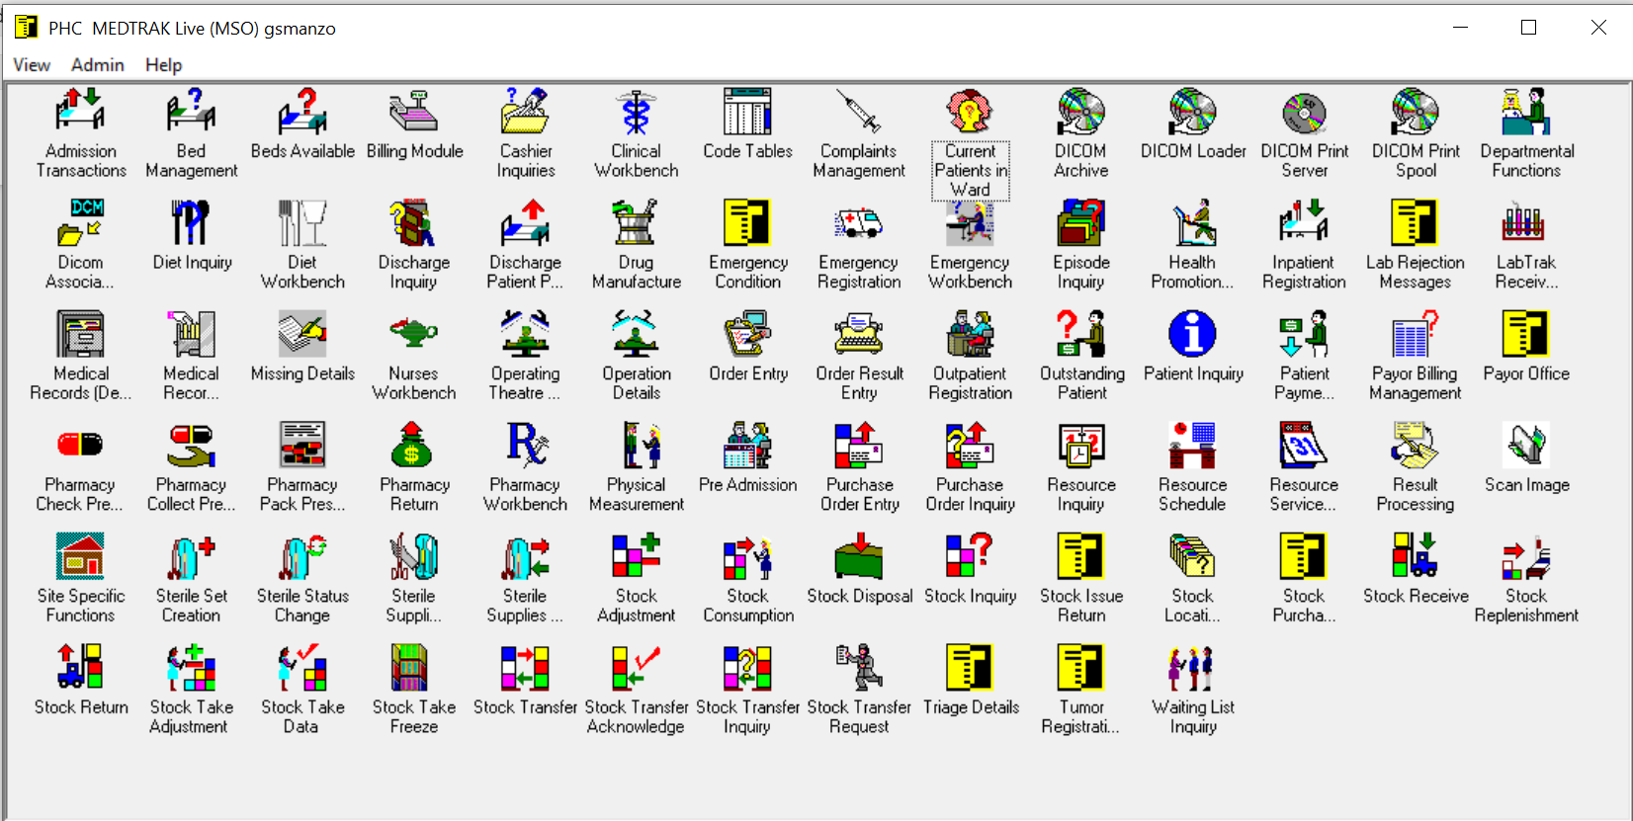
PHC INTEGRATED Hospital Information System and EMR

Slide 16

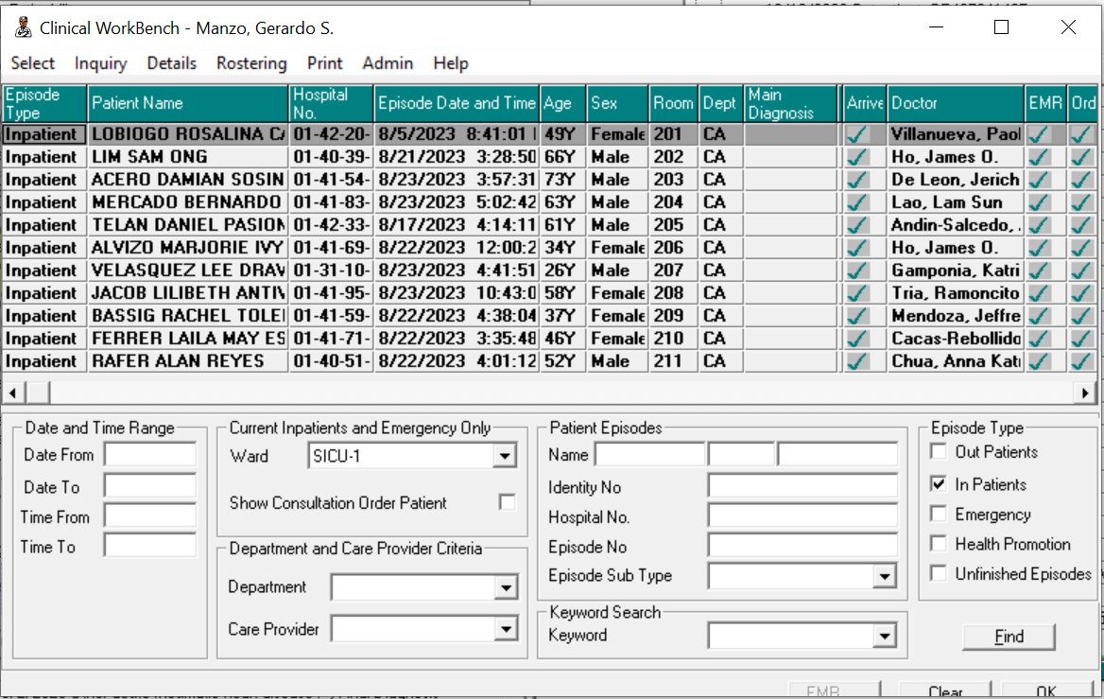
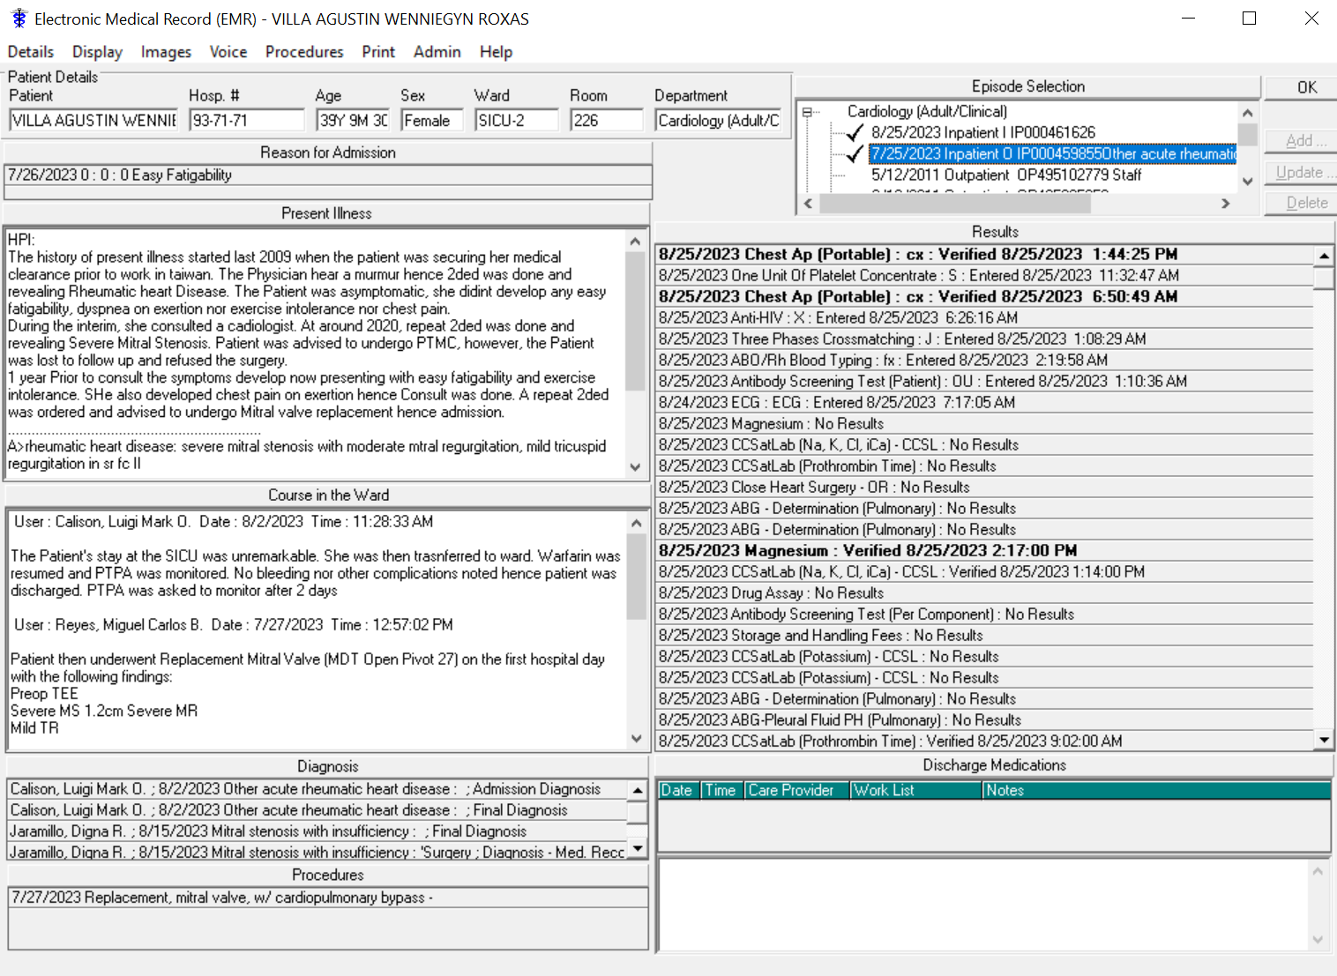
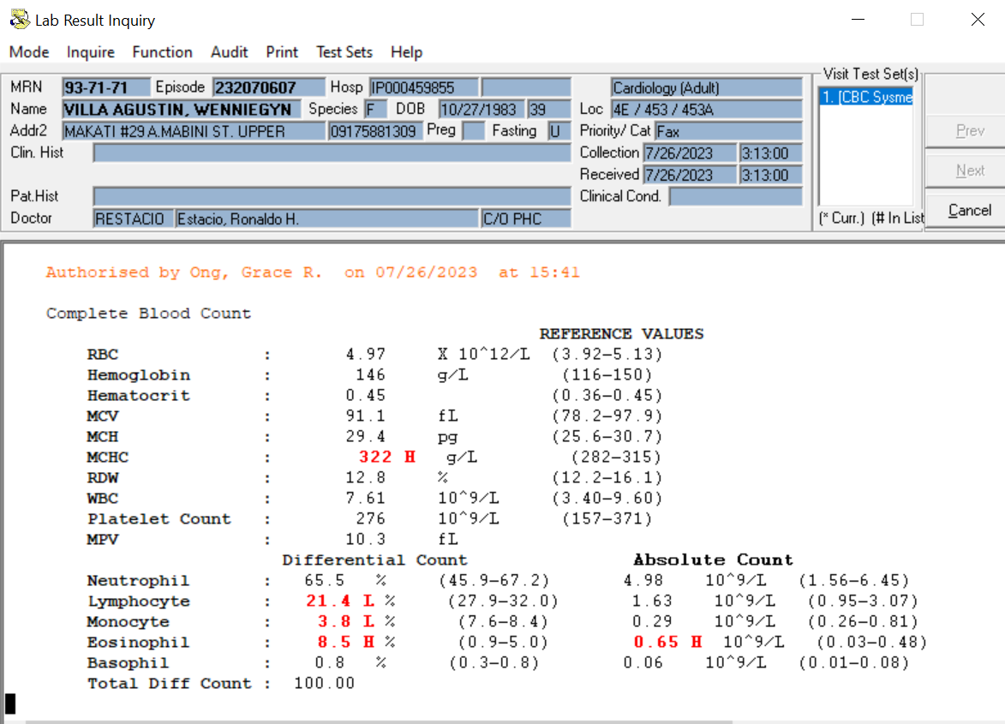
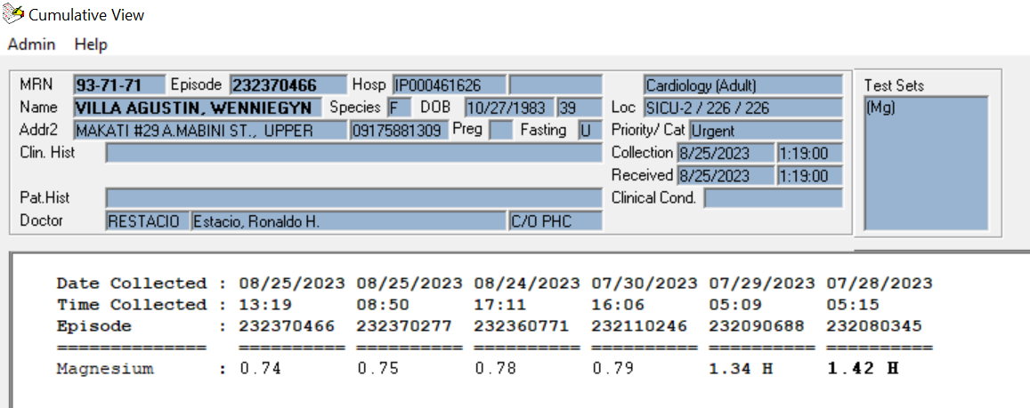
PHC Electronic Medical Record
EMR documents from Healthcare Providers maybe transmitted by
HL7 FHIR
to UHC-mandated PhilHealth National Health Data Repository

Slide 17




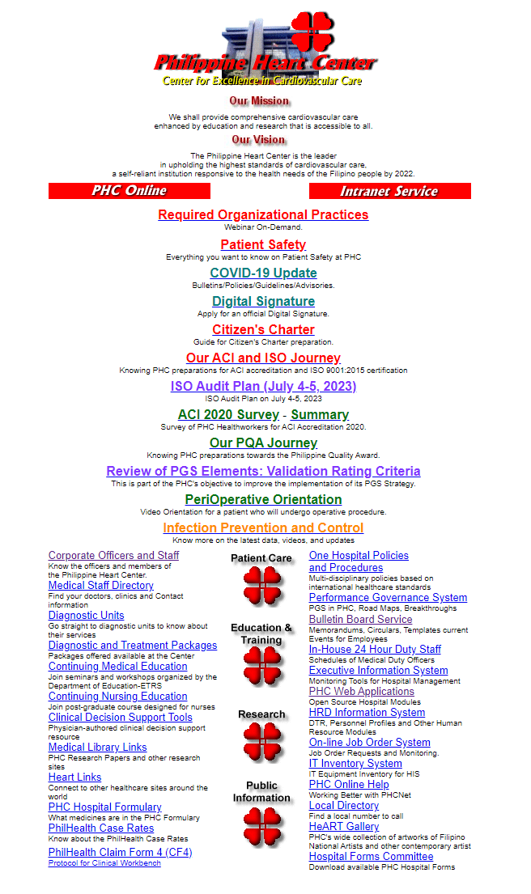
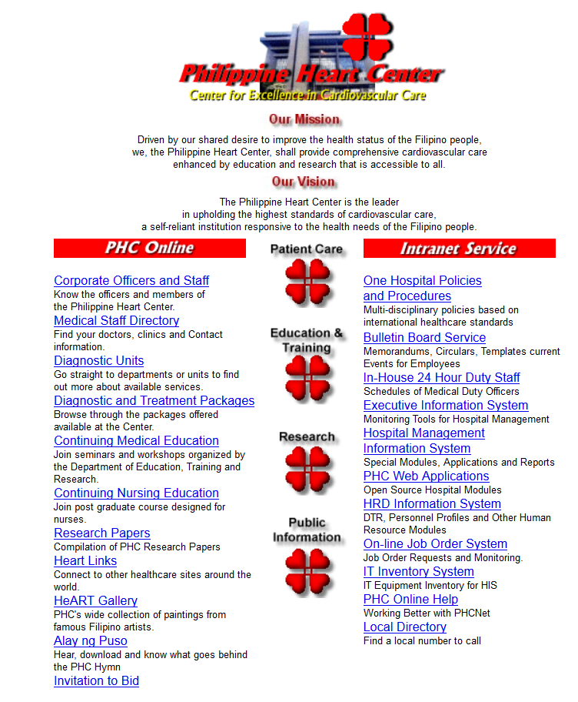






2014
2023
GSManzo I HL7 Summit I 26 August 2023

Slide 18
Early Lessons : LIMITED Government Resources LOW Priority eHealth
Extensive Use of FOSS Free and Open Source Software
As of 2023 Significant Increase in DOH Budget, STILL LOW Priority for eHealth
All “non-HIS” hospital modules are created by in-house programmers using:
Operating System for Linux Servers : Ubuntu 12.04 (14.04), Fedora 8 (20)
Database : PostgreSQL 8.0 (9.3), MySQL 5.0 (5.5)
GUI: PHP 5.2.4 (5.5.4)
Office utilities are open source:
Office Utilities: Open Office 4.0, 3.4
    Substantial savings
    Compliant with IPR and Data Privacy
Default Browser: Firefox 29.01

Slide 19
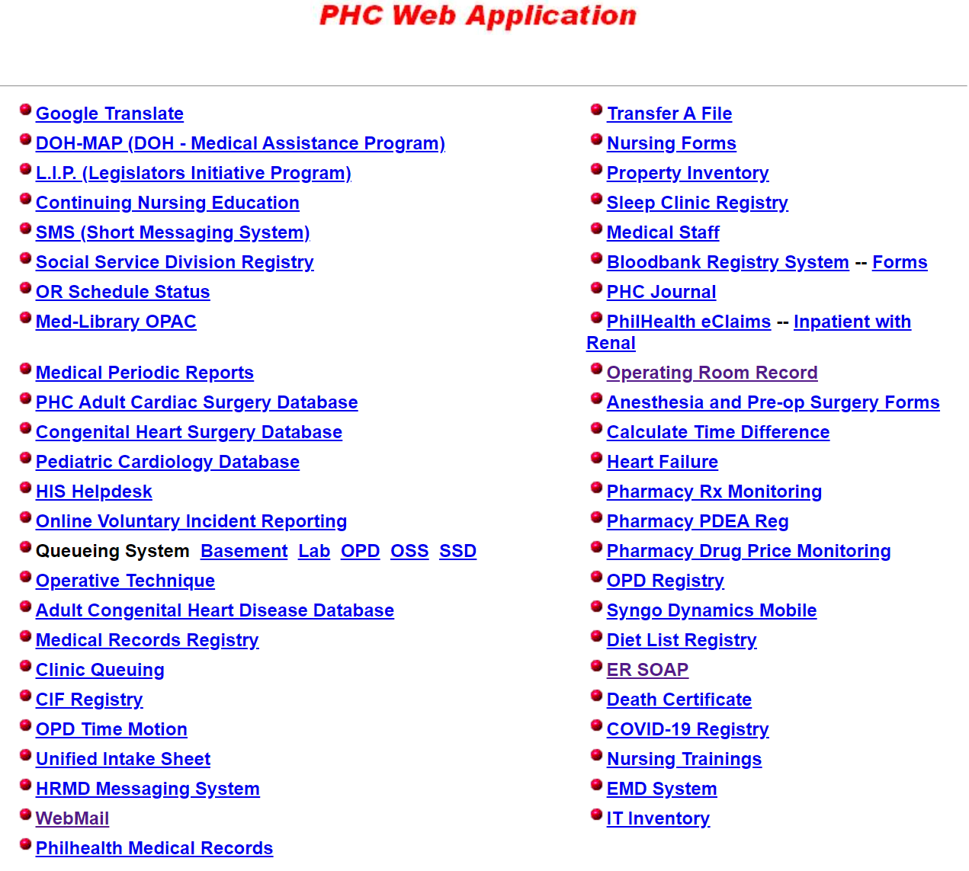
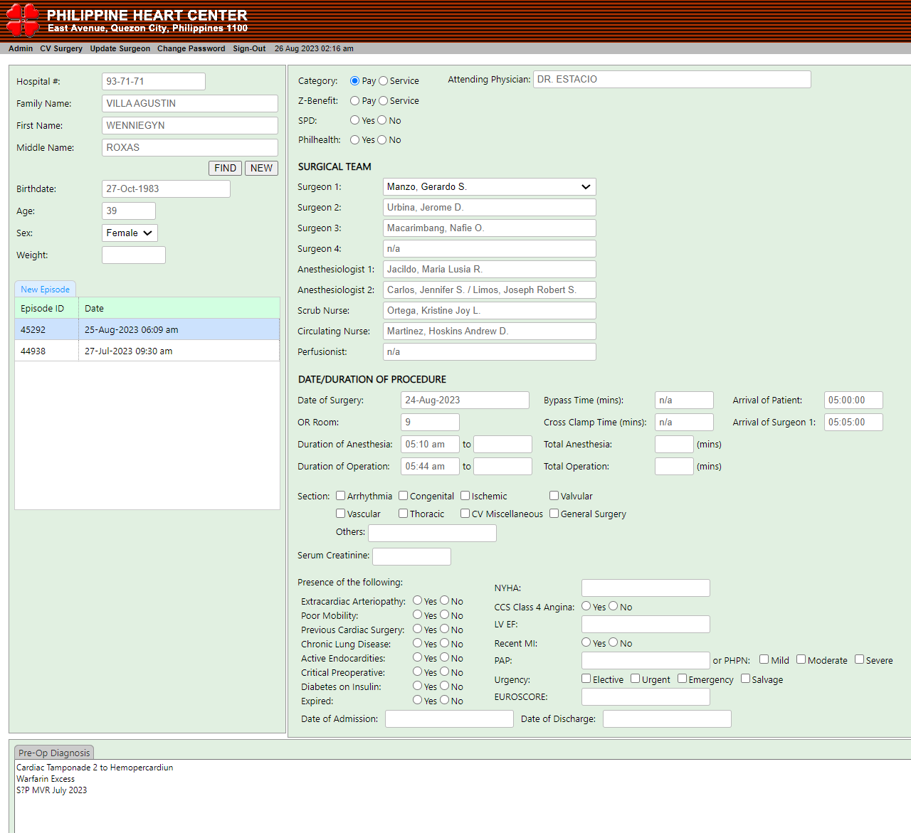
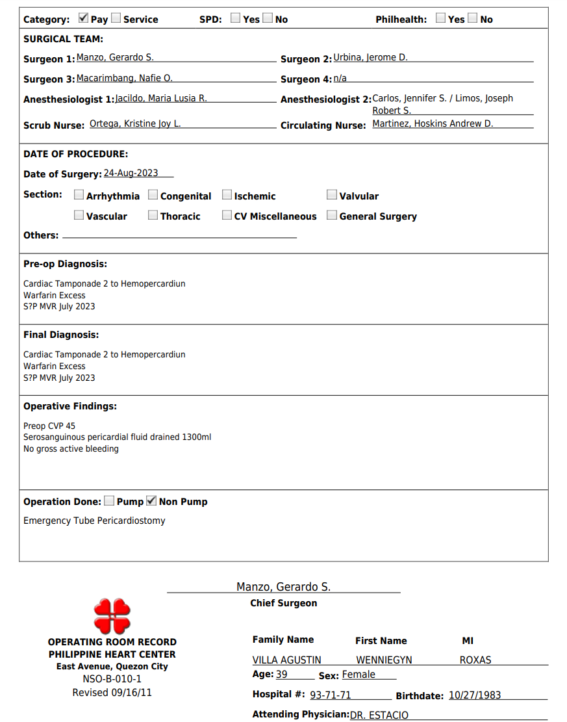
PHC INTRANET: FOSS Applications
PHC INTRANET: FOSS Applications

Slide 20
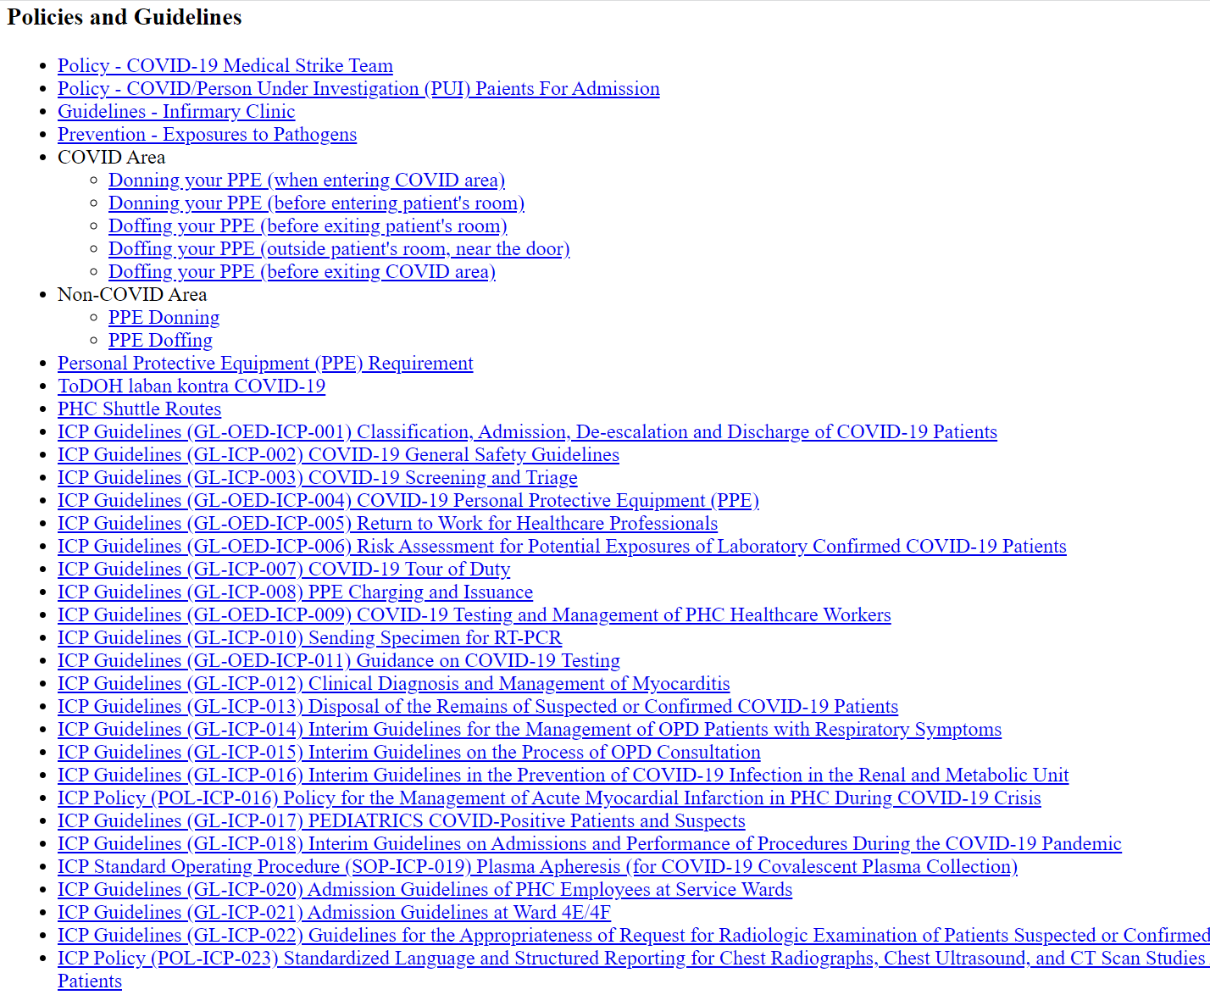
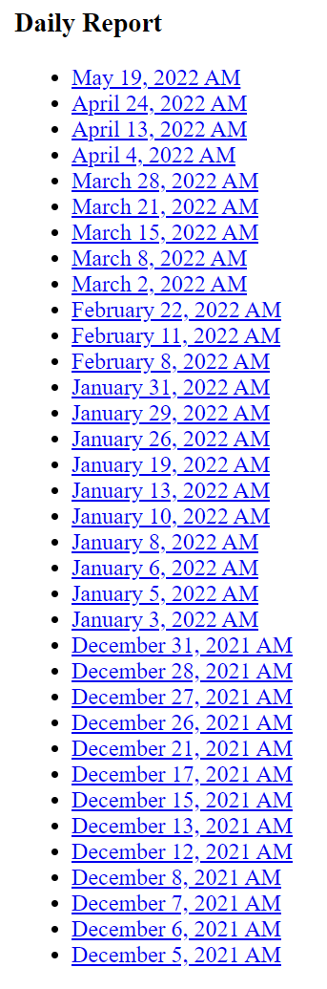
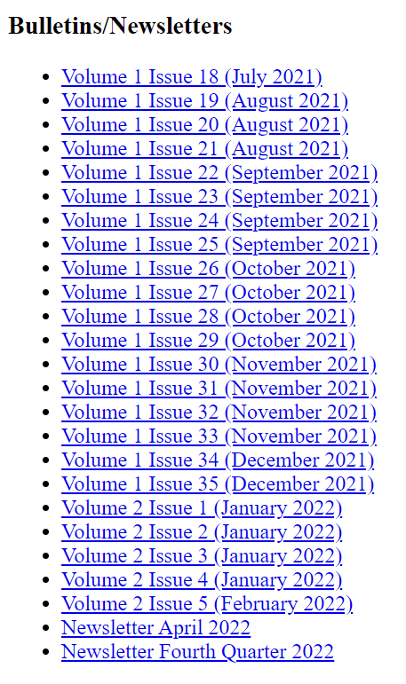
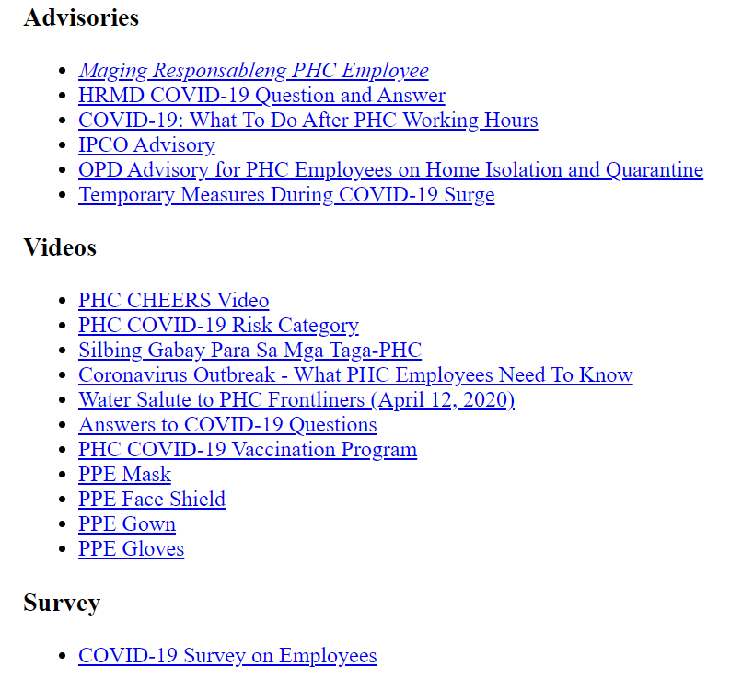
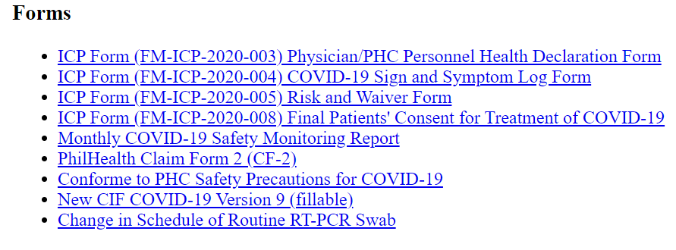
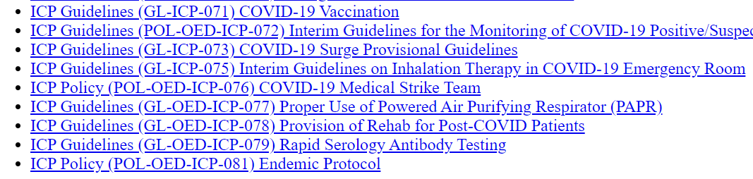
PHC INTRANET: COVID Archive Hyperlinked to Originals

Slide 21
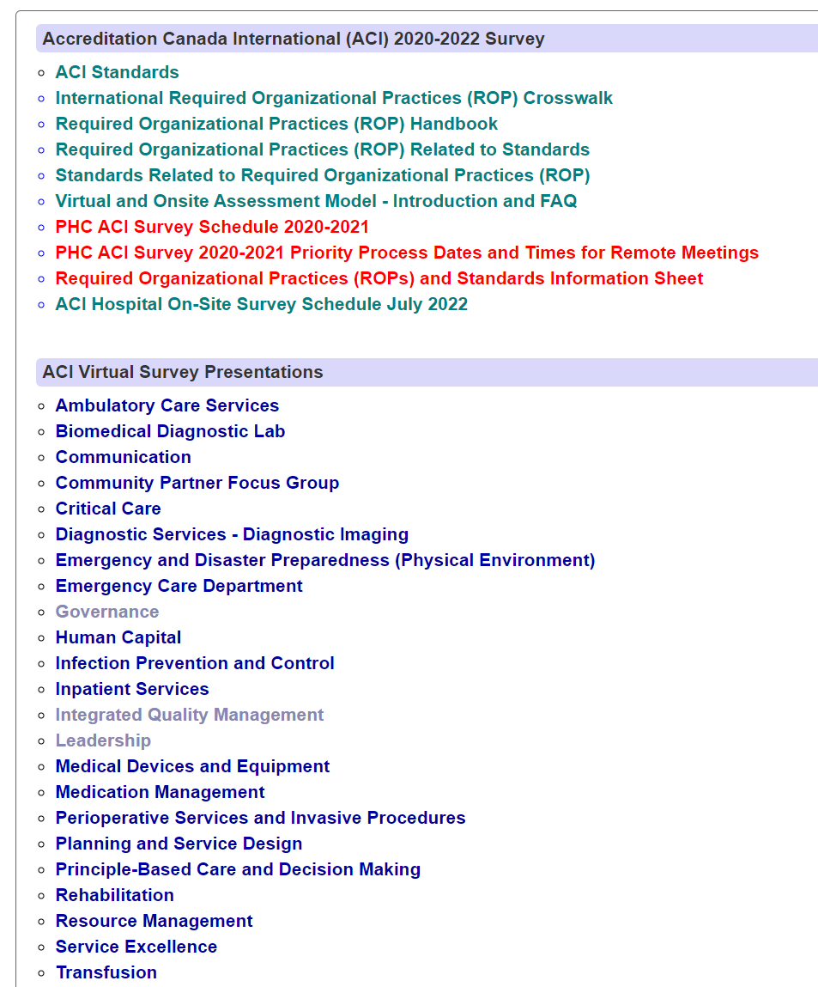
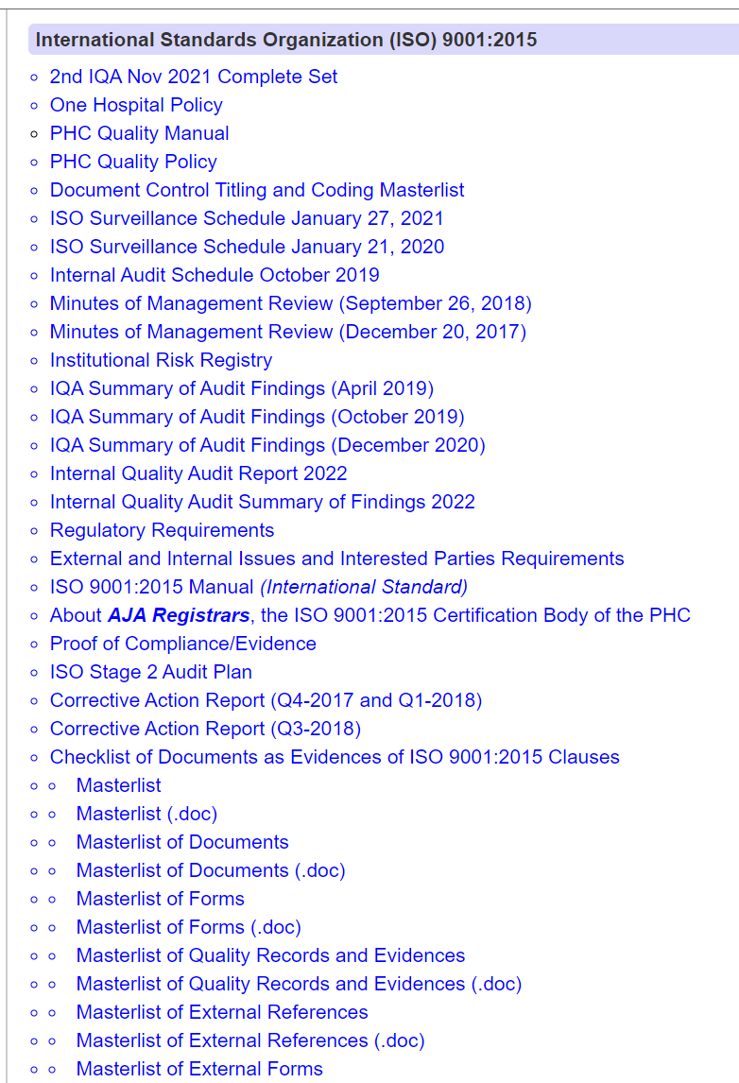
PHC INTRANET: ACI ISO AUDIT SURVEY Help Desk for Standards

Slide 22
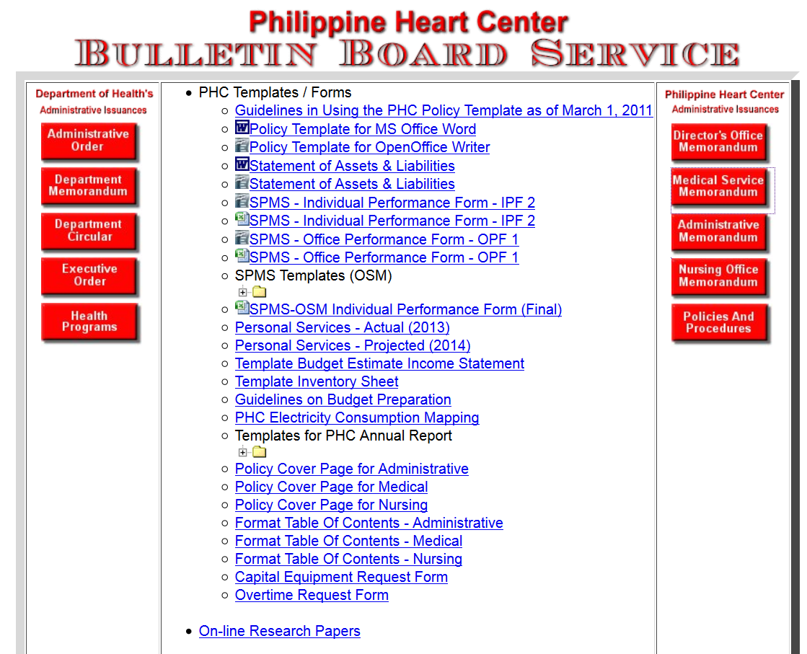
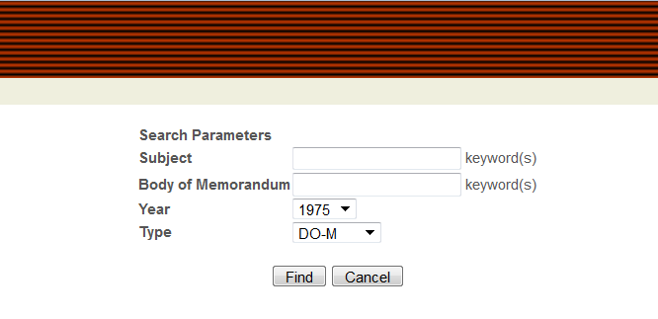
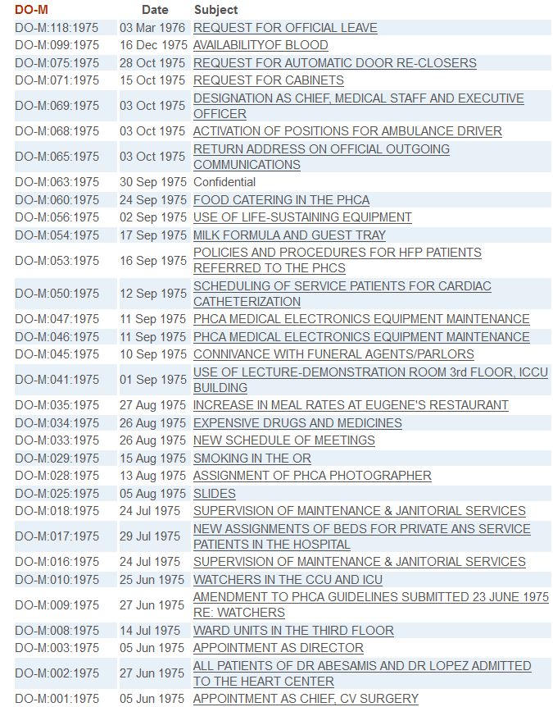
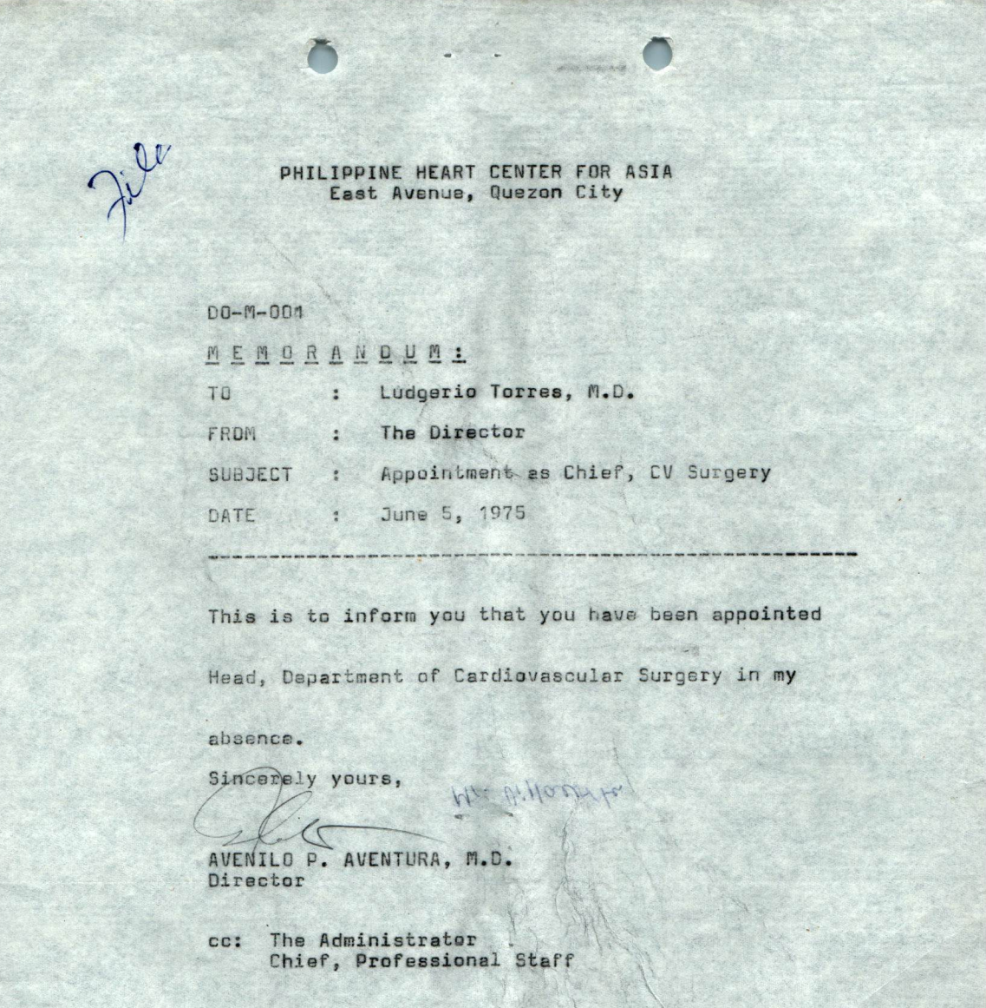
For General Reference
ARCHIVE AND CURRENT ISSUANCES
First Memo from Director’s Office
DO-M:001:1975 APPOINTMENT CHIEF CV SURGERY

Slide 23
PHC Lessons on
Meeting Stakeholder Needs
1
Enterprises exist to create value for their stakeholders.
Often forgotten: Patients should be the primary stakeholders and the CENTER of hospital “enterprise” goals
Select Hospital Information Systems and other Health technology that are Patient-Centered / Patient-Focused
Identify clinicians who can champion specific health IT goals.
Create and sustain super core team.
Health IT must be focused on the delivery of more efficient and timely patient care.

Slide 24
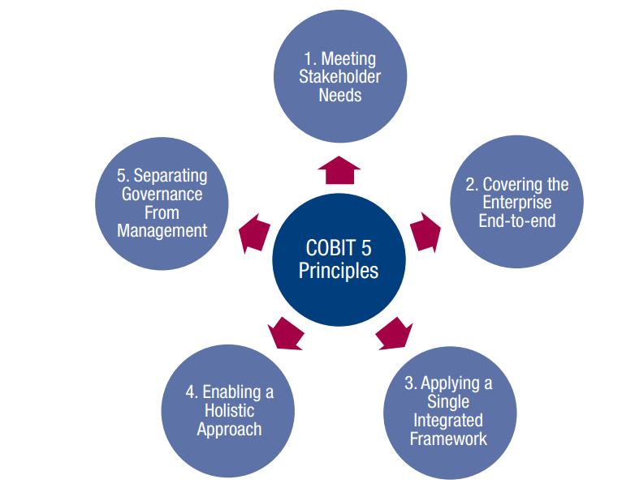
PHC Lessons on
Covering the Enterprise End-to End
2
Hospital IT should not focus only on IT functions.
Should be inclusive of everything and everyone—internal and external—that is relevant to governance and management of enterprise information and related IT.
Learn to prioritize IT needs of end-users.
Be firm with priorities. Remind IT staff to stay focused on project timelines.
Manage change requests.

Slide 25
PHC Lessons on
Applying a Single Integrated Framework
3
There are many IT-related standards and good practices, each providing guidance on a subset of IT activities.
Require standards compliance from IT vendors and from in-house programmers.
No real current standards for Health Information Exchange.

Slide 26
PHC Lessons on
Enabling a Wholistic Approach
4
Enablers are factors that, individually and collectively, influence whether something will work.
Needed for effective and efficient IT governance and management
Develop relevant and Document IT policies that are consistent, fully compliant to existing rules and standards, and responsive to the culture of your hospital.
Disseminate approved policies.
Anticipate resistance to change.

Slide 27
PHC Lessons on
Separating Governance from Management
5
COBIT 5 framework makes a clear distinction between governance and management. These two disciplines encompass different types of activities, require different organisational structures and serve different purposes.
Diligently prepare IT strategic plans and initiatives and be ready to promote and defend their implementation.
Involve Governing / Leadership bodies as early as possible and update them regularly. (Board, C-Level, EXECOM, MANCOM)

Slide 28

Courtesy Dr Alvin Marcelo

Slide 29
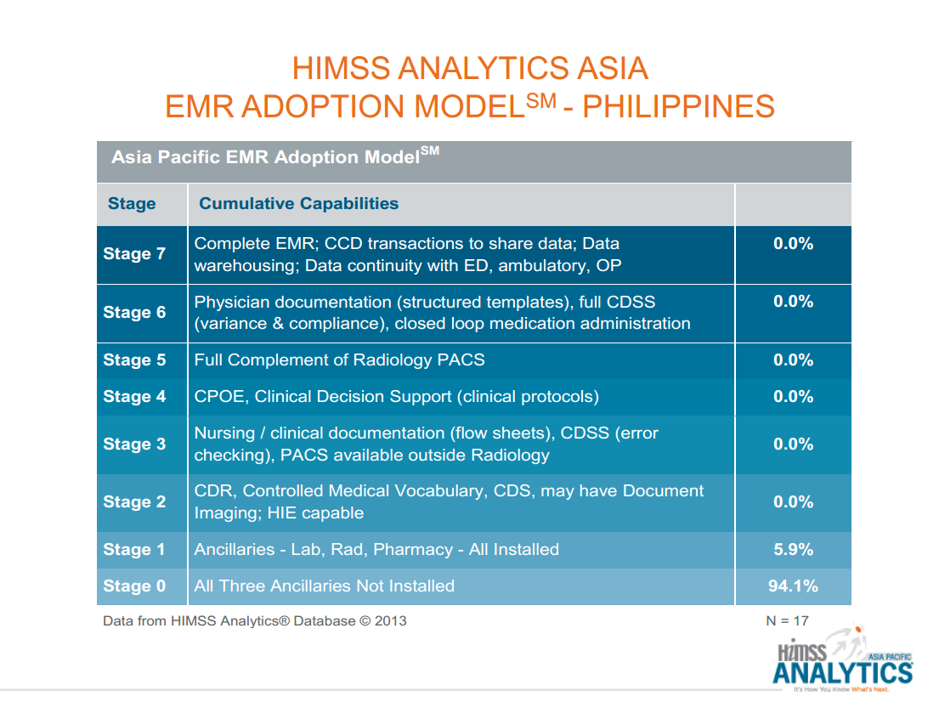
Courtesy Dr Alvin Marcelo

Slide 30
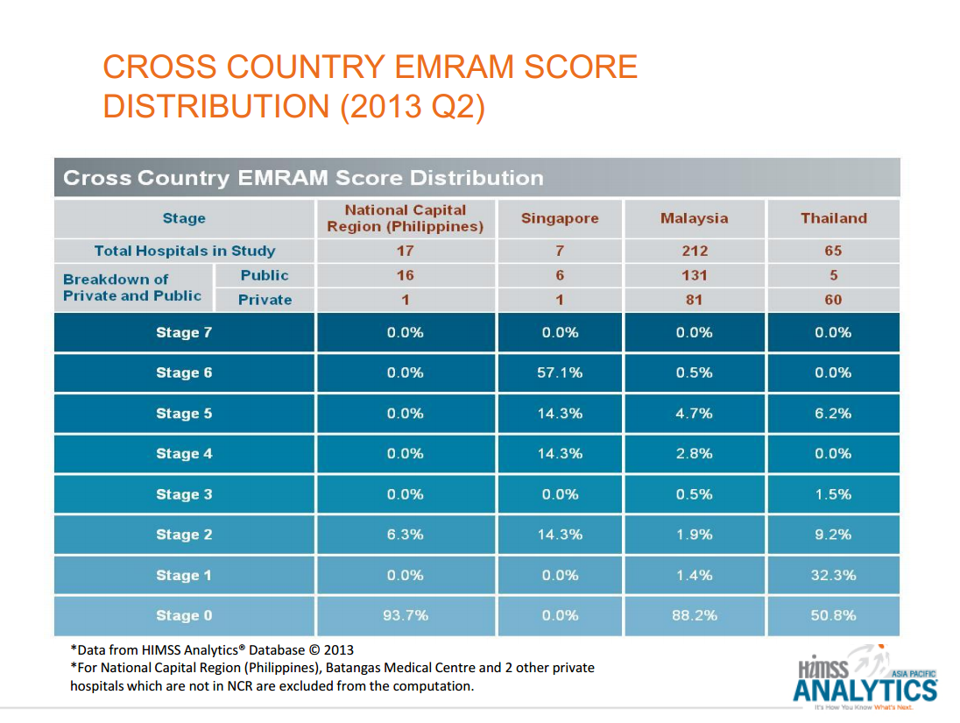
Courtesy Dr Alvin Marcelo

Slide 31
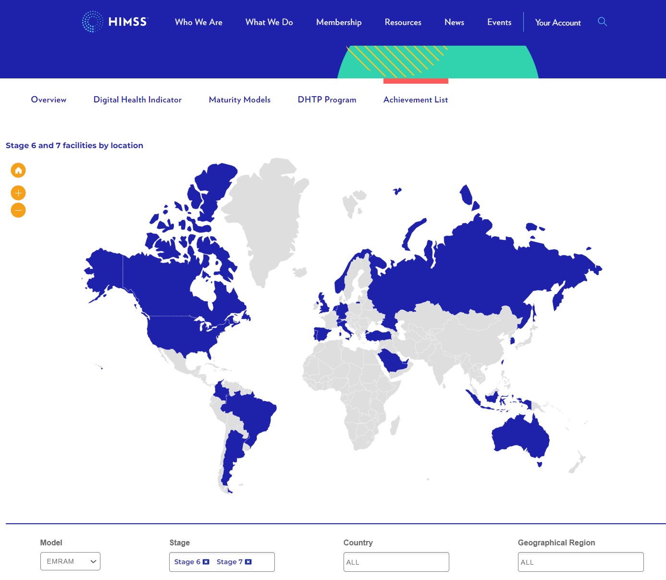
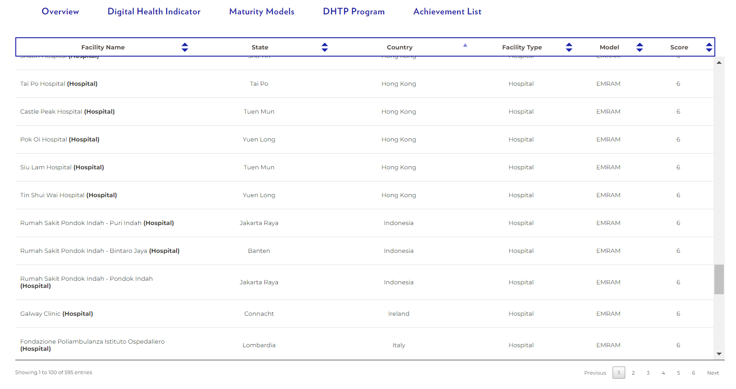
As of August 2023
Hong Kong 41
Indonesia 3
Singapore 2
REST ASEAN including PHL
ZERO Level 6,7
TOTAL WORLD 595 Level 6.7

Slide 32
Challenge for Philippine eHealth
Promote Standards-compliant Health Information Systems at DOH, PhilHealth, Private and Public Healthcare facilities
Create integrated Electronic Health Record accessible for all Filipino patients to improve health service delivery.

Slide 33


Slide 34
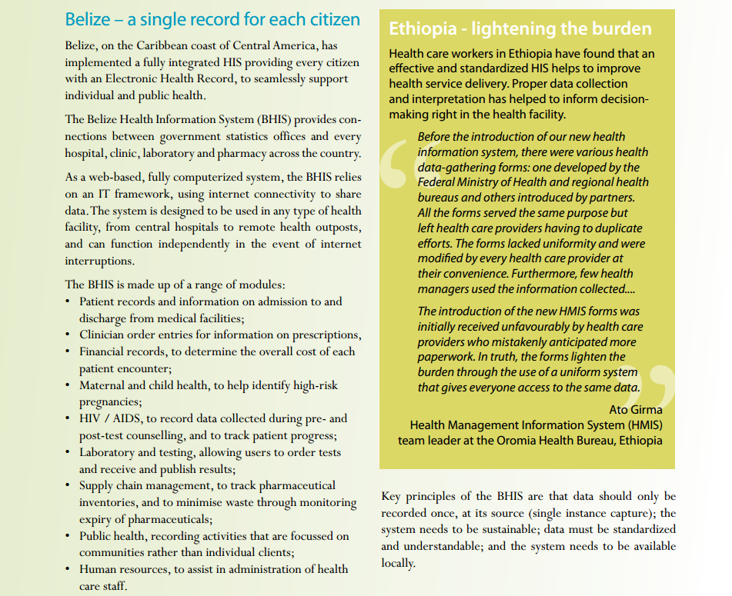
Belize : Single record for each citizen
Ethiopia: Standardized HIS

Slide 35
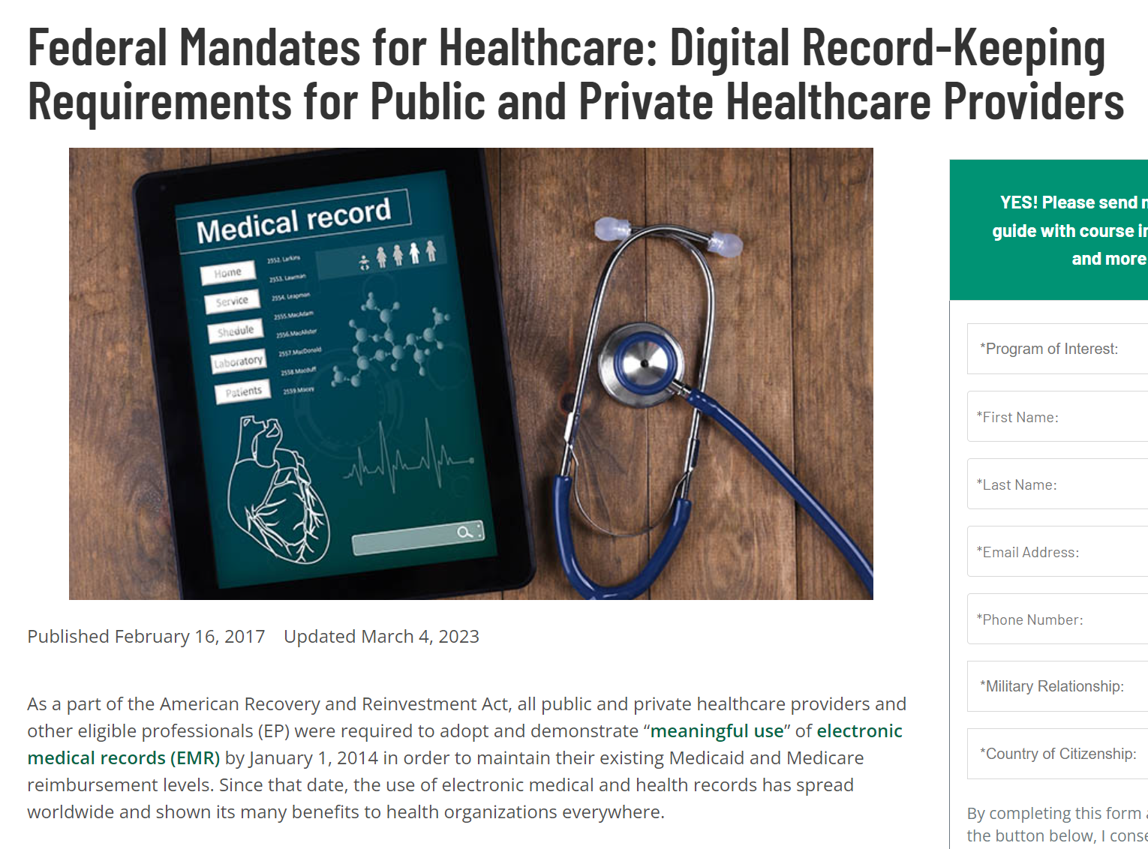

As a part of the American Recovery and Reinvestment Act, all public and private healthcare providers and other eligible professionals (EP) were required to adopt and demonstrate “meaningful use” of electronic medical records (EMR) by January 1, 2014 in order to maintain their existing Medicaid and Medicare reimbursement levels.

Slide 36


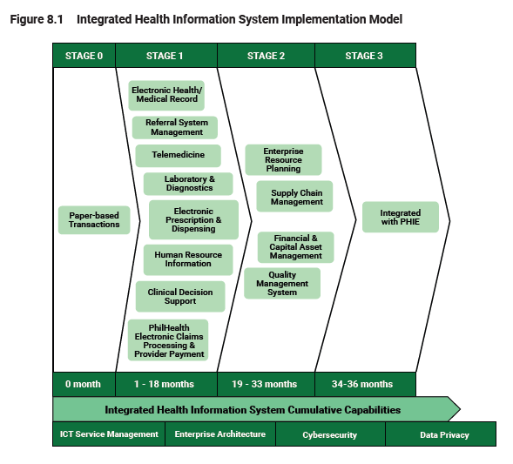
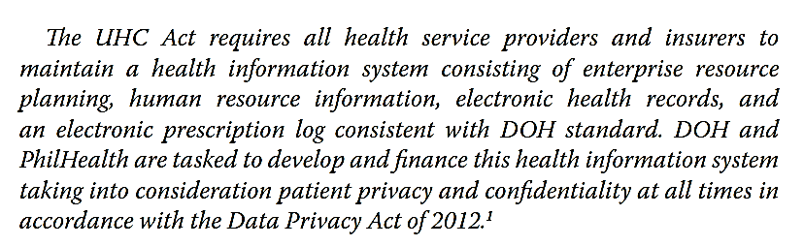
NO government financial framework to support Health Information Systems
  “not Equipment”
  “not Infrastructure”

Slide 37
Worst IT Predictions of All Time
"I think there is a world market for maybe five computers."—Thomas Watson, chairman of IBM, 1943
Computers? Who could possibly want one?
"There is no reason anyone would want a computer in their home." — Ken Olson.
He was the chairman, president, and founder of Digital Equipment Corp. (DEC), which was a maker of massive mainframe computers for business. Back in those days PC's were unheard of, and computers were the size of whole rooms.
GSManzo Health IT Philippines 22 May 2014

Slide 38
World Economic Forum, 2004: "Two years from now, spam will be solved.“ Bill Gates
"Apple [is] a chaotic mess without a strategic vision and certainly no future."—TIME, February 5, 1996
"Everyone's always asking me when Apple will come out with a cell phone. My answer is, 'Probably never.'"—David Pogue, The New York Times, 2006
GSManzo Health IT Philippines 22 May 2014

Slide 39
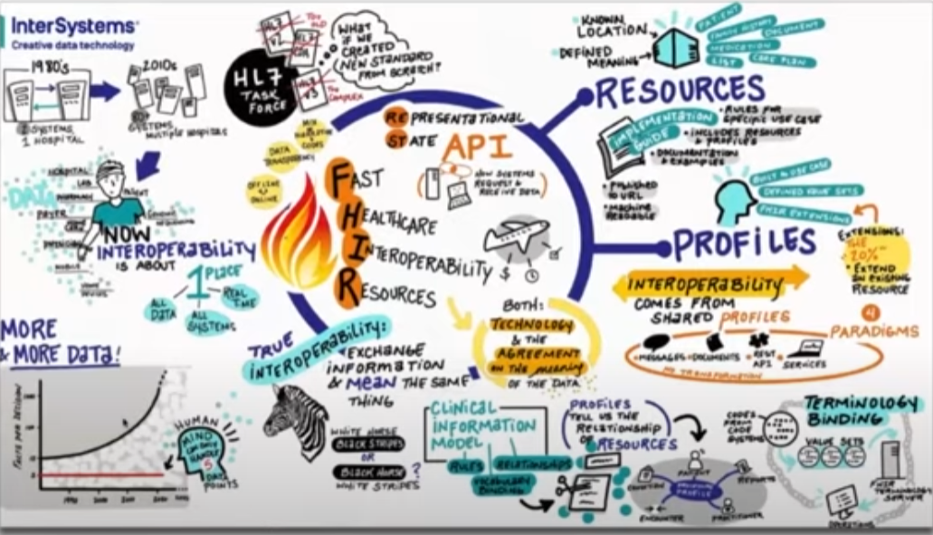


FHIR is the Future of Interoperability and Application Development in Healthcare
https://youtu.be/OIt0GrCPu8k?si=-2fpX8PRIiMH_341

Slide 40
Mabuhay
gsmanzo@phc.gov.ph

Slide 42
