Slide 1

Digital Transformation through Enterprise Architecture.
www.sinagsolutions.com

Slide 2
Development of the Health Sector
Enterprise Architecture
Mr. Francis Uy
Chief Enterprise Architecture, Sinag Solutions, Inc.
Consultant, DOH-Knowledge Management and Information Technology Service

Slide 3
Presentation Outline
Enterprise Architecture (EA)
EA applied to the Covid Response
EA for the Universal Health Care

Slide 4
1. Enterprise Architecture

Slide 5
Defining Enterprise Architecture
EA is the organizing logic for business processes and IT infrastructure reflecting the integration and standardization requirements of the company's operating model
EA is a management framework for decision making executed through a structured planning and design of business process, organization, KPI / information, and technology.
EA As Strategy
Sinag Solutions

Slide 6
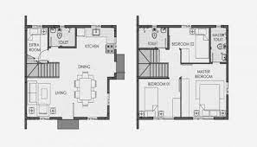



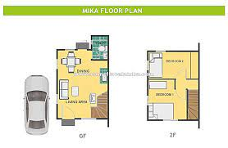

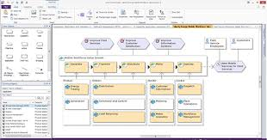


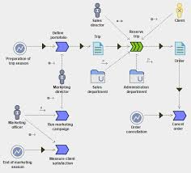
How EA Delivers Value
Govern the Construction and Implementation
Start with the
Architecture
Value Achieved!
Create Blueprint

Slide 7
2. Enterprise Architecture Applied during Covid Response

Slide 8
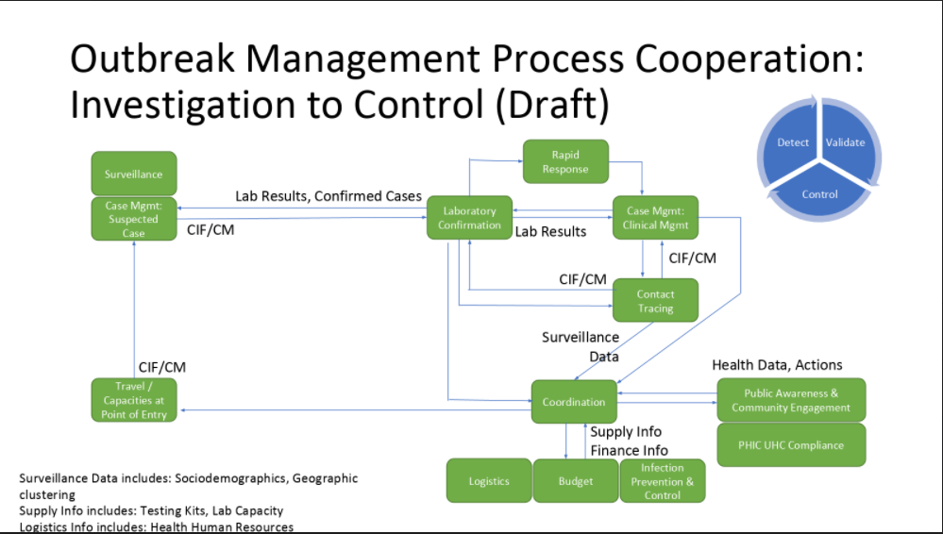

Slide 9
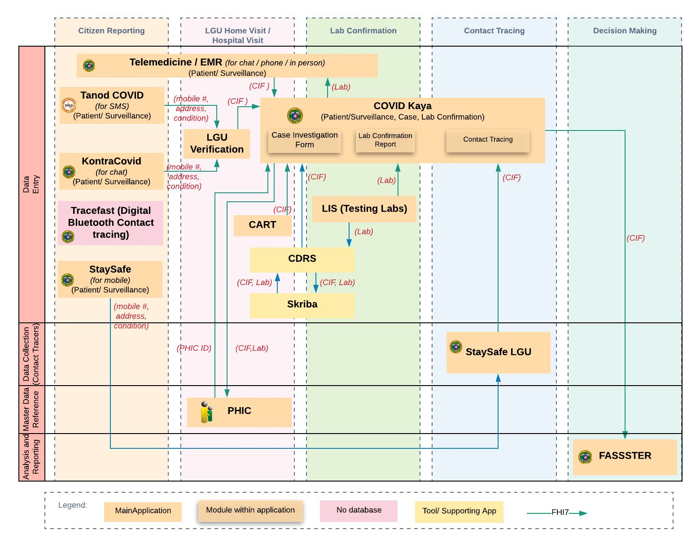
Application Communication Diagram

Slide 10
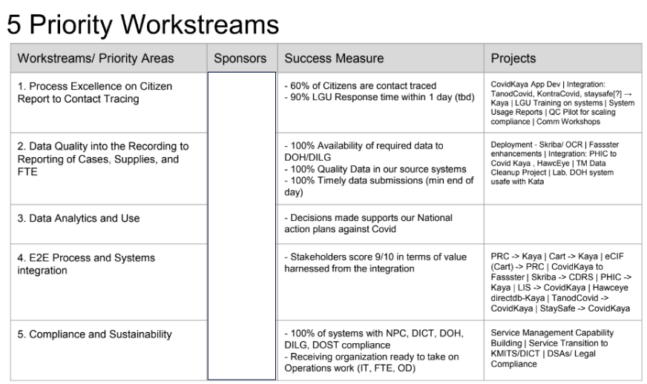

Slide 11
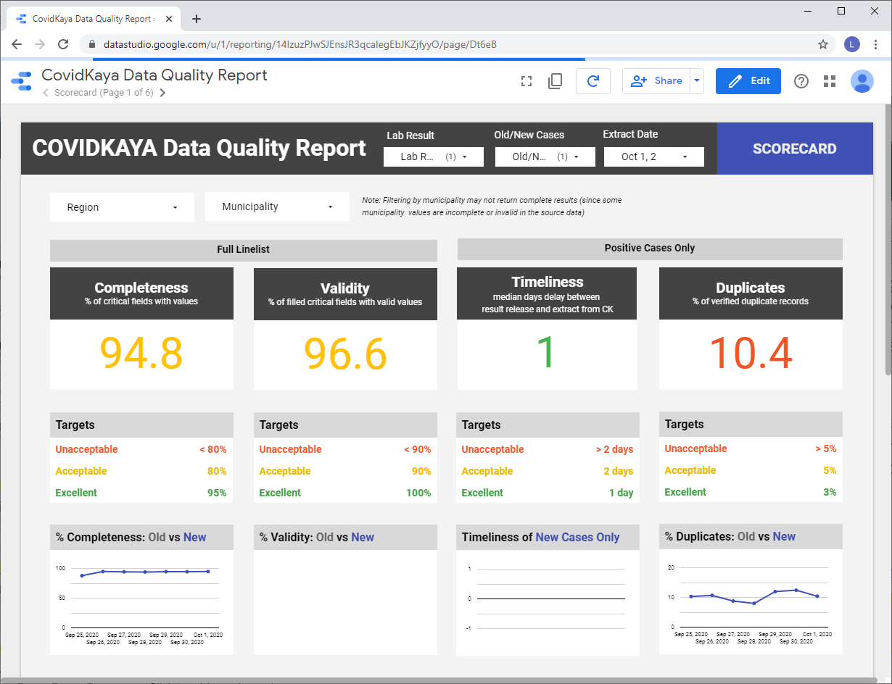
Outcomes on Data Quality
National Health Data Completeness score of 94.8% from 60% in June
Timeliness from Lab Result to Contact Tracing (CESU) in to < 2 days

Slide 12
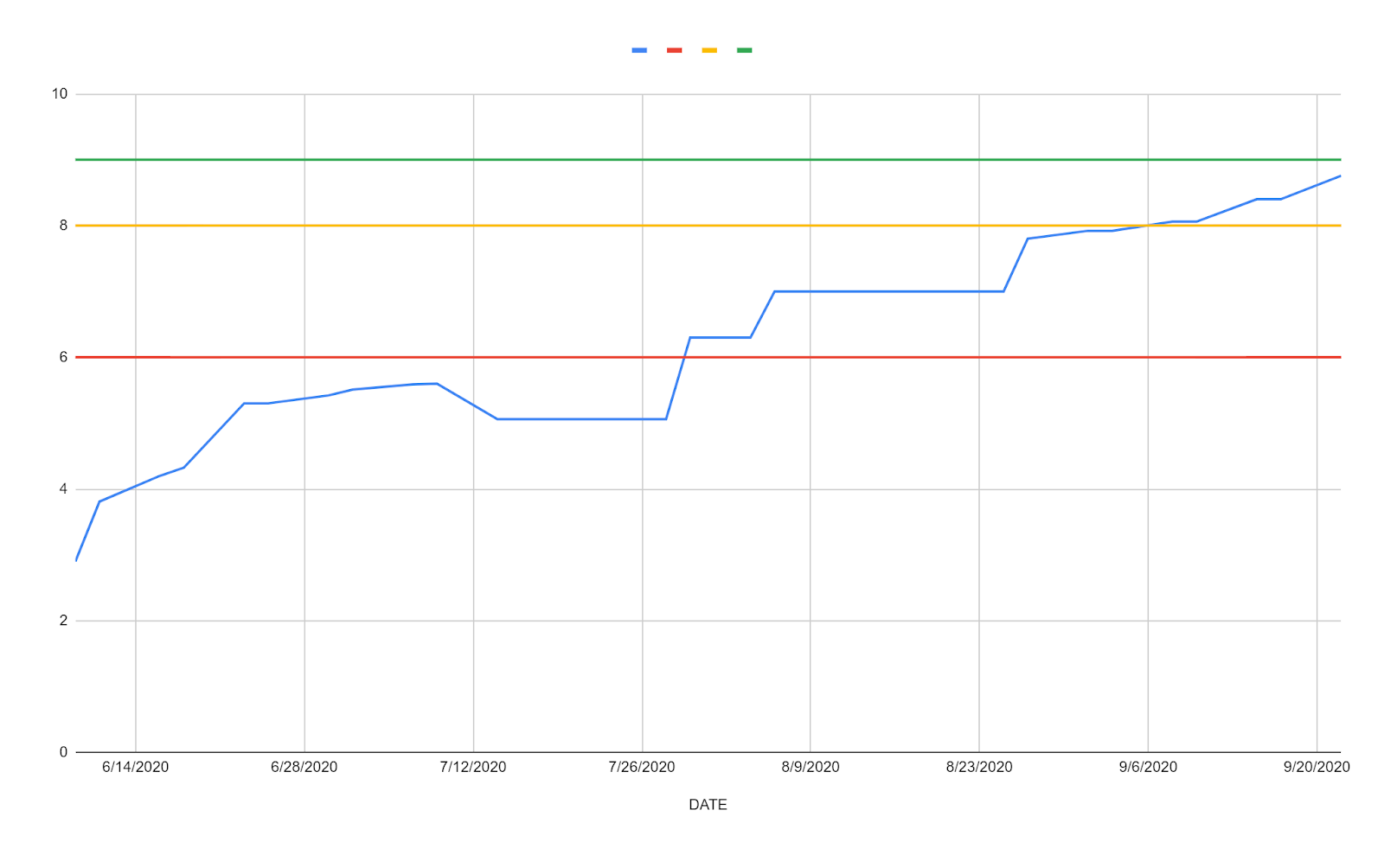
Outcomes on Application Integration
Integration Score (from 2.0 in May to 8.8 in September)

Slide 13
3. EA for Universal Health

Slide 14
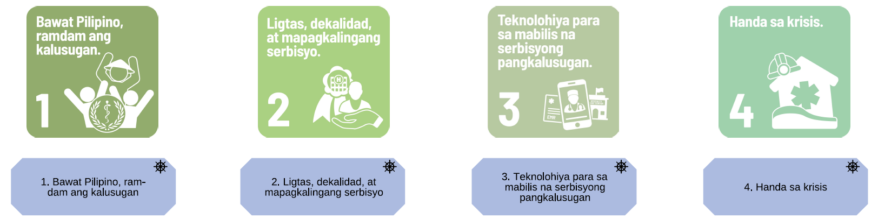
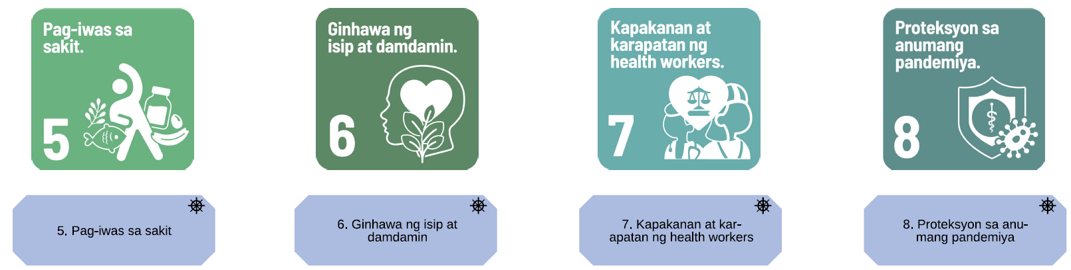
Secretary’s 8 Point Agenda

Slide 15
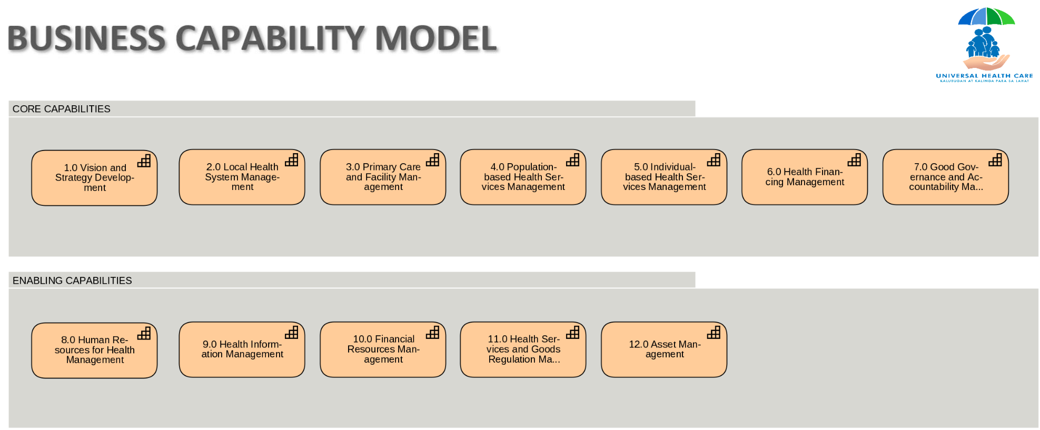
Business Capabilities of the Health Sector

Slide 16
Health Sector Organization/Stakeholder Scope
Academic & Research Institutions
C/PHWS
CHDs
Citizen
Civil Society Orgs
Community-based Health Care Orgs
Development Partners
DOH Bureaus
Donor or Funding Agencies
HCPN
Health Facilities
HealthCare Professionals and Associations
Insurers
Laboratories & Diagnostic Clinics
LGUs (including MHO, RHU, BHS)
Local & International Service Providers
Medical Societies
National Nutrition Council
Other HRH: CHED, TESDA, PRC
NGAs (CSC, DBM, DILG, DSWD, DMW, DOF)
PCUs/ PCPN
Pharmacies or Drug Outlets
PHIC
Supply/ Pharma/ FDA
Architecture to support Strategy
People

Slide 17
Health Sector Data
1. Accidents/Injuries | 20. Impact Assessments
2. Accomplishments | 21. Medical Care Assistance
3. Availed Health Services (Population and Individual) | 22. Membership Contributions to PhilHealth
4. Birth Data | 23. Monitoring and Evaluation
5. Blood Donors and Recipients | 24. Network Contracting
6. Death Data | 25. Nutrition Data
7. Drug Test Results | 26. Organ Donors and Recipients
8. Environmental Health | 27. PhilHealth Membership
9. Financial (Budgets and Expenditures) | 28. Population Data
10. Grants | 29. Program Activities and Projects
11. Health Care Institutions/Providers | 30. Researches
Licensing and Accreditation | 31. Resolutions
12. Health / Medical Records | 32. Resource Centers
13. Health and Medical Travels | 33. Surveys
14. Health Human Resources | 34. Technical Assistance
15. Health Promotions | 35. Vaccination Data
16. Health Regulations | 36. Water and Social Hygiene
17. Health Services | 37. Workplace Safety and Health Standards
18. Health Technology Assessments
19. Health Maintenance Organizations and Private Insurance Data
Architecture to support Strategy
Data
Source: NHDR

Slide 18







Digital Health eCosystem
Healthcare Providers & Facilities Info Systems
(PCUs, Network)
Payer Info Systems (Payers and Health Financing Entities)
Regulatory, Compliance,
and M&E Info Systems
Asset & Supply Chain Info Systems
Integration (Integration & IT)
& Healthcare Data Analysis
Public Health and Policy Info Systems
HR for Health Info Systems
Research and T&A Info Systems
Patient Info Systems
(Patients and Care Recipients)

Slide 19
Healthcare Interoperability Challenges
S.E.C.U.R.E.
Seamless Interoperability: Smooth data exchange among stakeholders.
Enhanced Care: Improved patient treatment and outcomes.
Consistency: Standardized, accurate health information.
Utility: Streamlined workflows and timely data access.
Resilience: Adaptability to changing healthcare needs.
Empowerment: Patient engagement and data control.
Integration (Integration & IT)
& Healthcare Data Analysis
Standard Registries
Terminology Services
Client Registry
Facility Registry
Human Resource Registry
Health Product Catalogue
Others
Consider the Service-Oriented Architecture Pattern to enable all of this

Slide 20
Point to Point example
App
App
App
App
App
App
App
App

Slide 21
SOA example
App
SOA
App
App
App
App
App
App
App

Slide 22
Thank You!

