Slide 1
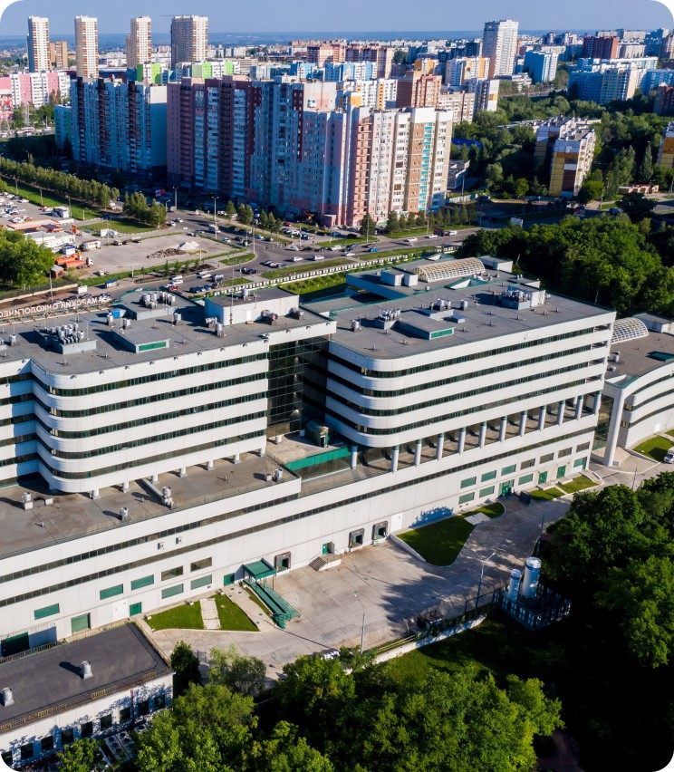
Medical Imaging & VNA
Kumar G R
GE Healthcare
© 2023 GE HealthCare. GE is a trademark of General Electric Company used under trademark license.

Slide 2


The challenge you face
EHR is trying to be the entire patient record, but it has gaps.
A good Enterprise Imaging strategy can help you close this gap to provide longitudinal imaging related patient records to help you drive better outcomes.
Anytime, anywhere access to the images
AI seamlessly embedded into the workflow
Intelligent reporting
Reduced turn around times
Cloud deployments
Lower cost of ownership
Less
reporting time
Increased productivity
Comprehensive patient timeline
Increased work efficiency
JB23468XX
Notes:
In this slide you establish context for your prospect, taking them from where they are (what they have invested in) to where they want to be, and text to see what outcome areas may be of most interest to them (where they next investments may be in). This sets the stage to frame how our solutions will map to the problems they are working to solve.
Points to make:
You have made significant investment in your EHR as the holistic patient record
But it is primarily a structured database and hence has gaps – most imaging related data exists in multiple, disparate and unstructured databases (data silos).
Closing these gaps with a good enterprise imaging IT strategy will help to provide more complete and easier/faster access to imaging related patient data to help drive better patient outcomes as well as improved clinical and operational efficiency.
Then say “such as …” and mention a few of the outcomes on the slide or ones you know ahead of time will resonate with your prospect.
You can then ask “Which of these might be the top 2-3 that your organization is looking to address in the coming year or two?”

Slide 3

Connected Care
Get the full picture
Enterprise Imaging
Radiology
Suite of solutions to support unstructured data management for your Enterprise Imaging workflows
Cardiology
Data Warehouse
(ED, Amb, OP)
Interoperability
Women’s Health
CPOE, CDS, CDR
Oncology
VNA
Closed-loop
medication
EHR
Interoperability
Enterprise Archive
Wound Care
Departmental Systems (LIS, RIS, PHIS)
Pathology
Aggregation of department structured content
Aggregation of department unstructured content
Structured templates, CDSS
Dermatology
Endoscopy
Patient records
Ophthalmology
Unstructured
Structured
JB23468XX
Notes:
CPOE – computerized physician order entry
CDS- clinical decision support
CDR – clinical data repository
In this slide, we explain what we mean by “Enterprise Imaging” and set the context to later correlate products we sell to problems we solve, as well as showing the architecture to show how we map into a customer’s current workflow and infrastructure.
Walk the prospect through from left to right:
Patient data is coming from ma variety of locations, departments and sources and flows into the EHR.
An enterprise archive interoperates with the EHR, as well as the data sources themselves such as scanners, reporting systems, etc to collect and store all your unstructured related content such as DICOM, PDF, white light images, movies, etc.
This makes all this unstructured data easily accessible to be used in all your patient workflows. It supports all your ‘ologies’ including radiology, cardiology, oncology, wound care, etc.
The collaborative HIMSS-SIIM Enterprise Imaging Workgroup defines Enterprise Imaging as “a set of strategies, initiatives and workflows implemented across a healthcare enterprise to consistently and optimally capture, index, manage, store, distribute, view, exchange, and analyze all clinical imaging and multimedia content to enhance the electronic health record.”

Slide 4
VNA - Structured for multi-level adoption
Infrastructure and Information Sharing
Multi-institution
Patient Information Management
Enterprise
Multi-specialty
Archive
Multi-PID, patient consent, gateway
to image exchange
Enterprise
DICOM Archive
Connecting
to ‘ologies,
enterprise
registry
Departmental Archive
Multi-PACS, cardiology
DICOM Archive
Level 1 (DICOM)
Independence of PACS application
Level 2 (DICOM)
Imaging consolidation across enterprise
Level 3 (+XDS)
Enterprise-wide clinical data consolidation
Level 4 (+XDS)
Cross-enterprise patient repository & sharing

Slide 5
VNA
JB23468XX

Slide 6
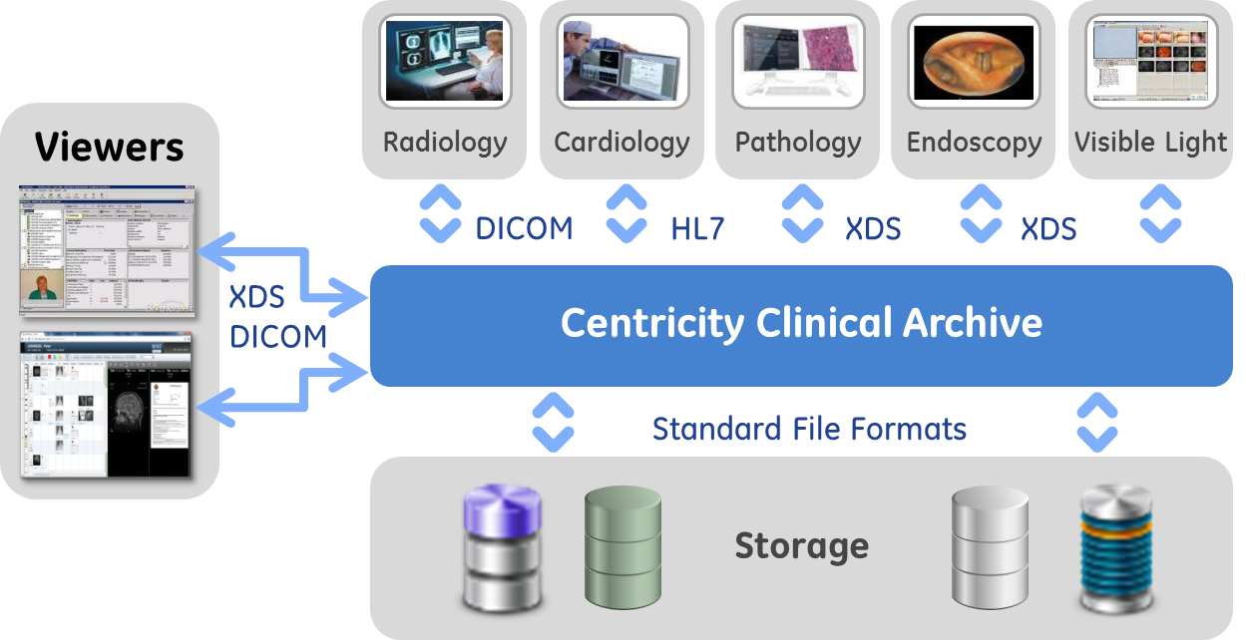
Edison Datalogue: Vendor Neutral Archive (VNA)
Consolidate images from multiple systems for rapid retrieval and display of patients’ full imaging history
Standards-based & vendor agnostic
Multi-site, multi-ology: Store clinical content from DICOM & non-DICOM systems
Image-enable your EMR: Location agnostic multi-ology information access
Capture & enter visible light images directly from mobile devices
Deliver proven scalability for large enterprises
Stream directly to Centricity Universal Viewer ZFP
VNA

Slide 7





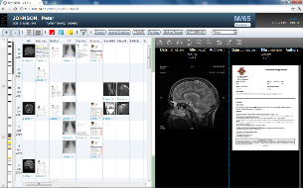
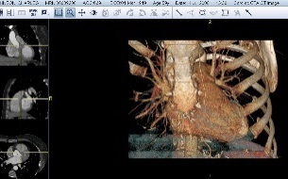


DICOM & Non-DICOM Content Archive
Deploy solutions at point of care
Manage centrally
Serve attending and referring base from EMR
DICOM and Non-DICOM sources
VNA
Radiology
RIS
Single sign-on (SSO) URL integration with the EMR
Virtual Archive A
PACS
Virtual Archive B
Virtual Archive C
Cardiology
Virtual Archive D
XDS viewer displays all content
CVIS
Card PACS
Virtual Archive “n”
Wound Care
XDS Repository
… including full DICOM quality
.word docs
.pdf docs
XDS Registry

Slide 8
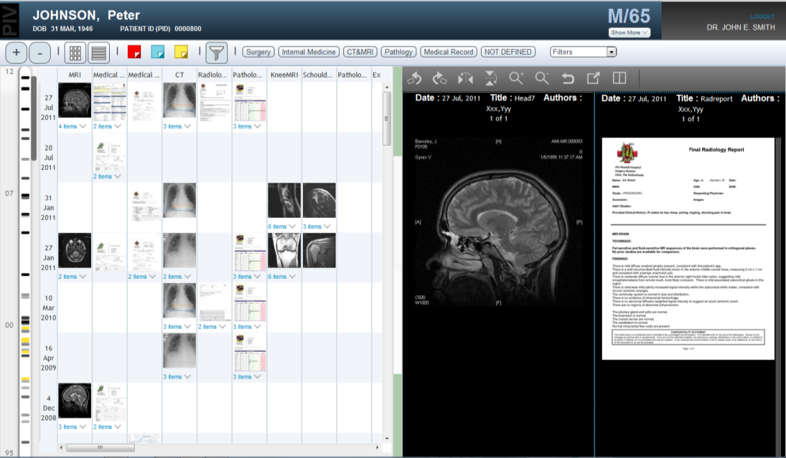
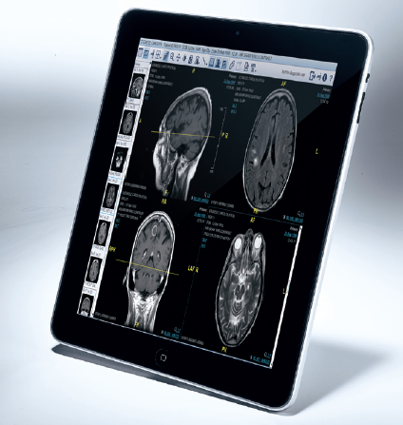
One Viewer: Zero Footprint Viewer (ZFP)
Clinicians can view images and documents on the patient timeline and report on a device of their choice, within or outside the hospital with little burden for IT.
Broad 3D toolset including 3D MIP/MPR, Volume Rendering
Can display both DICOM® and non-DICOM (XDS) ¹
Versatile: Windows, Mac, iPad, Android platforms^{2,3}
No software to download, no admin rights required
In- and outbound integration (e.g. EMR, Ortho templating, MUSE)
Deploy directly on Enterprise Archive or on Centricity PACS
1 DICOM is the registered trademark of the National Electrical Manufacturers Association for its standards publications relating to digital communications of medical information
2 Where an internet connection is available
3 Centricity Universal Viewer ZFP client has been validated and cleared for diagnostic use by the US FDA on Microsoft® Windows® and Apple® Mac® products. ZFP has also received CE Mark for diagnostic use. As regulatory clearance requirements differ by country and region, GE Healthcare must obtain clearance in countries where local specific regulatory approvals are required. Your sales representative can provide information on the status of availability in your area. ZFP can also be used on the Apple® iPad,® Samsung Galaxy Note,® 10.1 and Galaxy Tab® 4 in a review only mode and is not meant for primary diagnosis on these devices. Please refer to the product datasheet for a list of operating systems and browsers supported on these devices.

Slide 9
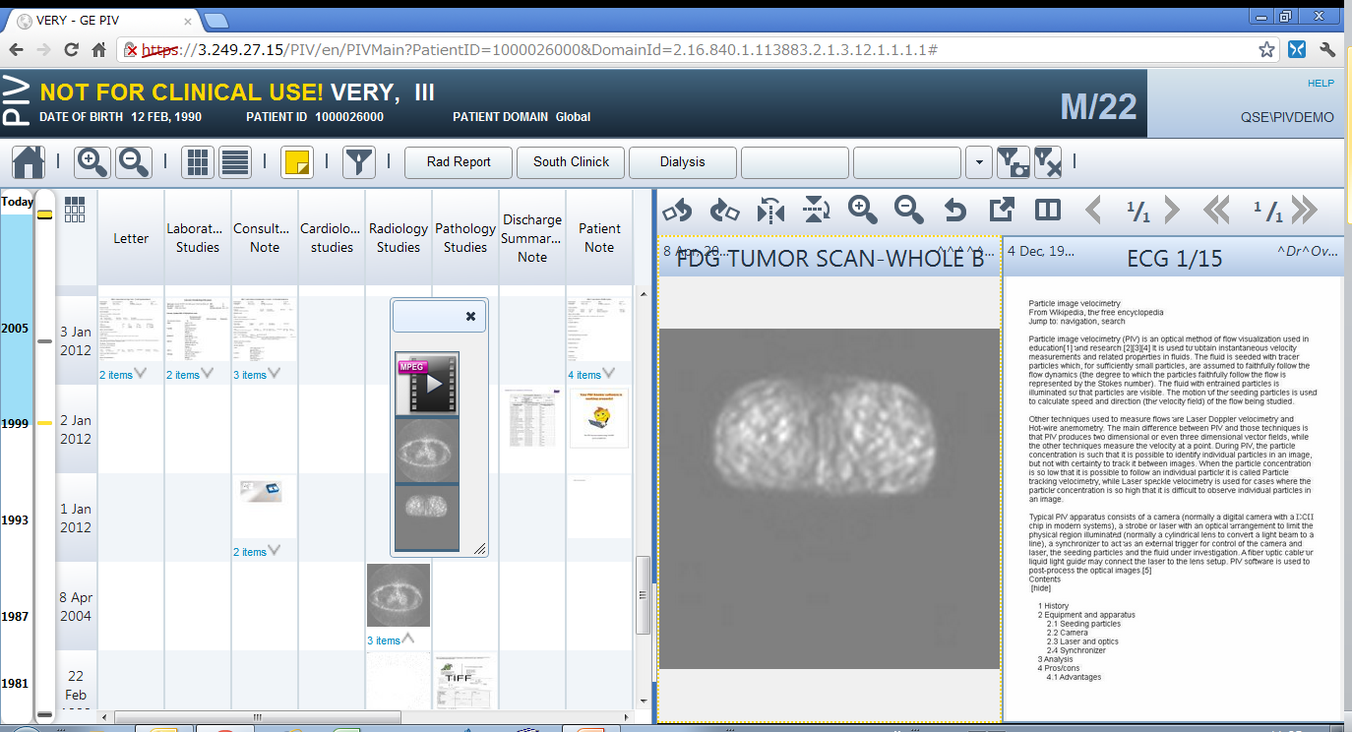
One Viewer : ZFP - Highly Intuitive User Interface
Patient Header Area
Filter Buttons
Zoom in / Zoom out
Filter Mode Controller
External Application Launcher
View Selector
Flag Button
Document View Controller
Home Button
Page Navigator
Scope Indicator
Series Navigator
Time Line Bar
Document Selection Regions
Splitter
Document View Region
Multi Document Panel

Slide 10










Committed to Interoperability
Integration
Collaboration
Experience
Centricity Clinical Archive
PIX/PDQ
XDS
XDS-I
ATNA
BPPC
XCA
IOCM
3rd Party EMR
3rd Party RIS
3rd Party PACS
& Archives
3rd Party Viewers
Integrated with GE clients’ EMRs.
Active members, chairs and co-chairs in key industry & government standards bodies
Proven connectivity through open standards
and established APIs
Notes:
Interoperability is central to our strategy and portfolio. We focus on three key ingredients in driving interoperable solutions:
Integration: We are committed to drive integration with the leading EHRs. Our interoperability center of excellence engages expert resources who identify and develop standards, guide product development, enable deployment and support, and also test and certify every step of the way to ensure that our solutions work with your solutions.
Collaboration: We collaborate and play an active role in the leading standards bodies. GE Healthcare engineers provide thought leadership throughout the standards development lifecycle—writing and developing standards in organizations like HL7 and DICOM, creating interoperability use cases in bodies like IHE and Continua Health Alliance. We also use our position as a leader in vendor and industry associations to guide and promote these standards worldwide, influencing national and regional adoption of standards to support implementation and use throughout the healthcare industry.
Experience: We have proven interoperability expertise daily. We recognize that in serving the unique needs of clinicians, it is best to offer the combination of an EMR solution that interoperates with a robust department solution. For example, our Centricity Perioperative solutions works with more than 600 interfaces for 300+ customers, with 35 different IT systems and a DDI interface. Our solutions integrate with all leading EMR systems, including Epic®, Cerner® and Allscripts®.

Slide 11
VNA - Data Ingestion

Slide 12
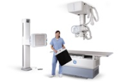
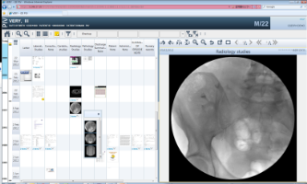
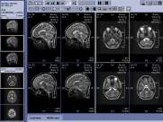
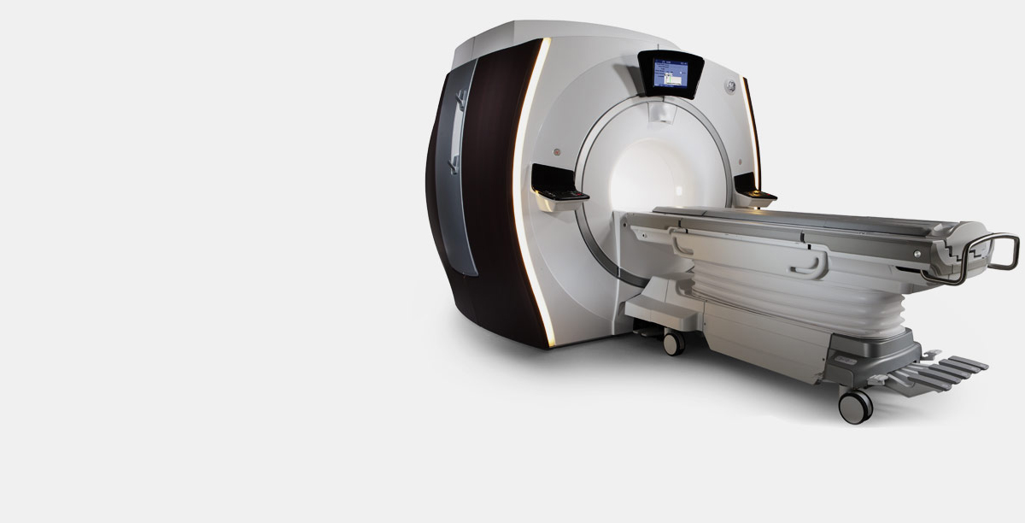
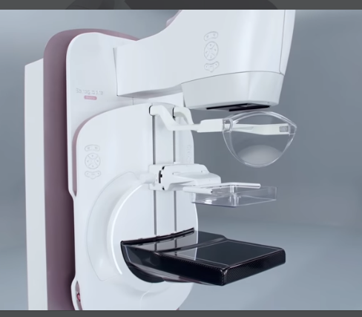


Use Case – Ingesting DICOM Images – Radiology & Cardiology
1. Multiple sites/facilities create patient images
Site 1
Site 2
Site 3
Site 4…………
Site n
3. Query registry and view content
XDS Consumer
DICOM viewer
DICOM Sources
XDS Registry
EMPI
DICOM & XDS/XDS-i Repository
Stores and registers DICOM images

Slide 13
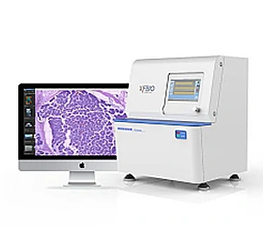
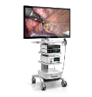
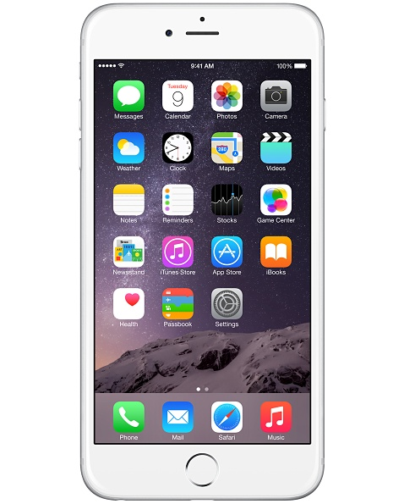
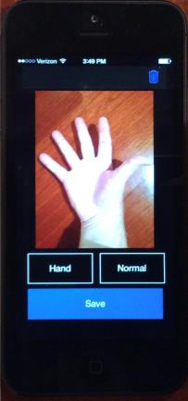








Use Case – Ingesting non-DICOM Images / Documents
Share images and other clinical documents with care providers
1. Multiple sites/facilities create patient images & documents
3. Query registry and view content
Site 1
Site 2
Site 3
Site 4…………
Site n
XDS Consumer
DICOM viewer
Non-DICOM Sources
Media Manager
(non-DICOM ingestion App)
XDS Registry
EMPI
DICOM & XDS/XDS-i Repository
Stores and registers images and documents

Slide 14
Non – DICOM Image / File Ingestion – Patient Search Screen

Slide 15
Non – DICOM Image / File Ingestion – Selecting Patient

Slide 16
Non – DICOM Image / File Ingestion – Choose Image

Slide 17
Non – DICOM Image / File Ingestion
Select Facility, Care group, Confidentiality

Slide 18
Non – DICOM Image / File Ingestion –
Confirm Image / File Submission

Slide 19
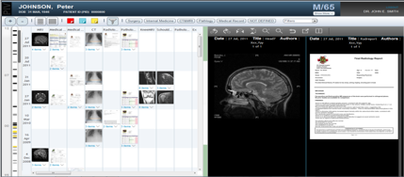
Use Case – RIS/CVIS/LIS etc., publish report thru HL7
1. Multiple sites/facilities create patient images & documents
3. Query registry and view content
Site 1
Site 2
Site 3
Site 4…………
Site n
XDS Consumer
DICOM viewer
RIS/CVIS/LIS
HL7 ORU
Clinical Gateway (HL7)
XDS Registry
EMPI
CDA
DICOM & XDS/XDS-i Repository
Report is registered into XDS Repository & Registry

Slide 20

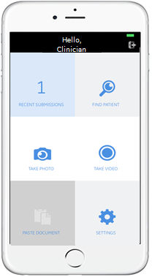
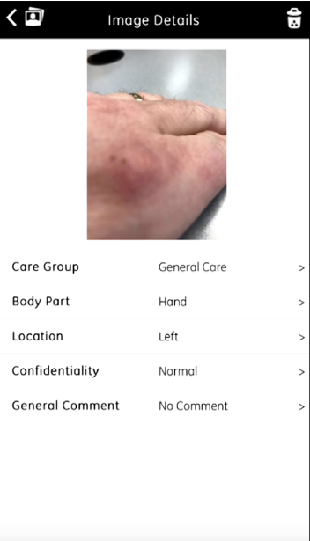
Mobile Ingestion Tools
Key capabilities
“Click and push” images with mobile devices
Automated patient identification
Pictures uploaded to VNA as an XDS document
EMR notifications
Access images via Zero Footprint (ZFP) viewer
Key benefits
Designed with security top of mind
Enhance staff efficiency
Reduce documentation time compared to manual workflows
Enhance enterprise wide access to pictures
Standardize documentation
Example Wound Care Work Flow:
Evaluate
Scan Patient ID
Capture Image
Document
Physician Access

Slide 21

Intelligent Connected Digital Enterprise
Data Management
Data Consumption
Aggregate data & pipeline for Adv. Visualization
AI orchestration embedded in workflow
Bulk anonymization plus AI training & learning
Outcomes
Secure data access from any site on any device
Enterprise-wide AI-assisted reading, global worklist
Access for patient, referring physician, care teams
Increase speed and accuracy of diagnosis
More efficient workflow eliminates steps, rework, costs
Predictive analytics improves throughput, outcomes
Any device, any location
Outsourced Radiology
Build and train AI models
Clinical Viewer
External Data
AI Workbench
Enterprise Data Hub
Patients
Patients
Clinicians
Patients
Data Lake
¸
Imaging Insights
MDT
Consume algorithms
DoseWatch
AI Orchestration
Invasive Cardiology Insights
Adv. Visualization & CVIT
GPs & Referring
Rad PACS
Imaging Systems
Imaging Systems
Monitoring & Lab Data
WFM
Data pipeline
Radiology Operations Module
Card PACS
Radiology & Cardiology
Vendor Neutral Archive
(DICOM + non-DICOM data)
BI Platform
Clinical collaboration
Case Exchange
Connect systems
Optimize productivity & care quality
Vendor agnostic analytics to understand which departmental processes to target for improvement
Connect people
Develop care collaboration networks
Edison
Developer
Marketplace
Clinical Data Integration Platform (CDIP)
Developer Services
Developer Services
Edison
Developer Services
Developer Services
Notes:
Print out this Script (This is for the builds in this slide)
Most providers we target will have some discreet solutions, often loosely coupled — across their landscape — a PACS for radiology and maybe a CVIT solution.
As hospitals continue to merge and acquire, or form regional networks, they inevitably run into the challenge of disparate systems needing to communicate.
This is where we’ve introduced the Edison Datalogue to connect the disparate PACS systems together and thus allow users seamless access to images, regardless of location.
But, there’s more to connect than the systems. Our Datalogue includes modules to connect the care teams. We want to connect people. Which people? We have a specific module to connect Multidisciplinary Teams; We connect Clinicians with our Clinician Viewer providing access from any device, from anywhere.
In addition to these groups within the hospital networks, hospitals need to exchange case files in qualified circumstances; they need to collaborate with GPs and Referring Physicians. Increasingly, patients are more engaged and Datalogue offers a Patient Access functionality. And with more hospitals opting to outsource radiology reading, we’re adding more advanced workflows to accommodate a de-constructed configuration.
Ultimately, what all these groups want is access to data. To ingest, aggregate and integrate data comprehensively across so many domains, GE developed the Edison platform. While Edison AI gets a lot of well-deserved attention, the platform is first and foremost about data aggregation and integration. Afterall, you can’t build useful AI without high quality, high volume data.
So first, we’re using the Edison CDIP to enable Datalogue to ingest and aggregate an increasing number of data formats — we’ll bring in Lab data and monitoring data (that’s what MURAL does). We’ll bring in data from sources outside the hospital — genomic data, population health, consumer wearables, clinical trials, and so on.
But what’s important is we’ll make that data available to applications — that we and others build — that can generate insights to enable better decisions and better care.
Already today, we’re doing this with the Edison Business Intelligence platform for Analytics. The BI platform is used by applications like DoseWatch, Imaging Insights, Radiology Operations Module, Interventional Cardiology Insights ,and so on.
Now to AI. We’re just launched Open PACS AI and the Edison AI Orchestrator, which allows our PACS to consume AI algorithms — both GE and non-GE — and receive the AI results, while leaving the Radiology workflow —completely unchanged.
Today, to build the GE algorithms, we’ve initially used the Edison DataLake. This is where we’ve developed and trained our AI models. Using the cloud allows us to easily bring in diverse datasets from around the globe, and give access to radiologists anywhere in the world to help annotate the studies to establish ground truth.
In the future, we plan to enable the Edison AI Workbench on Edison Datalogue. This way customers who wish to develop algorithms can build and train AI models directly on data in their Datalogue.
This central data infrastructure that I’ve described — Datalogue, the BI platform, the AI Orchestration, the DataLake — all of this is included in what we label as the customer’s Enterprise Data Hub. It obviously includes systems from many vendors besides GE.
So what you can observe is that the left half of this page addresses Data Management and the capabilities we bring to that.
The right side of the page addresses Data Consumption.
Most important are the Outcomes we drive for our customers.
Let me call your attention to the lower left of the page. A critical element of our Edison strategy is to enable an broad ecosystem of developers to accelerate new solutions into the market for our customers. Edison Developer is workspace for developers to access the rich set of Edison developer services to create their own artifacts.
Notice on the lower right, we will be launching a GE Healthcare Marketplace — a public web page where GE and third-party developers can market their innovations and customers can search and find all digital software from GE and our ecosystem partners.

Slide 22
Thank You

Slide 23
Connected Care
A holistic approach to Enterprise Imaging
Multiple
Imaging workflows
ONE
Unstructured¹ repository for imaging
Multiple
departments
Multiple
facilities
Multiple
care pathways
1 - Images, reports, PDFs, MPG, etc
JB23468XX
Notes:
This is a transition slide where we now set the stage for the value we provide to the prospect with our solutions.
Talk track: To support connected care you need a holistic approach to your enterprise imaging. You need (or we provide) ONE unstructured repository for your imaging related data that supports multiple imaging workflows across multiple facilities, departments and care pathways.

Slide 24

VNA - Features at a Glance
Media Manager (Visible-light image ingestion)
Zero Footprint
Viewing
Image Lifecycle Management
Role Based Access Control
Privacy and Security
DICOM and Non DICOM Archive
Vendor Neutral
Governance
Standards Based Interoperability
Dynamic Tag Morphing
Master Patient Index
IT Management
Governance
Access
IT Management
Use slides in appendix modularly

Slide 25
Key enablers
AI integration
Intelligent workflows
Cloud-enabled¹
New levels of productivity and aid in diagnostic accuracy
Future-proof your investment
Working smarter, not harder
Faster report turnaround times
Make more efficient use of
IT resources
More rapid adoption to new technologies
1 - Not all technologies are available on cloud. Cloud deployment not available in all countries.
JB23468XX
JB16464XX
Notes:
We leverage three key enablers: to deliver more value though our enterprise imaging solutions:
First, native AI integration to support both increased productivity and accuracy, as well as for providing indications to support triage.
These can in turn help to support intelligent workflows, supporting radiologists to work smarter, not necessarily harder, and improving the turnaround times on reports, especially those with abnormal findings. These smart workflows also help to ensure the right radiologist is reading for the right patient at the right time, to fairly distribute work which can help prevent burnout, and to help ensure service level agreements on exam reporting times are met.
Finally, cloud enablement can support these smart workflows over wide geographic areas as well as disparate IT systems. Cloud deployments can support faster and more affordable access to new productivity tools such as new AI applications when they become available. And for radiology IT departments, it can allow more efficient use of human resources, freeing them up for higher value activities within the organization.
Next we’ll look at each of our solutions in a bit more detail.

