Slide 1







UP Manila Standards & Interoperability Lab
HL7 Philippines Summit 2023
Mapping Hepatitis B Data to FHIR using
WHO SMART Guidelines
Jan Michael M. Herber, RN
Terminology Specialist
University of the Philippines Manila
Standards and Interoperability Lab (UPM SILab)
UPM SILab
upm_silab
silab.upm@up.edu.ph
UPM SILab

Slide 2
Disclaimer:
"HL7, FHIR and the FHIR [FLAME DESIGN] are the registered trademarks of Health Level Seven International and their use does not constitute endorsement by HL7."

Slide 3

Overview of the Case Study:
Viral Hepatitis Project
HL7 Philippines Summit 2023 | Mapping Hepatitis B Data to FHIR using WHO SMART Guidelines

Slide 4

Hepatitis Situation
LEADING CAUSE
9.8% OF FILIPINOS WITH CHRONIC HEPATITIS B
Approximately 10,143,000 Filipinos have Chronic Hepatitis B (1)
CIRRHOSIS
HEPATOCELLULAR CARCINOMA
2nd in Cancer Deaths
0.9% OF FILIPINOS WITH CHRONIC HEPATITIS C
Approximately 600,000 Filipinos have Chronic Hepatitis C (2)
(1) The Polaris Observatory Collaborators, Lancet Gastroenterol Hepatol ,2018
(2) The Polaris Observatory HCV Collaborators, Lancet Gastroenterol Hepatol 2017; Gower E, J Hepatol 2014
HL7 Philippines Summit 2023 | Mapping Hepatitis B Data to FHIR using WHO SMART Guidelines

Slide 5
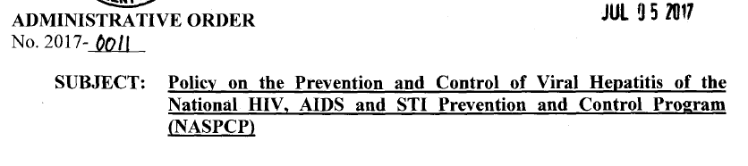
Project Background
Specific Guideline # 2: Robust research and information system
The National HIV, AIDS and STI Prevention and Control Program (NASPCP) shall collaborate with the Epidemiology Bureau (EB) and other relevant stakeholders to develop a national investment case for action on hepatitis with a focus initially on chronic hepatitis B and hepatitis C, informed by the local epidemiological context; and to harmonize databases and surveillance systems related to viral hepatitis.
The strategic plan shall also include research agenda to address the identified needs and to guide future policy-making for the prevention and control of viral hepatitis.
HL7 Philippines Summit 2023 | Mapping Hepatitis B Data to FHIR using WHO SMART Guidelines

Slide 6
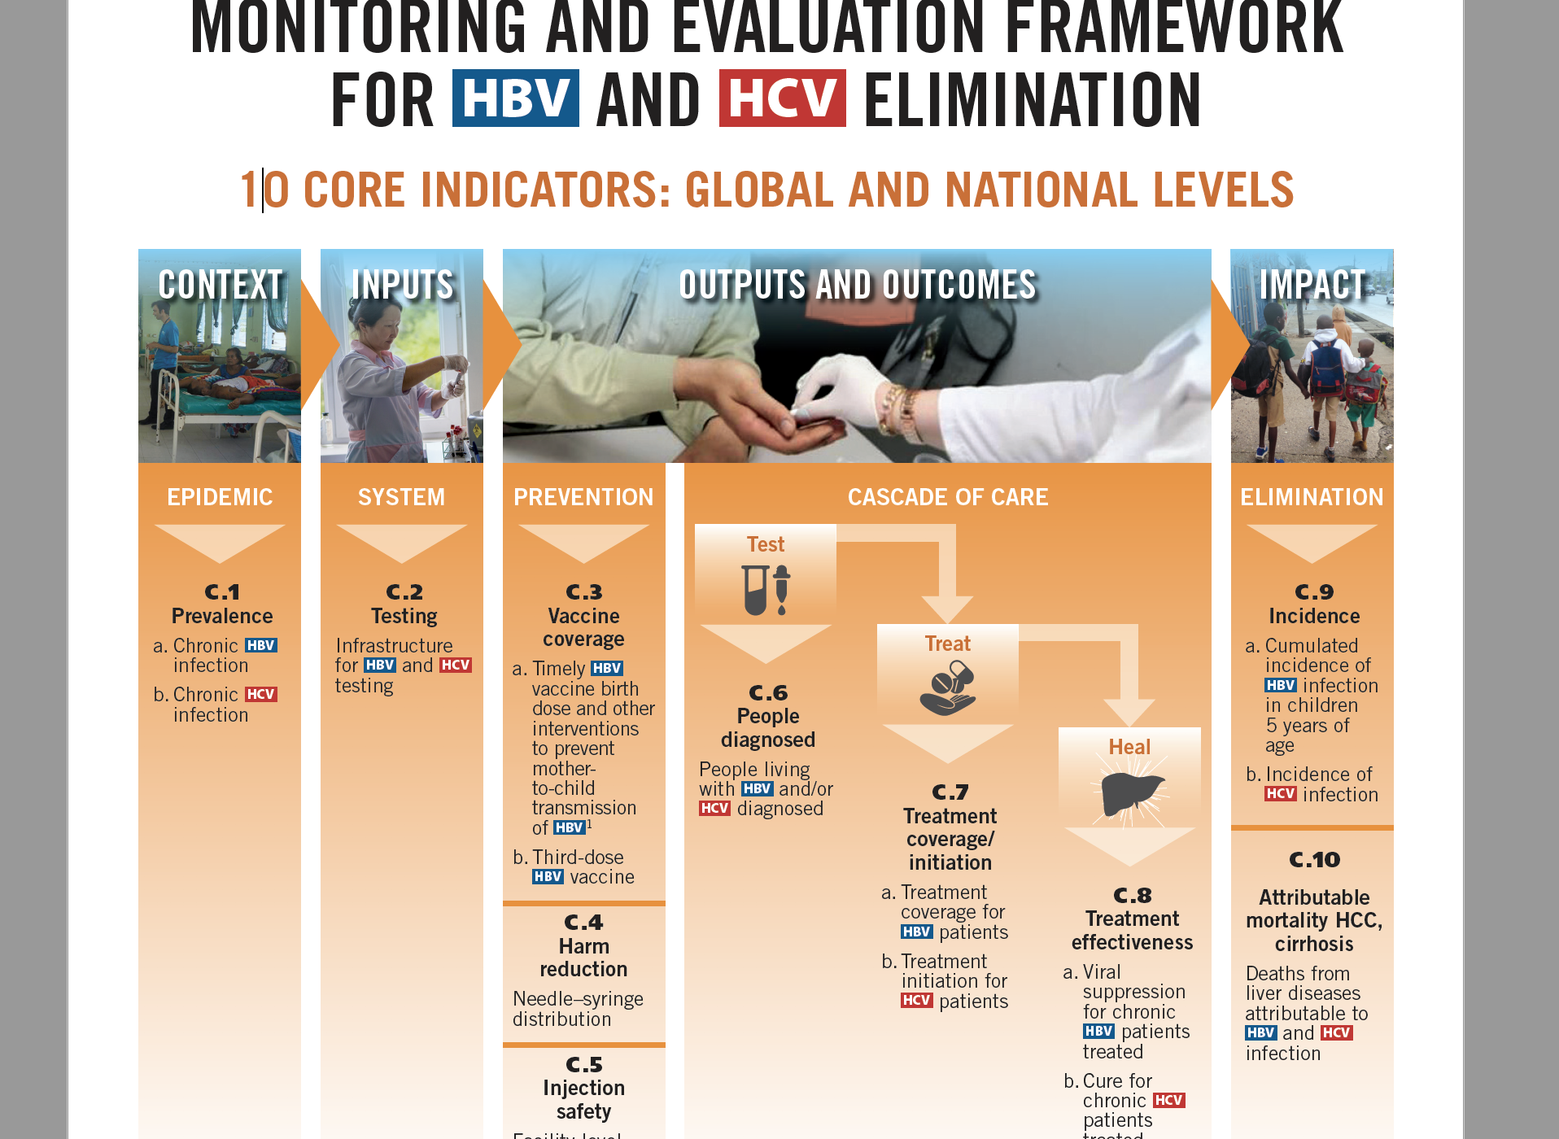
Project Background
Global Hepatitis Progamme. Department of HIV/AIDS
World Health Organization
HL7 Philippines Summit 2023 | Mapping Hepatitis B Data to FHIR using WHO SMART Guidelines

Slide 7
Project Background
Gaps Identified towards Achieving Full Interoperability
Multiple EMR providers
  different programming languages and architectures
  Data encoded -> different names but may mean the same
  Or the data may look alike but may mean different things
A data dictionary is an important standard to resolve these issues
(AO 2017-0011).
HL7 Philippines Summit 2023 | Mapping Hepatitis B Data to FHIR using WHO SMART Guidelines

Slide 8
Project Background
Monitoring the Chronic Viral Hepatitis Treatment Cascade Through Electronic Medical Records
GOAL: To have standardized data for the hepatitis program by creating a shared data dictionary for viral hepatitis
OBJECTIVES:
To obtain expert consensus on the terminologies related to viral hepatitis to create the data dictionary
To populate a data terminology service with the data dictionary
To map EMR terms to the terminology service
To collect data from EMRs into a monitoring dashboard
To support for the Hepatitis Program through e-Health initiatives (Computer-Based Training and TeleMentoring).
HL7 Philippines Summit 2023 | Mapping Hepatitis B Data to FHIR using WHO SMART Guidelines

Slide 9
Project Team
Team Member | Role
Janus P. Ong, MD, MPH, FACP, FACG | Project Leader
Alvin B. Marcelo, MD, FPCS | Health Informatics Lead
Geohari L. Hamoy, MD, MPH | Project Manager
Jan Michael M. Herber, RN | Data Management Officer
Jhunnel P. Macalanda | Systems Administrator
Gerard Paolo F. Villanueva, RN | Guidelines Analyst
Jae-ann O. Somalo, RN | Research Assistant
Bianca Camille D. Pacao | Research Assistant
Christian Paul Tupas | Java Developer
Eric Ornos, MD, PhD | Technical Writer
Neil Benjamin Kho, MD | Technical Writer
HL7 Philippines Summit 2023 | Mapping Hepatitis B Data to FHIR using WHO SMART Guidelines

Slide 10
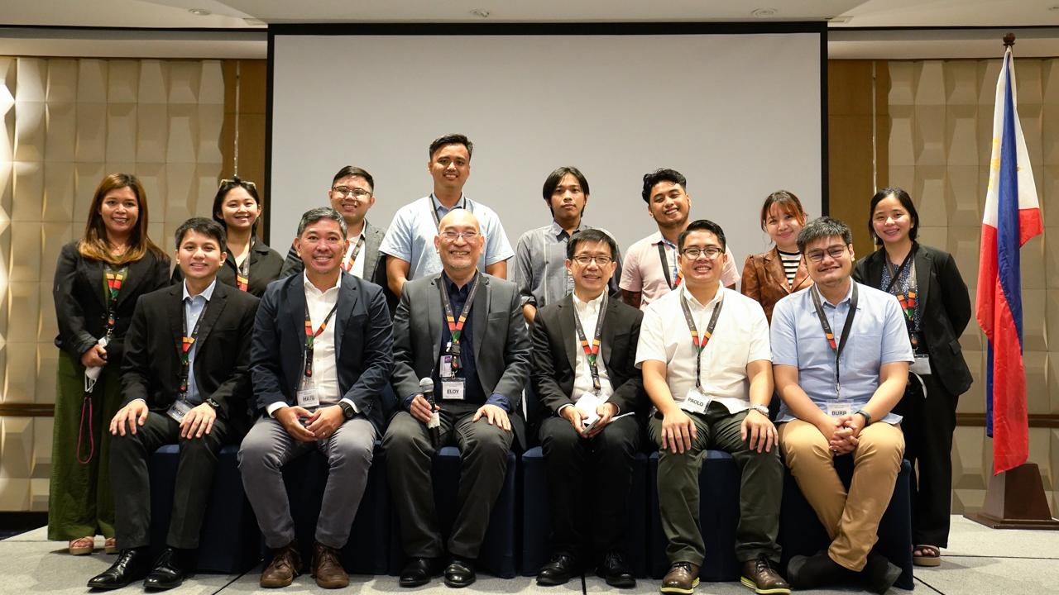
Project Team
HL7 Philippines Summit 2023 | Mapping Hepatitis B Data to FHIR using WHO SMART Guidelines

Slide 11
Stakeholder Overview
Stakeholders | Function/Role
University of the Philippines Manila | Proponent
Hepatology Society of the Philippines | Technical Experts
EMR Providers | EMR Data Source
Department of Health Epidemiology Bureau Knowledge Management and Information Technology Service (KMITS) Disease Prevention and Control Bureau (DPCB) National AIDS, STI Prevention and Control Program (NASPCP) | Ownership, Administrative, and Policy
Yellow Warriors Society of the Philippines | Advocates
World Health Organization | Technical Experts
HL7 Philippines Summit 2023 | Mapping Hepatitis B Data to FHIR using WHO SMART Guidelines

Slide 12
How a Terminology Service Works
NATIONAL HEALTH DATA REPOSITORY
EMR PROVIDERS
TERMINOLOGY SERVICE
“HEPATITIS B”
Government EMR
“VIRAL HEPATITIS”
Private EMR
Translates submitted Hepatitis data to a Reference Terminology
“HEPATITIS B
[66071002]
Reference Terminology
“HEPATITIS B”
Unambiguous, shared meaning
“HEPATITIS B POSITIVE”
Private EMR
HL7 Philippines Summit 2023 | Mapping Hepatitis B Data to FHIR using WHO SMART Guidelines

Slide 13
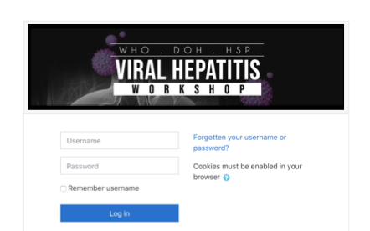
Other eHealth Initiatives
Computer-Based Training
Creation of CBT modules with multiple chapters for health workers
  Hepatitis B
  Hepatitis C
CBT modules were based on the DOH guidelines on the diagnosis and treatment of HBV and HCV
Embed in a website for access by health workers
HL7 Philippines Summit 2023 | Mapping Hepatitis B Data to FHIR using WHO SMART Guidelines

Slide 14
Project Timeline
Timeline | Informatics Track | eLearning Track
Q4 (2020) | Stakeholder Engagement
Q1 (2021) | Forms Analysis; Terminology Mapping | Computer-Based Training (CBT) Content Development
Q2 (2021) | Consensus Conference of Viral Hepatitis Terminology
Q3 (2021) | Workshop Documentation
Q4 (2021) | Data Exchange Protocol (FHIR Resource) Mapping
Q1 (2022) | Data Exchange Server (FHIR Server) Setup | CBT Rollout: Region 3
Q2 (2022) | FHIR API Development and Testing | CBT Rollout: Region 4a
Q3 (2022) | Alignment with WHO SMART Guidelines; Datathon Workshop | Telementoring Sessions
Q4 (2022) | Follow-up Datathon Workshop
Q1 (2023) | Face-to-Face Datathon/Hacktahon | CBT Rollout: Taguig Telementoring Graduation
HL7 Philippines Summit 2023 | Mapping Hepatitis B Data to FHIR using WHO SMART Guidelines

Slide 15
Transforming Paper to Digital:
WHO SMART Guidelines
HL7 Philippines Summit 2023 | Mapping Hepatitis B Data to FHIR using WHO SMART Guidelines

Slide 16
Project Objectives
OBJECTIVES:
To obtain expert consensus on the terminologies related to viral hepatitis to create the data dictionary
To populate a data terminology service with the data dictionary
To map EMR terms to the terminology service
To collect data from EMRs into a monitoring dashboard
To support for the Hepatitis Program through e-Health initiatives (Computer-Based Training and TeleMentoring).
HL7 Philippines Summit 2023 | Mapping Hepatitis B Data to FHIR using WHO SMART Guidelines

Slide 17
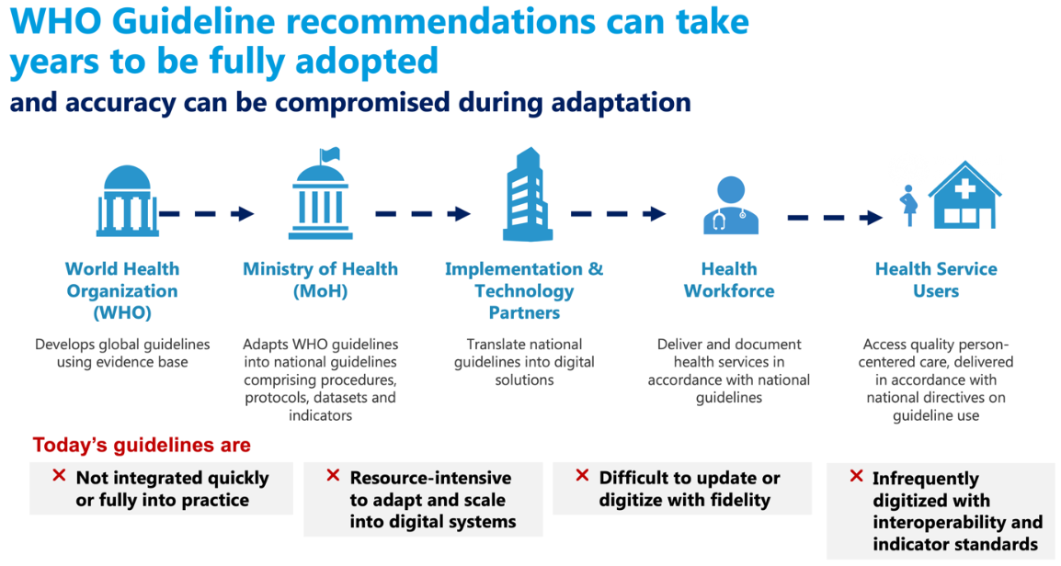
Problem Statement
Successful Information Systems require Multi-stakeholder Engagement
SMART Guidelines (who.int)
HL7 Philippines Summit 2023 | Mapping Hepatitis B Data to FHIR using WHO SMART Guidelines

Slide 18
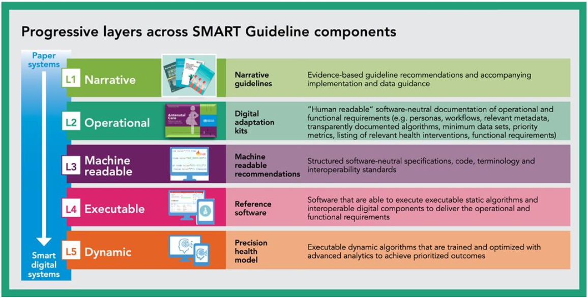
WHO SMART Guidelines
SMART Guidelines (who.int)
HL7 Philippines Summit 2023 | Mapping Hepatitis B Data to FHIR using WHO SMART Guidelines

Slide 19
WHO SMART Guidelines in Steps (L1)
WHO SMART Guideline |  | Project Steps
L1 (Narrative) | National Viral Hepatitis Surveillance Initiative | Desk review of existing policies.
HL7 Philippines Summit 2023 | Mapping Hepatitis B Data to FHIR using WHO SMART Guidelines

Slide 20
WHO SMART Guidelines Applied to Viral Hepatitis
applied into Viral Hepatitis
National Viral Hepatitis Surveillance Initiative
SMART Guidelines (who.int)
HL7 Philippines Summit 2023 | Mapping Hepatitis B Data to FHIR using WHO SMART Guidelines

Slide 21
WHO SMART Guidelines in Steps (L2)
WHO SMART Guideline |  | Project Steps
L1 (Narrative) | National Viral Hepatitis Surveillance Initiative | Desk review of existing policies.
L2 (Operational) | Operational Guidelines; Case Report and Care Form Elements | Analyze the Viral Hepatitis Forms and its Data Elements. Map each form element into Terminology Code Sets and Data Exchange Protocols. Present the output to the content experts for consensus.
HL7 Philippines Summit 2023 | Mapping Hepatitis B Data to FHIR using WHO SMART Guidelines

Slide 22
WHO SMART Guidelines Applied to Viral Hepatitis
applied into Viral Hepatitis
National Viral Hepatitis Surveillance Initiative
Clinical: Operational Guidelines
Informatics: Case Report, Care Form Elements
SMART Guidelines (who.int)
HL7 Philippines Summit 2023 | Mapping Hepatitis B Data to FHIR using WHO SMART Guidelines

Slide 23
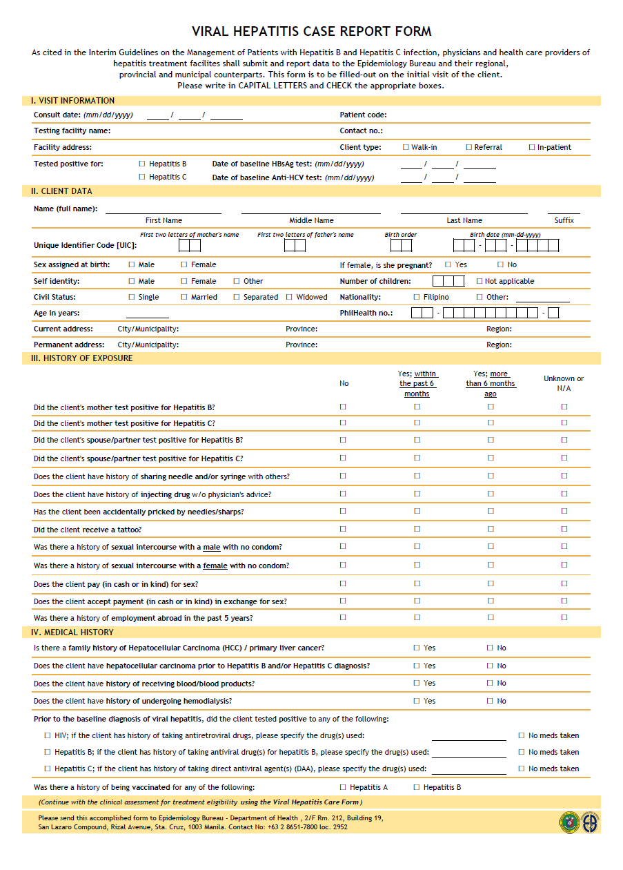
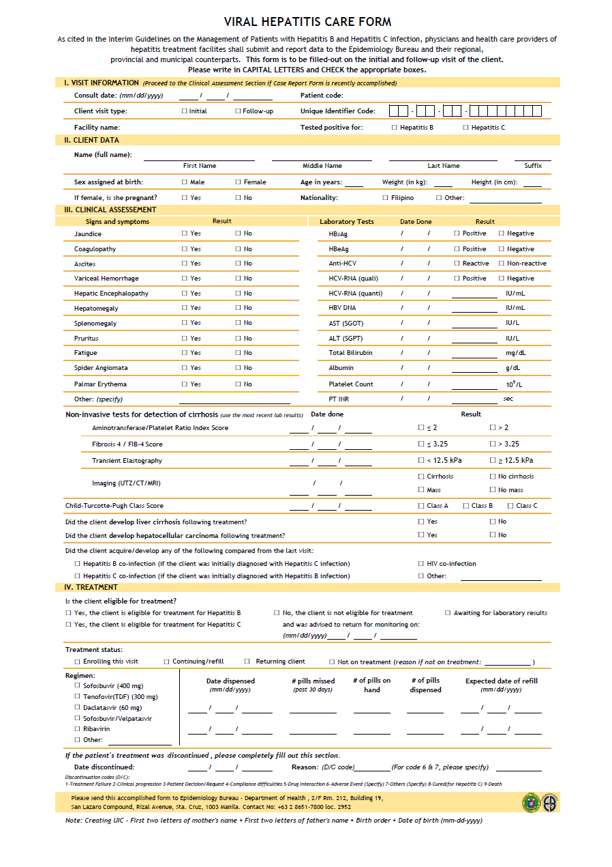
Objective 1: Obtaining Expert Consensus
STEP 1:
Analyze the Viral Hepatitis Forms and its Data Elements.
Case Report Form
Care Form
HL7 Philippines Summit 2023 | Mapping Hepatitis B Data to FHIR using WHO SMART Guidelines

Slide 24
Objective 1: Obtaining Expert Consensus
STEP 1:
Analyze the Viral Hepatitis Forms and its Data Elements.
59 elements
100 elements
125 unique elements
(34 duplicate elements)
Case Report Form
Care Form
HL7 Philippines Summit 2023 | Mapping Hepatitis B Data to FHIR using WHO SMART Guidelines

Slide 25
Objective 1: Obtaining Expert Consensus
STEP 2: Map each form element into Terminology Code Sets and Data Exchange Protocols.
Terminology Code Sets:
The Project Team looked for terminology code sets to be used for mapping the data elements with preference for:
  Curated terminology over non-curated,
  International standards over local standards, and
  Free-to-use over pay-for-use terminology systems
Name of Standard [Website] | Context | Curator | Cost
HL7-FHIR (hl7.org/fhir) | Data Exchange | HL7 International | Free
International Classification of Diseases 11th Revision (ICD-11) [icd.who.int] | Disease | WHO Family of International Classifications | Free
Logical Observation Identifiers Names and Codes (LOINC) [loinc.org] | Laboratory | Regenstrief Institute | Free
SNOMED Clinical Terms (SNOMED-CT) [snomed.org] | Clinical Terminologies | SNOMED International | By national membership
SNOMED Global Patient Set [snomed.org/gps] | Clinical Terminologies | SNOMED International | Free *
HL7 Philippines Summit 2023 | Mapping Hepatitis B Data to FHIR using WHO SMART Guidelines

Slide 26
Objective 1: Obtaining Expert Consensus
STEP 2: Map each form element into Terminology Code Sets and Data Exchange Protocols.
Terminology (Semantic): Each of the identified data element was mapped into the following terminology code sets:
  Free-to-Use: ICD-11 / LOINC
  Pay-for-Use: SNOMED CT
Data Exchange Format (Syntactic):
All data elements were initially mapped into HL7-FHIR.
OUTPUT: Spreadsheet of Terminology Mapping
HL7 Philippines Summit 2023 | Mapping Hepatitis B Data to FHIR using WHO SMART Guidelines

Slide 27
Objective 1: Obtaining Expert Consensus
STEP 3: Present the output to the content experts for consensus.
A virtual workshop with three breakout sessions was conducted, represented by hepatologists and public health officers.
During the breakout sessions:
  Each data element was presented to the audience showing both free-to-use and pay-for-use terminologies.
  A recommendation from the Project Team was then followed with preference to free-to-use.
  The audience were instructed to accept or reject the recommendation. If they are to reject, they were asked on their comments/suggestions on the terminology.
HL7 Philippines Summit 2023 | Mapping Hepatitis B Data to FHIR using WHO SMART Guidelines

Slide 28
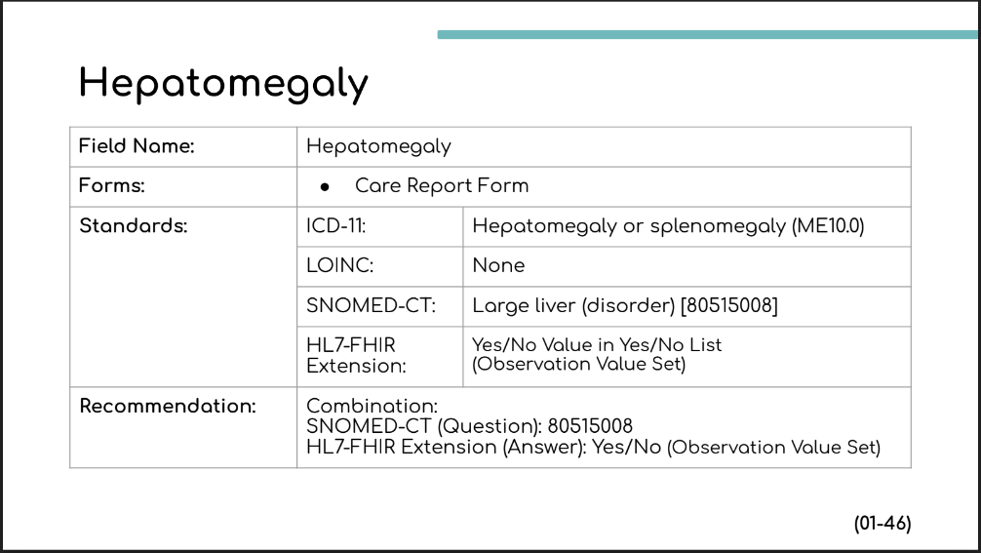
Objective 1: Obtaining Expert Consensus
STEP 3: Present the output to the content experts for consensus.
HL7 Philippines Summit 2023 | Mapping Hepatitis B Data to FHIR using WHO SMART Guidelines

Slide 29
Objective 1: Obtaining Expert Consensus
STEP 3: Present the output to the content experts for consensus.
INITIAL RESULTS:
70% of data elements achieved consensus.
  A total of 38 data elements were parked due to comments or in the interest of time.
Some comments elicited was on the actual content of the form, not the terminology mapping.
 | Consensus | Minor Comment | Suggestion | Not Reviewed
Group 1 (Patient Demographics and Physical Examination) | 43 | 4 | 5 | 0
Group 2 (Medical History) | 8 | 0 | 11 | 6
Group 3 (Diagnostics and Therapeutics) | 36 | 11 | 1 | 0
Total | 87 (69.60%) | 15 (12.00%) | 17 (13.60%) | 6 (4.80%)
HL7 Philippines Summit 2023 | Mapping Hepatitis B Data to FHIR using WHO SMART Guidelines

Slide 30
Objective 1: Obtaining Expert Consensus
STEP 3: Present the output to the content experts for consensus.
RESULTS:
A follow-up virtual workshop was reconvened to settle the remaining elements.
  Expectations were set that the consensus shall be elicited on the terminologies, not on the actual content of the form.
  The remaining 38 data elements were presented once again with the revisions from the comments and those that were not discussed.
Consensus was then achieved to all 125 data elements.
OUTPUT: Expert Consensus
HL7 Philippines Summit 2023 | Mapping Hepatitis B Data to FHIR using WHO SMART Guidelines

Slide 31
WHO SMART Guidelines in Steps (Revisit)
WHO SMART Guideline |  | Project Steps
L1 (Narrative) | National VIral Hepatitis Surveillance Initiative | Desk review of existing policies.
L2 (Operational) | Operational Guidelines; Case Report and Care Form Elements | Analyze the Viral Hepatitis Forms and its Data Elements. Map each form element into Terminology Code Sets and Data Exchange Protocols. Present the output to the content experts for consensus.
HL7 Philippines Summit 2023 | Mapping Hepatitis B Data to FHIR using WHO SMART Guidelines

Slide 32
WHO SMART Guidelines in Steps (L3)
WHO SMART Guideline |  | Project Steps
L3 (Machine Readable) | FHIR Profiles and Implementation Guide | Map the Proposed National Viral Hepatitis Data Dictionary to the appropriate FHIR Element/Resource. Translate each field into a FHIR StructureDefinition Resources(JSON or xml). Test JSON file using Postman API. Translate each JSON file into FHIR Shorthand (FSH) Language. Upload the FSH files into the Git repository. Develop and Publish the FHIR Implementation Guide.
HL7 Philippines Summit 2023 | Mapping Hepatitis B Data to FHIR using WHO SMART Guidelines

Slide 33
WHO SMART Guidelines Applied to Viral Hepatitis
applied into Viral Hepatitis
National Viral Hepatitis Surveillance Initiative
Clinical: Operational Guidelines
Informatics: Case Report, Care Form Elements
Data Exchange Protocol:
FHIR Profiles and Implementation Guide
SMART Guidelines (who.int)
HL7 Philippines Summit 2023 | Mapping Hepatitis B Data to FHIR using WHO SMART Guidelines

Slide 34
HL7 FHIR®
FHIR (Fast Healthcare Interoperability Resources)
A standard developed by HL7 (Health Level 7), a standards development organization.
  HL7 (as a company) provides framework and governance
  HL7 (as a community) provides actual development creation by working together
A robust data model for describing health and administrative data
A RESTful API for interacting with that data using either JSON or XML
    Protocol to exchange information between two applications
A collection of FHIR Servers around the world that you can interact with
A community of implementers working together
“Intro to FHIR” by SmileCDR is licensed under Creative Commons “Attribution-ShareAlike 4.0 International” license. (CC BY SA)
HL7 Philippines Summit 2023 | Mapping Hepatitis B Data to FHIR using WHO SMART Guidelines

Slide 35
FHIR® Manifesto
Principles based on lessons learned from previous efforts:
  Implementer Focus
    Targeted at developers and implementers, not clinicians
    Every detail of the specification is tested at connectathon events.
  Common Scenarios (Emphasis on the 80:20 rule)
    20% of the data are used by 80% of the implementers
  Free to use and free to contribute
    Specification is licensed under Creative Commons CC0
    Tools are open source; tutorials are free.
  Easy to Adopt (“F” in FHIR)
“Intro to FHIR” by SmileCDR is licensed under Creative Commons “Attribution-ShareAlike 4.0 International” license. (CC BY SA)
HL7 Philippines Summit 2023 | Mapping Hepatitis B Data to FHIR using WHO SMART Guidelines

Slide 36
FHIR® Data Model
FHIR defines a set of roughly 150 resources (data model).
Examples:
  Patient (the person who receives healthcare services)
  Encounter (a doctor’s appointment or hospital stay)
  Observation (clinical observation on a patient - e.g. signs/symptoms, usually for a short period of time)
  Condition (diagnosis, problem, or symptoms that needs to be managed over a period of time)
  Location (facility details)
  Questionnaire (case reporting)
  QuestionnaireResponse (case reporting output)
“Intro to FHIR” by SmileCDR is licensed under Creative Commons “Attribution-ShareAlike 4.0 International” license. (CC BY SA)
HL7 Philippines Summit 2023 | Mapping Hepatitis B Data to FHIR using WHO SMART Guidelines

Slide 37
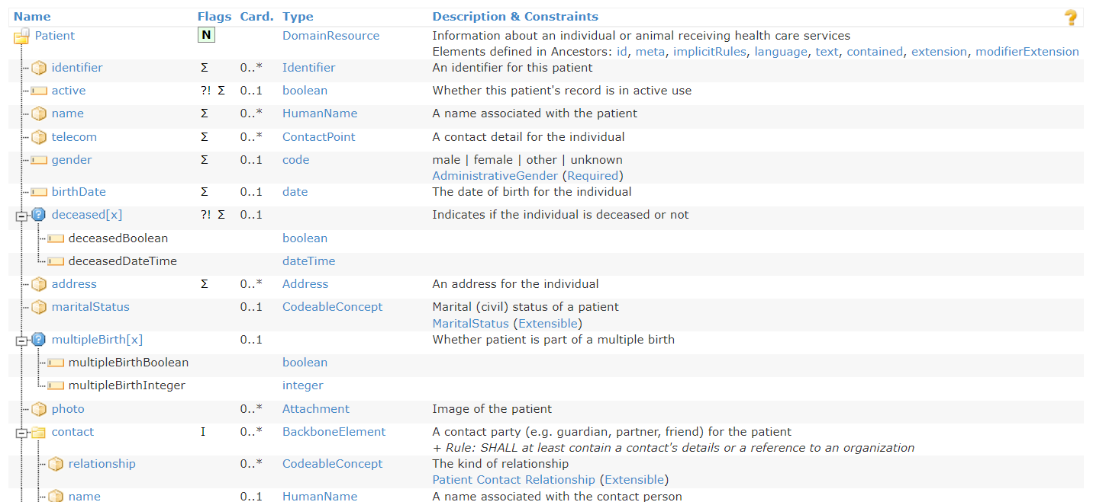
Patient Resource (Sample)
Resource
Cardinality
Type
Element
Reference: Patient Resource from https://www.hl7.org/fhir/patient.html
HL7 Philippines Summit 2023 | Mapping Hepatitis B Data to FHIR using WHO SMART Guidelines

Slide 38
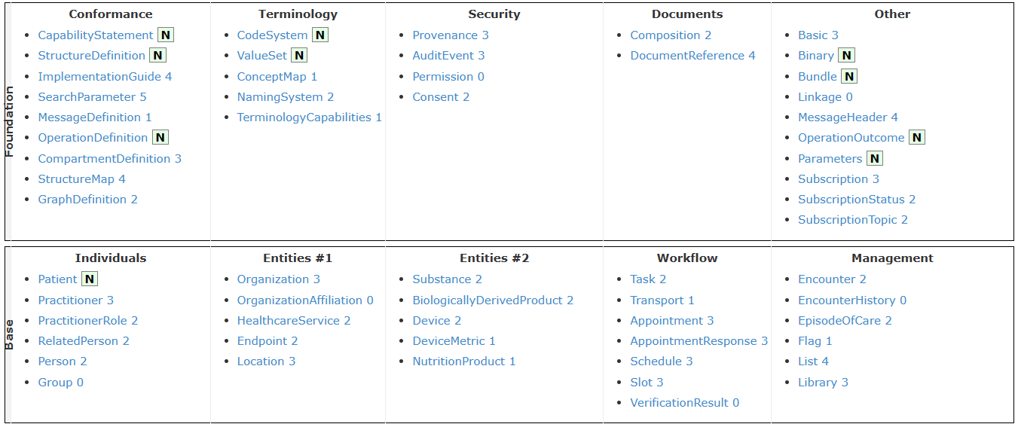
FHIR® Terminology Service
HL7 Philippines Summit 2023 | Mapping Hepatitis B Data to FHIR using WHO SMART Guidelines

Slide 39
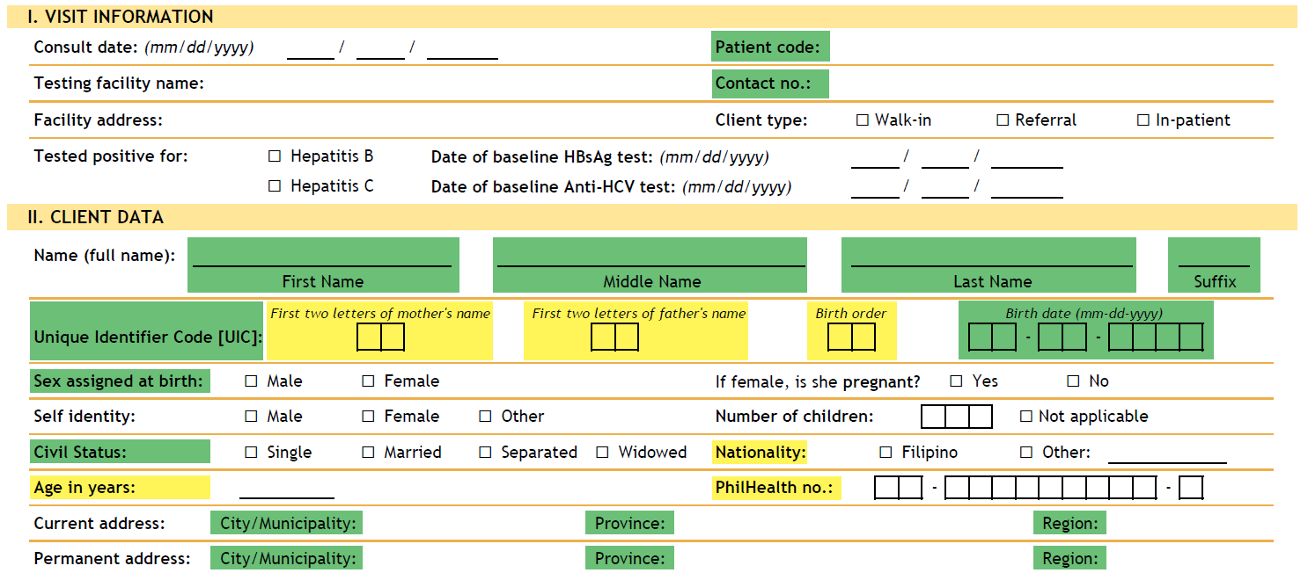
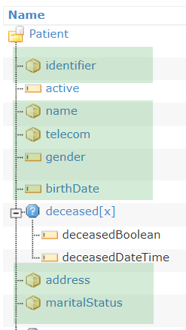
Objective 2: Mapping to Terminology Service
STEP 4: Map the Proposed National Viral Hepatitis Data Dictionary to the appropriate FHIR Element/Resource.
HL7 Philippines Summit 2023 | Mapping Hepatitis B Data to FHIR using WHO SMART Guidelines

Slide 40
Objective 2: Mapping to Terminology Service
STEP 4: Map the Proposed National Viral Hepatitis Data Dictionary to the appropriate FHIR Element/Resource.
FHIR Resource | Case Report Form
Patient | 24
Encounter | 2
FamilyMemberHistory | 5
Observation | 30
Organization | 1
FHIR Resource | Care Form
Patient | 10
Encounter | 4
Condition | 16
Observation | 45
CarePlan | 7
MedicationStatement | 32
Provenance | 39
Location | 1
HL7 Philippines Summit 2023 | Mapping Hepatitis B Data to FHIR using WHO SMART Guidelines

Slide 41
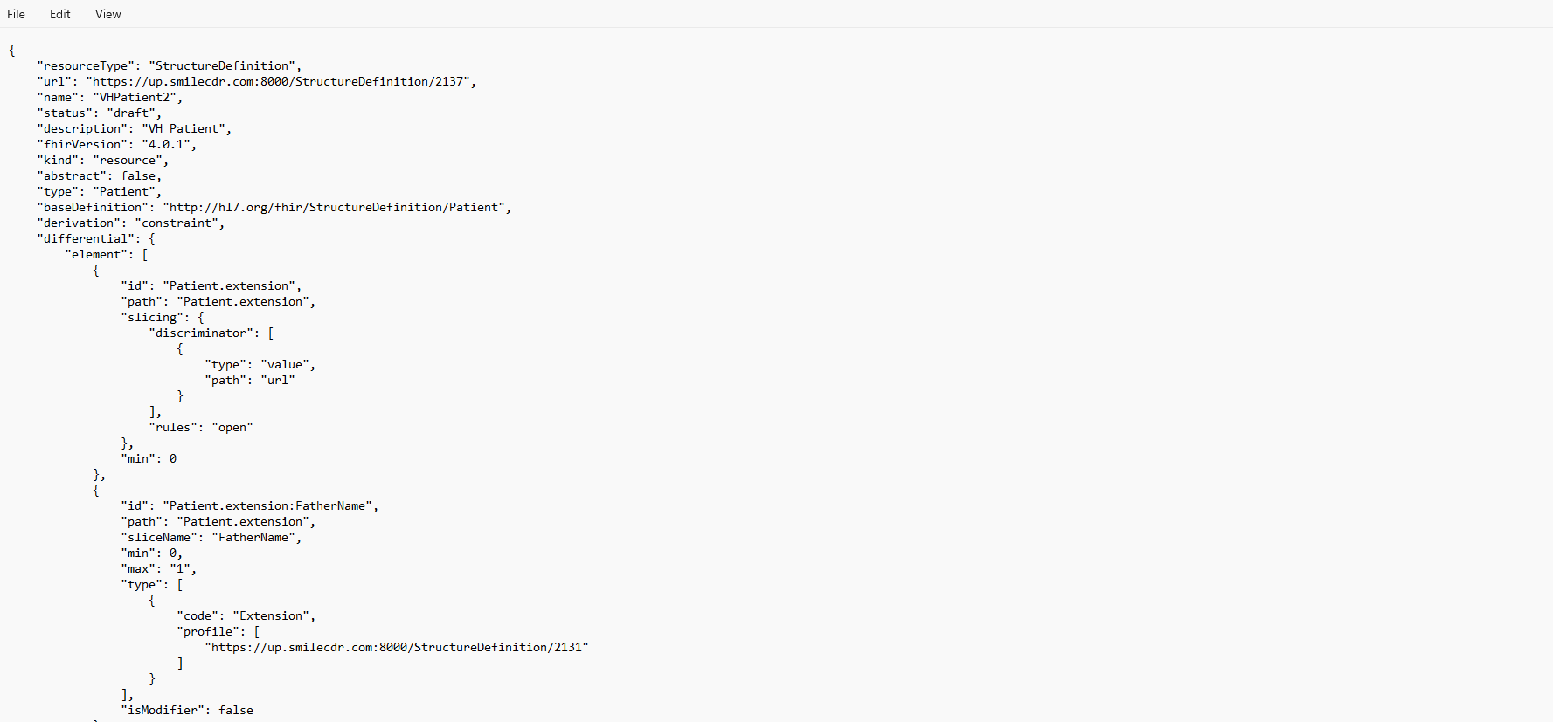
Objective 2: Mapping to Terminology Service
STEP 5: Translate each field into a FHIR StructureDefinition Resources (JSON or xml).
HL7 Philippines Summit 2023 | Mapping Hepatitis B Data to FHIR using WHO SMART Guidelines

Slide 42
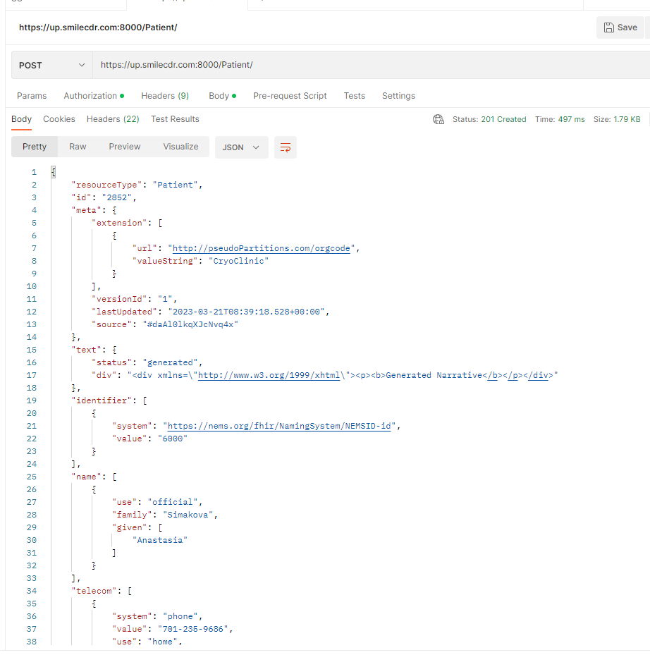
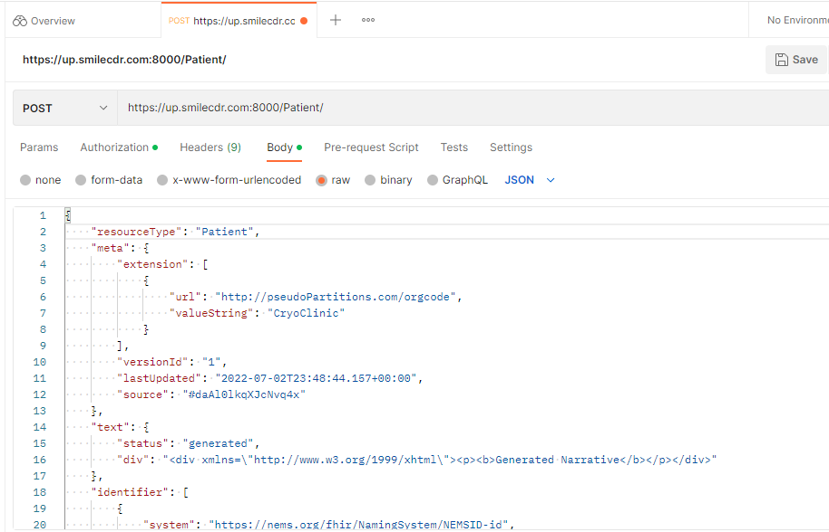
Objective 2: Mapping to Terminology Service
STEP 6: Test JSON file using Postman (API).
HL7 Philippines Summit 2023 | Mapping Hepatitis B Data to FHIR using WHO SMART Guidelines

Slide 43
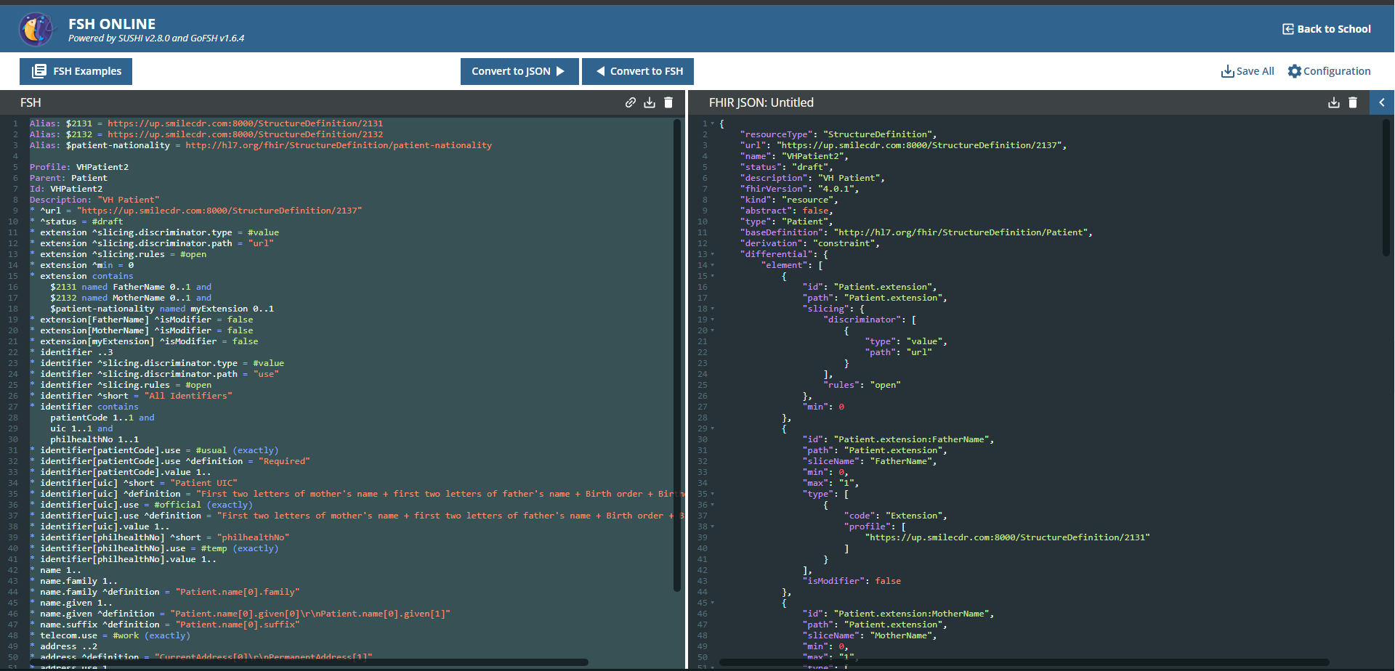
Objective 2: Mapping to Terminology Service
STEP 7: Translate each JSON file into FHIR Shorthand (FSH) Language.
HL7 Philippines Summit 2023 | Mapping Hepatitis B Data to FHIR using WHO SMART Guidelines

Slide 44
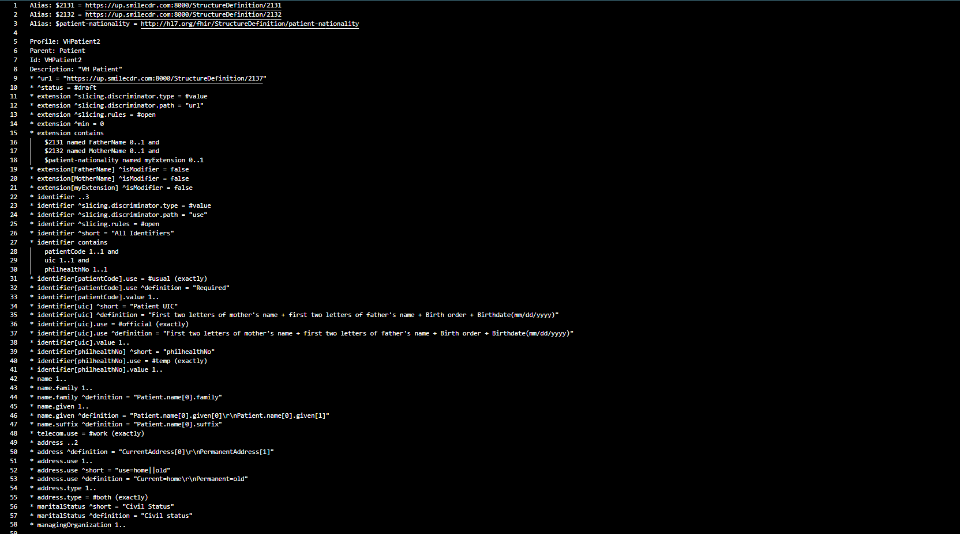
Objective 2: Mapping to Terminology Service
STEP 8: Upload the FSH files into the Git repository.
HL7 Philippines Summit 2023 | Mapping Hepatitis B Data to FHIR using WHO SMART Guidelines

Slide 45
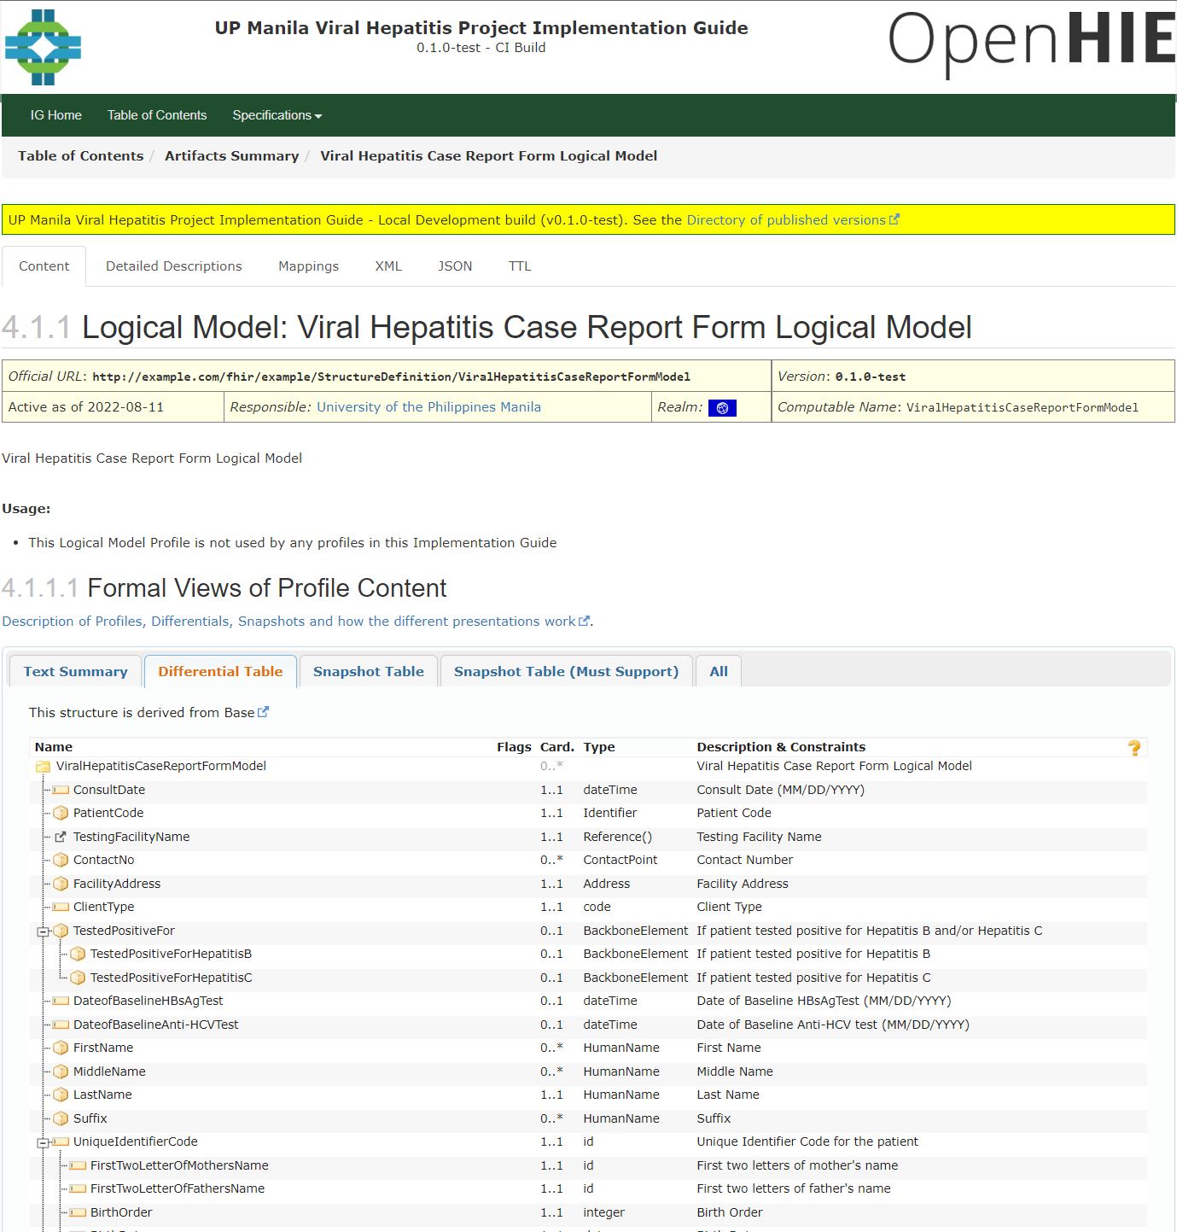
Objective 2: Mapping to Terminology Service
STEP 9: Develop and Publish the FHIR Implementation Guide on Git repository.
FHIR Implementation Guide
A set of rules of how a particular interoperability or standards problem is solved - typically through the use of FHIR resources - to publish a computable definition of all the parts.
ImplementationGuide - FHIR v4.3.0 (hl7.org)
HL7 Philippines Summit 2023 | Mapping Hepatitis B Data to FHIR using WHO SMART Guidelines

Slide 46
WHO SMART Guidelines in Steps (Revisit)
WHO SMART Guideline |  | Project Steps
L3 (Machine Readable) | FHIR Profiles and Implementation Guide | Map the Proposed National Viral Hepatitis Data Dictionary to the appropriate FHIR Element/Resource. Translate each field into a FHIR StructureDefinition Resources(JSON or xml). Test JSON file using Postman API. Translate each JSON file into FHIR Shorthand (FSH) Language. Upload the FSH files into the Git repository. Develop and Publish the FHIR Implementation Guide.
HL7 Philippines Summit 2023 | Mapping Hepatitis B Data to FHIR using WHO SMART Guidelines

Slide 47
WHO SMART Guidelines in Steps (L4)
WHO SMART Guideline |  | Project Steps
L3 (Machine Readable) | FHIR Profiles and Implementation Guide | Map the Proposed National Viral Hepatitis Data Dictionary to the appropriate FHIR Element/Resource. Translate each field into a FHIR StructureDefinition Resources(JSON or xml). Test JSON file using Postman API. Translate each JSON file into FHIR Shorthand (FSH) Language. Upload the FSH files into the Git repository. Develop and Publish the FHIR Implementation Guide.
L4 (Executable) | FHIR Compliant EMRs Submitting Data | Set up the FHIR Server. Upload (i.e. POST) necessary FHIR StructureDefinition Resources to the FHIR API Server using POSTMAN. Build capacity of EMRs through a hacktahon.
HL7 Philippines Summit 2023 | Mapping Hepatitis B Data to FHIR using WHO SMART Guidelines

Slide 48
WHO SMART Guidelines Applied to Viral Hepatitis
applied into Viral Hepatitis
National Viral Hepatitis Surveillance Initiative
Clinical: Operational Guidelines
Informatics: Case Report, Care Form Elements
Data Exchange Protocol:
FHIR Profiles and Implementation Guide
EMR Development and Implementation:
FHIR Compliant EMRs Submitting Data
SMART Guidelines (who.int)
HL7 Philippines Summit 2023 | Mapping Hepatitis B Data to FHIR using WHO SMART Guidelines

Slide 49


Objective 3: EMR Data Mapped to Terminology Service
STEP 10: Set up and secure the FHIR Server.
FHIR Server Architecture
Smile CDR FHIR Test Server
FHIR Storage Module
Electronic Medical Record
FHIR endpoint
Observation
Condition
End User
Patient
Encounter
Location
Admin Module
System Administrator
HL7 Philippines Summit 2023 | Mapping Hepatitis B Data to FHIR using WHO SMART Guidelines

Slide 50
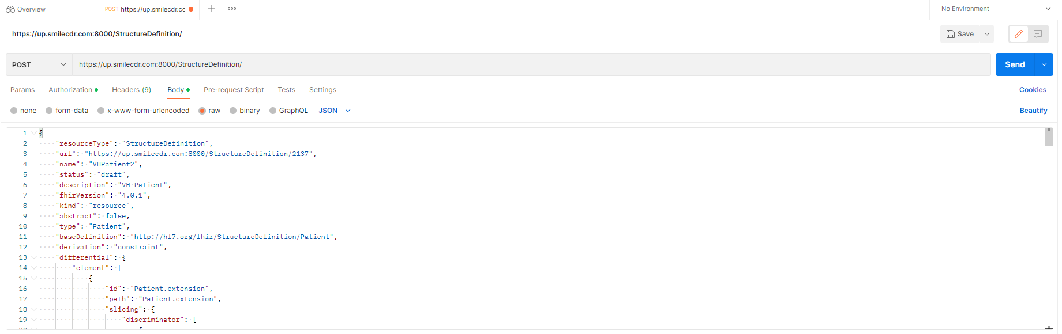
Objective 3: EMR Data Mapped to Terminology Service
STEP 11: Upload (i.e. POST) necessary FHIR StructureDefinition Resources to the FHIR API Server using POSTMAN.
HL7 Philippines Summit 2023 | Mapping Hepatitis B Data to FHIR using WHO SMART Guidelines

Slide 51
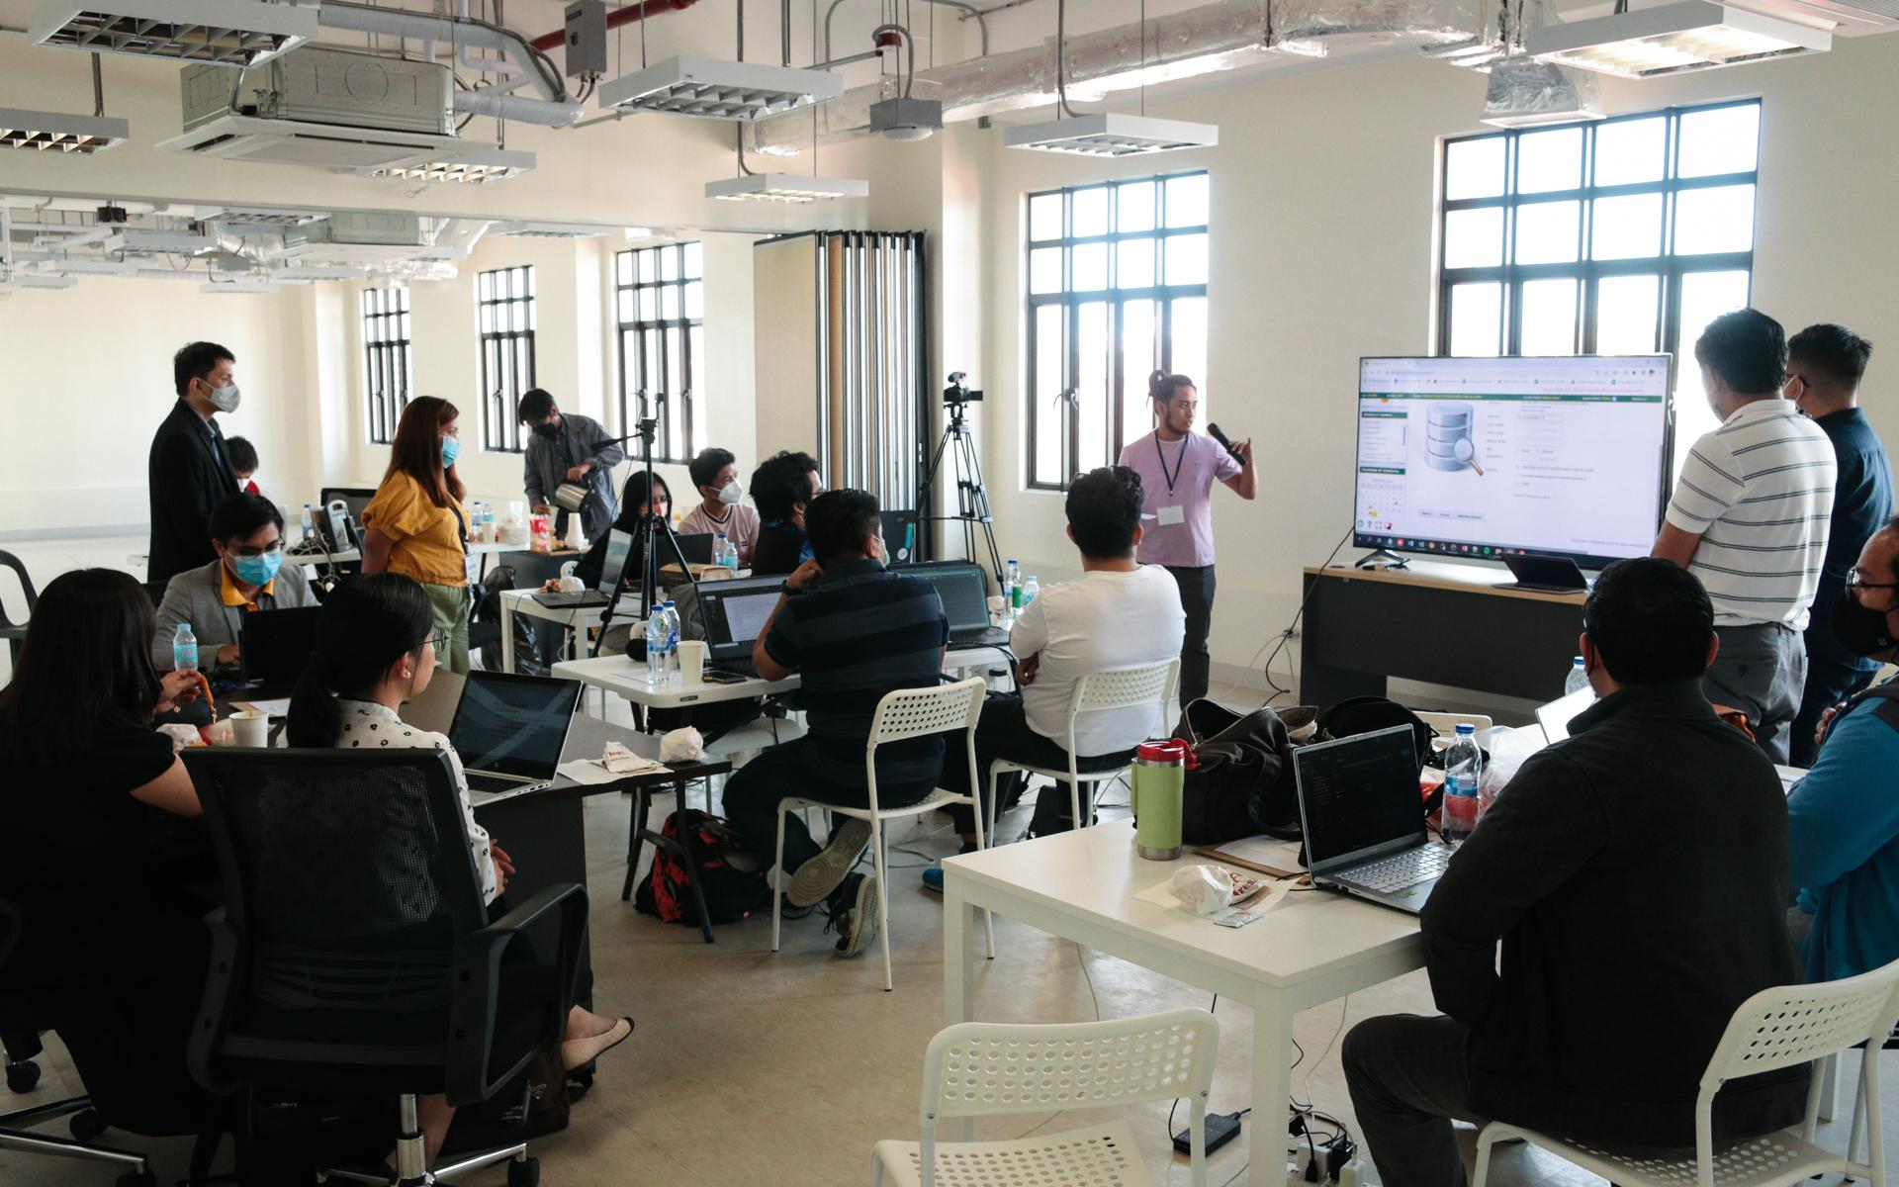
Objective 3: EMR Data Mapped to Terminology Service
STEP 12: Build capacity of EMRs through a hacktahon.
RESULTS:
HepaCon 2
  August 2022
HepaCon 2.5a - Virtual
  December 2022
HepaCon 2.5b - Face to Face
  February 2023
HL7 Philippines Summit 2023 | Mapping Hepatitis B Data to FHIR using WHO SMART Guidelines

Slide 52
Objective 3: EMR Data Mapped to Terminology Service
STEP 12: Build capacity of EMRs through a hacktahon.
User Requirements are patient-journey centered.
  Search Patient
    UR1. Patient does not exist. (GET Patient)
    UR2. Patient does exist. (GET Patient, GET Encounter, GET Condition)
  Case Reporting
    UR3. Patient’s record and information are created.
(POST Patient, POST Encounter, POST Condition)
    UR4. Patient’s information is created (if the patient has an existing record).
(POST Encounter, POST Condition)
    UR5. Patient’s information is updated.
(PUT Patient, POST Encounter, POST Condition)
HL7 Philippines Summit 2023 | Mapping Hepatitis B Data to FHIR using WHO SMART Guidelines

Slide 53
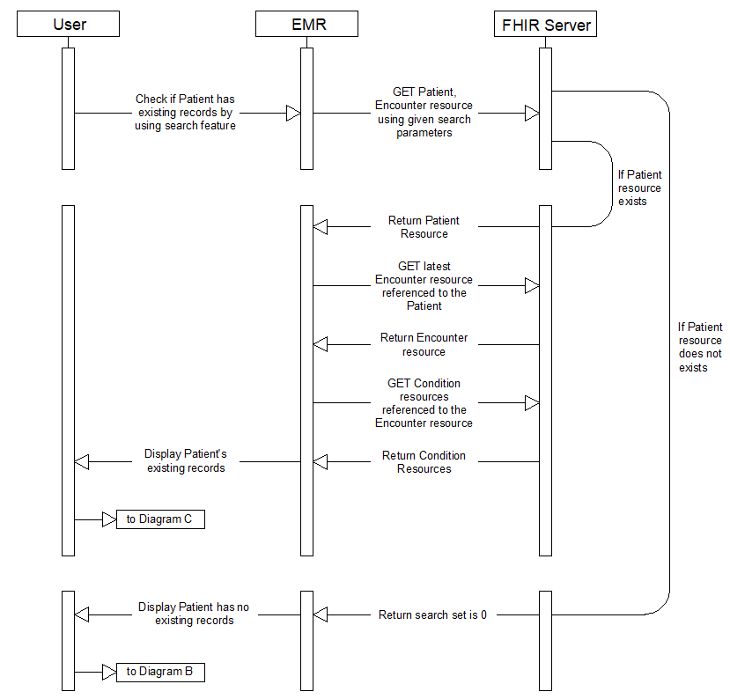
Objective 3: EMR Data Mapped to Terminology Service
STEP 12: Build capacity of EMRs through a hacktahon.
Diagram A: Patient Search Workflow
Patient Name: Johnny Dela Cruz
PhilHealth Number: 12-123456789-8
GET https://up.smilecdr.com:8000/Patient?identifier=12-123456789-8
GET
https://up.smilecdr.com:8000/Encounter?_lastUpdated=gt2022-11-04&patient=2167
GET https://up.smilecdr.com:8000/Condition?encounter=2227
HL7 Philippines Summit 2023 | Mapping Hepatitis B Data to FHIR using WHO SMART Guidelines

Slide 54
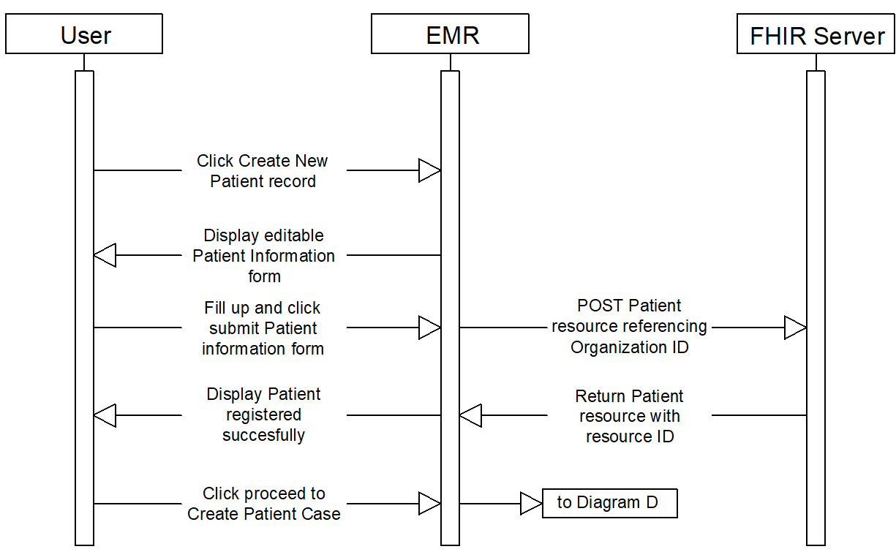
Objective 3: EMR Data Mapped to Terminology Service
STEP 12: Build capacity of EMRs through a hacktahon.
Diagram B: Create New Patient Record Workflow
POST https://up.smilecdr.com:8000/Patient
HL7 Philippines Summit 2023 | Mapping Hepatitis B Data to FHIR using WHO SMART Guidelines

Slide 55
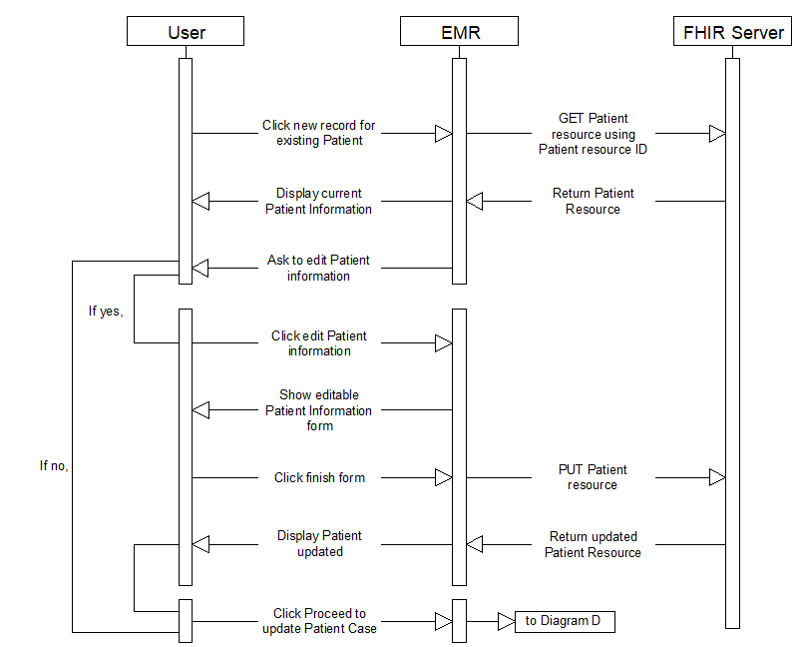
Objective 3: EMR Data Mapped to Terminology Service
STEP 12: Build capacity of EMRs through a hacktahon.
Diagram C:
Update Existing Patient Information
GET
https://up.smilecdr.com:8000/Patient/2167
PUT
https://up.smilecdr.com:8000/Patient/2167
HL7 Philippines Summit 2023 | Mapping Hepatitis B Data to FHIR using WHO SMART Guidelines

Slide 56
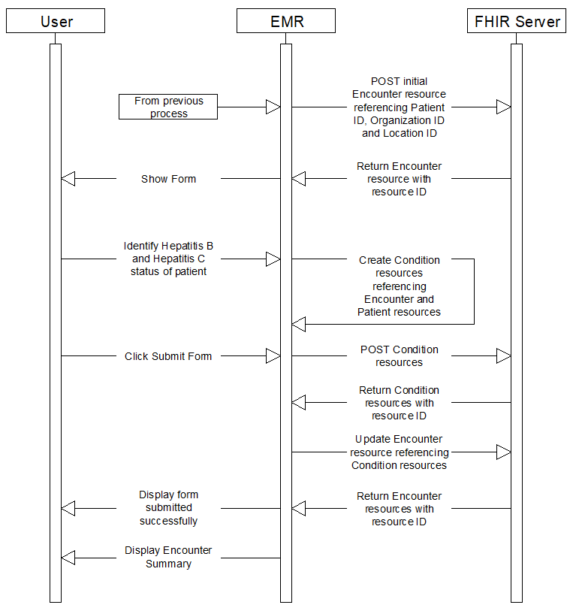
Objective 3: EMR Data Mapped to Terminology Service
STEP 12: Build capacity of EMRs through a hacktahon.
Diagram D:
Updating/Creating Patient VH Record
POST https://up.smilecdr.com:8000/Encounter
POST https://up.smilecdr.com:8000/Condition
POST https://up.smilecdr.com:8000/Encounter
HL7 Philippines Summit 2023 | Mapping Hepatitis B Data to FHIR using WHO SMART Guidelines

Slide 57
Objective 3: EMR Data Mapped to Terminology Service
STEP 12: Build capacity of EMRs through a hacktahon.
Smile CDR FHIR Test Server
Observation
Condition
Location
Encounter
EMR Providers
Patient
HL7 Philippines Summit 2023 | Mapping Hepatitis B Data to FHIR using WHO SMART Guidelines

Slide 58
Objective 3: EMR Data Mapped to Terminology Service
STEP 12: Build capacity of EMRs through a hacktahon.
Smile CDR FHIR Test Server
Observation
Condition
EMR Providers 1
EMR Providers 2
Location
Encounter
Patient
EMR Providers 3
EMR Providers 4
HL7 Philippines Summit 2023 | Mapping Hepatitis B Data to FHIR using WHO SMART Guidelines

Slide 59
Objective 3: EMR Data Mapped to Terminology Service
STEP 12: Build capacity of EMRs through a hacktahon.
LESSONS LEARNED FROM THE HACKATHON:
Provide orientation to policymakers on WHO SMART Guidelines.
Provide trainings to EMRs on FHIR consumption.
Organize more frequent hackathons/datathons on different use cases.
EMR are willing to use FHIR if there is a directive from DOH or PhilHealth.
HL7 Philippines Summit 2023 | Mapping Hepatitis B Data to FHIR using WHO SMART Guidelines

Slide 60
WHO SMART Guidelines in Steps (Revisit)
WHO SMART Guideline |  | Project Steps
L3 (Machine Readable) | FHIR Profiles and Implementation Guide | Map the Proposed National Viral Hepatitis Data Dictionary to the appropriate FHIR Element/Resource. Translate each field into a FHIR StructureDefinition Resources(JSON or xml). Test JSON file using Postman API. Translate each JSON file into FHIR Shorthand (FSH) Language. Upload the FSH files into the Git repository. Develop and Publish the FHIR Implementation Guide.
L4 (Executable) | FHIR Compliant EMRs Submitting Data | Set up the FHIR Server. Upload (i.e. POST) necessary FHIR StructureDefinition Resources to the FHIR API Server using POSTMAN. Build capacity of EMRs through a hacktahon.
HL7 Philippines Summit 2023 | Mapping Hepatitis B Data to FHIR using WHO SMART Guidelines

Slide 61
WHO SMART Guidelines in Steps (L5)
WHO SMART Guideline |  | Project Steps
L3 (Machine Readable) | FHIR Profiles and Implementation Guide | Map the Proposed National Viral Hepatitis Data Dictionary to the appropriate FHIR Element/Resource. Translate each field into a FHIR StructureDefinition Resources(JSON or xml). Test JSON file using Postman API. Translate each JSON file into FHIR Shorthand (FSH) Language. Upload the FSH files into the Git repository. Develop and Publish the FHIR Implementation Guide.
L4 (Executable) | FHIR Compliant EMRs Submitting Data | Set up the FHIR Server. Upload (i.e. POST) necessary FHIR StructureDefinition Resources to the FHIR API Server using POSTMAN. Build capacity of EMRs through a hacktahon.
L5 (Dynamic) | Dashboard | Connect FHIR Server into a monitoring dashboard.
HL7 Philippines Summit 2023 | Mapping Hepatitis B Data to FHIR using WHO SMART Guidelines

Slide 62
WHO SMART Guidelines Applied to Viral Hepatitis
applied into Viral Hepatitis
National Viral Hepatitis Surveillance Initiative
Clinical: Operational Guidelines
Informatics: Case Report, Care Form Elements
Data Exchange Protocol:
FHIR Profiles and Implementation Guide
EMR Development and Implementation:
FHIR Compliant EMRs Submitting Data
Population Health: Dashboards, Precision Health
SMART Guidelines (who.int)
HL7 Philippines Summit 2023 | Mapping Hepatitis B Data to FHIR using WHO SMART Guidelines

Slide 63
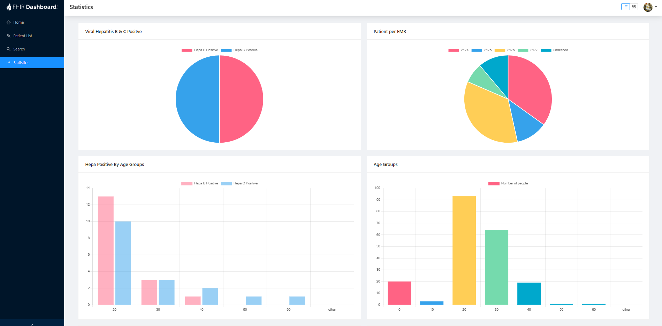
Objective 4: EMR Data into Monitoring Dashboard
STEP 13: Connect FHIR Server into a monitoring dashboard.
Smile CDR FHIR Test Server
Observation
Condition
EMR Providers 1
EMR Providers 2
Location
Encounter
Patient
Viral Hepatitis Dashboard
EMR Providers 3
EMR Providers 4
HL7 Philippines Summit 2023 | Mapping Hepatitis B Data to FHIR using WHO SMART Guidelines

Slide 64
Objective 4: EMR Data into Monitoring Dashboard
STEP 13: Connect FHIR Server into a monitoring dashboard.
HL7 Philippines Summit 2023 | Mapping Hepatitis B Data to FHIR using WHO SMART Guidelines

Slide 65
WHO SMART Guidelines in Steps (Summary)
WHO SMART Guideline |  | Project Steps
L1 (Narrative) | National VIral Hepatitis Surveillance Initiative | Desk review of existing policies.
L2 (Operational) | Operational Guidelines; Case Report and Care Form Elements | Analyze the Viral Hepatitis Forms and its Data Elements. Map each form element into Terminology Code Sets and Data Exchange Protocols. Present the output to the content experts for consensus.
HL7 Philippines Summit 2023 | Mapping Hepatitis B Data to FHIR using WHO SMART Guidelines

Slide 66
WHO SMART Guidelines in Steps (Summary)
WHO SMART Guideline |  | Project Steps
L3 (Machine Readable) | FHIR Profiles and Implementation Guide | Map the Proposed National Viral Hepatitis Data Dictionary to the appropriate FHIR Element/Resource. Translate each field into a FHIR StructureDefinition Resources(JSON or xml). Test JSON file using Postman API. Translate each JSON file into FHIR Shorthand (FSH) Language. Upload the FSH files into the Git repository. Develop and Publish the FHIR Implementation Guide.
L4 (Executable) | FHIR Compliant EMRs Submitting Data | Set up the FHIR Server. Upload (i.e. POST) necessary FHIR StructureDefinition Resources to the FHIR API Server using POSTMAN. Build capacity of EMRs through a hacktahon.
L5 (Dynamic) | Dashboard | Connect FHIR Server into a monitoring dashboard.
HL7 Philippines Summit 2023 | Mapping Hepatitis B Data to FHIR using WHO SMART Guidelines

Slide 67

Thank you :)

Slide 68






CONTACT US
sites.google.com/up.edu.ph/upmsilab
University of the Philippines Manila
Philippine General Hospital Compound,
Taft Ave., Ermita, Manila 1000
silab.upm@up.edu.ph
UPM SILab
upm_silab
UPM SILab
UPM SILab
University of the Philippines Manila Standards & Interoperability Lab
upmsilab

