Slide 1
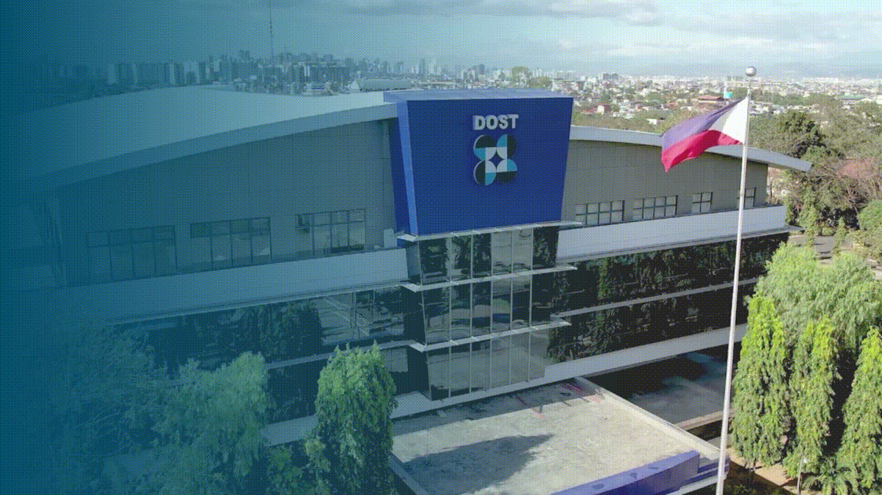


PCHRD Programs and Services:
Digital Health Innovation
Ms. Joana A. America
Intellectual Property and Technology Management
pchrd.dost.gov.ph
01
Notes:
Our partners from HL7 Philippines, dear guests, ladies and gentlemen, magandang araw po sa inyong lahat.
The Department of Science and Technology - Philippine Council for Health Research and Development (DOST-PCHRD) is the lead agency responsible for monitoring and coordinating health research initiatives in the country.

Slide 2
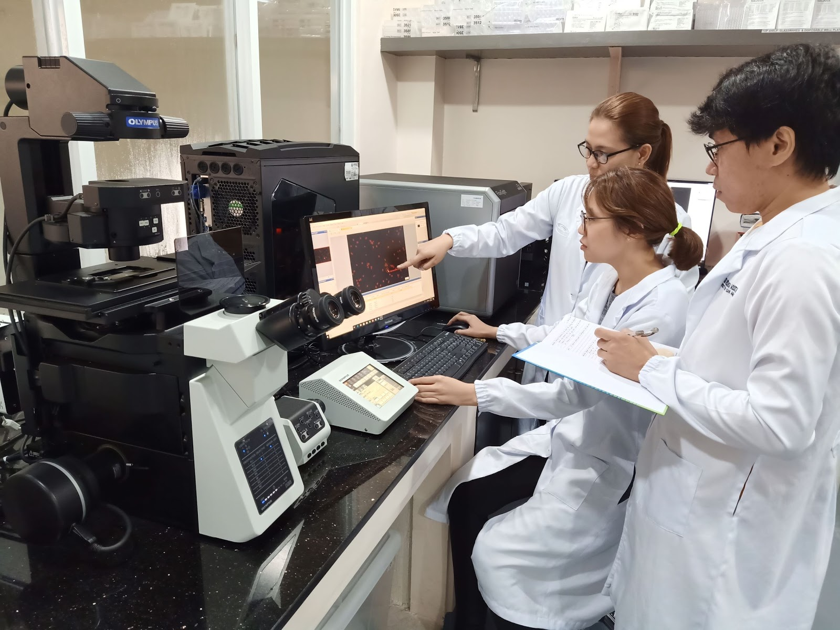





WHAT IS DOST-PCHRD?
A sectoral council
of DOST
Research monitoring and coordination
Forward-looking
Partnership-based
Established in March 17, 1982 through Executive Order No. 784
Notes:
The Philippine Council for Health Research and Development (PCHRD) is one of the three sectoral councils of the Department of Science and Technology (DOST). It is a forward-looking, partnership-based national body responsible for coordinating and monitoring research activities in the country.
PCHRD was created on March 17, 1982 through Executive order No. 784. In 1987, Executive Order No. 128 reaffirmed its existence and relevance. This directive reorganized the National Science and Technology Authority into what is now the Department of Science and Technology.

Slide 3

OUR VISION
The PCHRD as the recognized lead provider of research-based solutions and innovations to address health system needs by 2028.

Slide 4
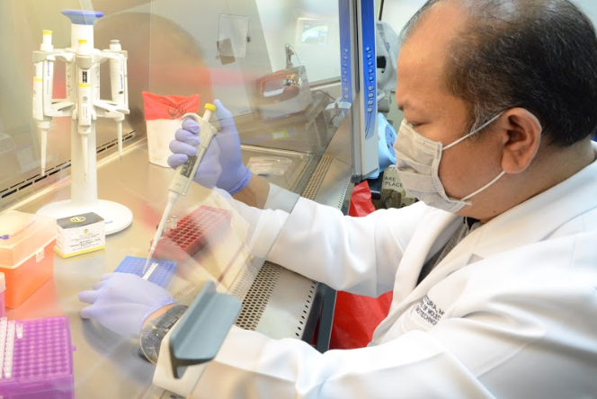
OUR MISSION
Provide central direction, leadership, and coordination of health S & T by:
Formulating Agenda
Mobilizing Resources
Developing Capacity
Supporting Innovations
Ensuring Dissemination, Utilization and Commercialization
Monitoring and Evaluating
Establishing linkages
Advocating ethical health research culture
Notes:
As the national coordinating body for health research, we provide central direction, leadership and coordination of health research S&T activities by…

Slide 5

DOST-PCHRD supports every stage of health research – from conceptualization to utilization
Research Management
Ethics Review
Capacity Building
to support the development of affordable, accessible, and quality S&T-based solutions and innovations
to ensure the protection of human participants in various research projects
to support the growth and to capacitate the country's own pool of experts
Research Dissemination
Technology Transfer
Research to Policy
to communicate research results to target users using different platforms
to guide researchers and investors as they go through each step of idea generation to utilization
to examine ways in which health research may be integrated into policymaking and implementation
02
Notes:
Our programs and services cover every stage of health research, from conceptualization to utilization.
Support is given to health researchers in the areas of research management, ethics review, capacity building, research dissemination, technology transfer, and even up to the translation of research to policy.
On behalf of the Council, it is my pleasure to share with you today our initiatives dedicated to advancing the utilization of health research efforts.

Slide 6

Research Grants
PCHRD funds research proposals that are aligned with the National Unified Health Research Agenda (NUHRA) and the DOST’s Harmonized National Research and Development Agenda (HNRDA).
pchrd.dost.gov.ph
Notes:
R&D Funding is for specific R&D priority areas under the Harmonized National R&D Agenda (HNRDA), which hinges on DOST’s S&T thrusts, emerging and re-emerging health concerns, and health researches that will better equip the country in the next pandemic, and beyond. This encourages public and private higher education institutes, research and development institutes and non-profit organizations to conduct applied R&D and forge collaboration by and among organizations involved in health R&D.

Slide 7





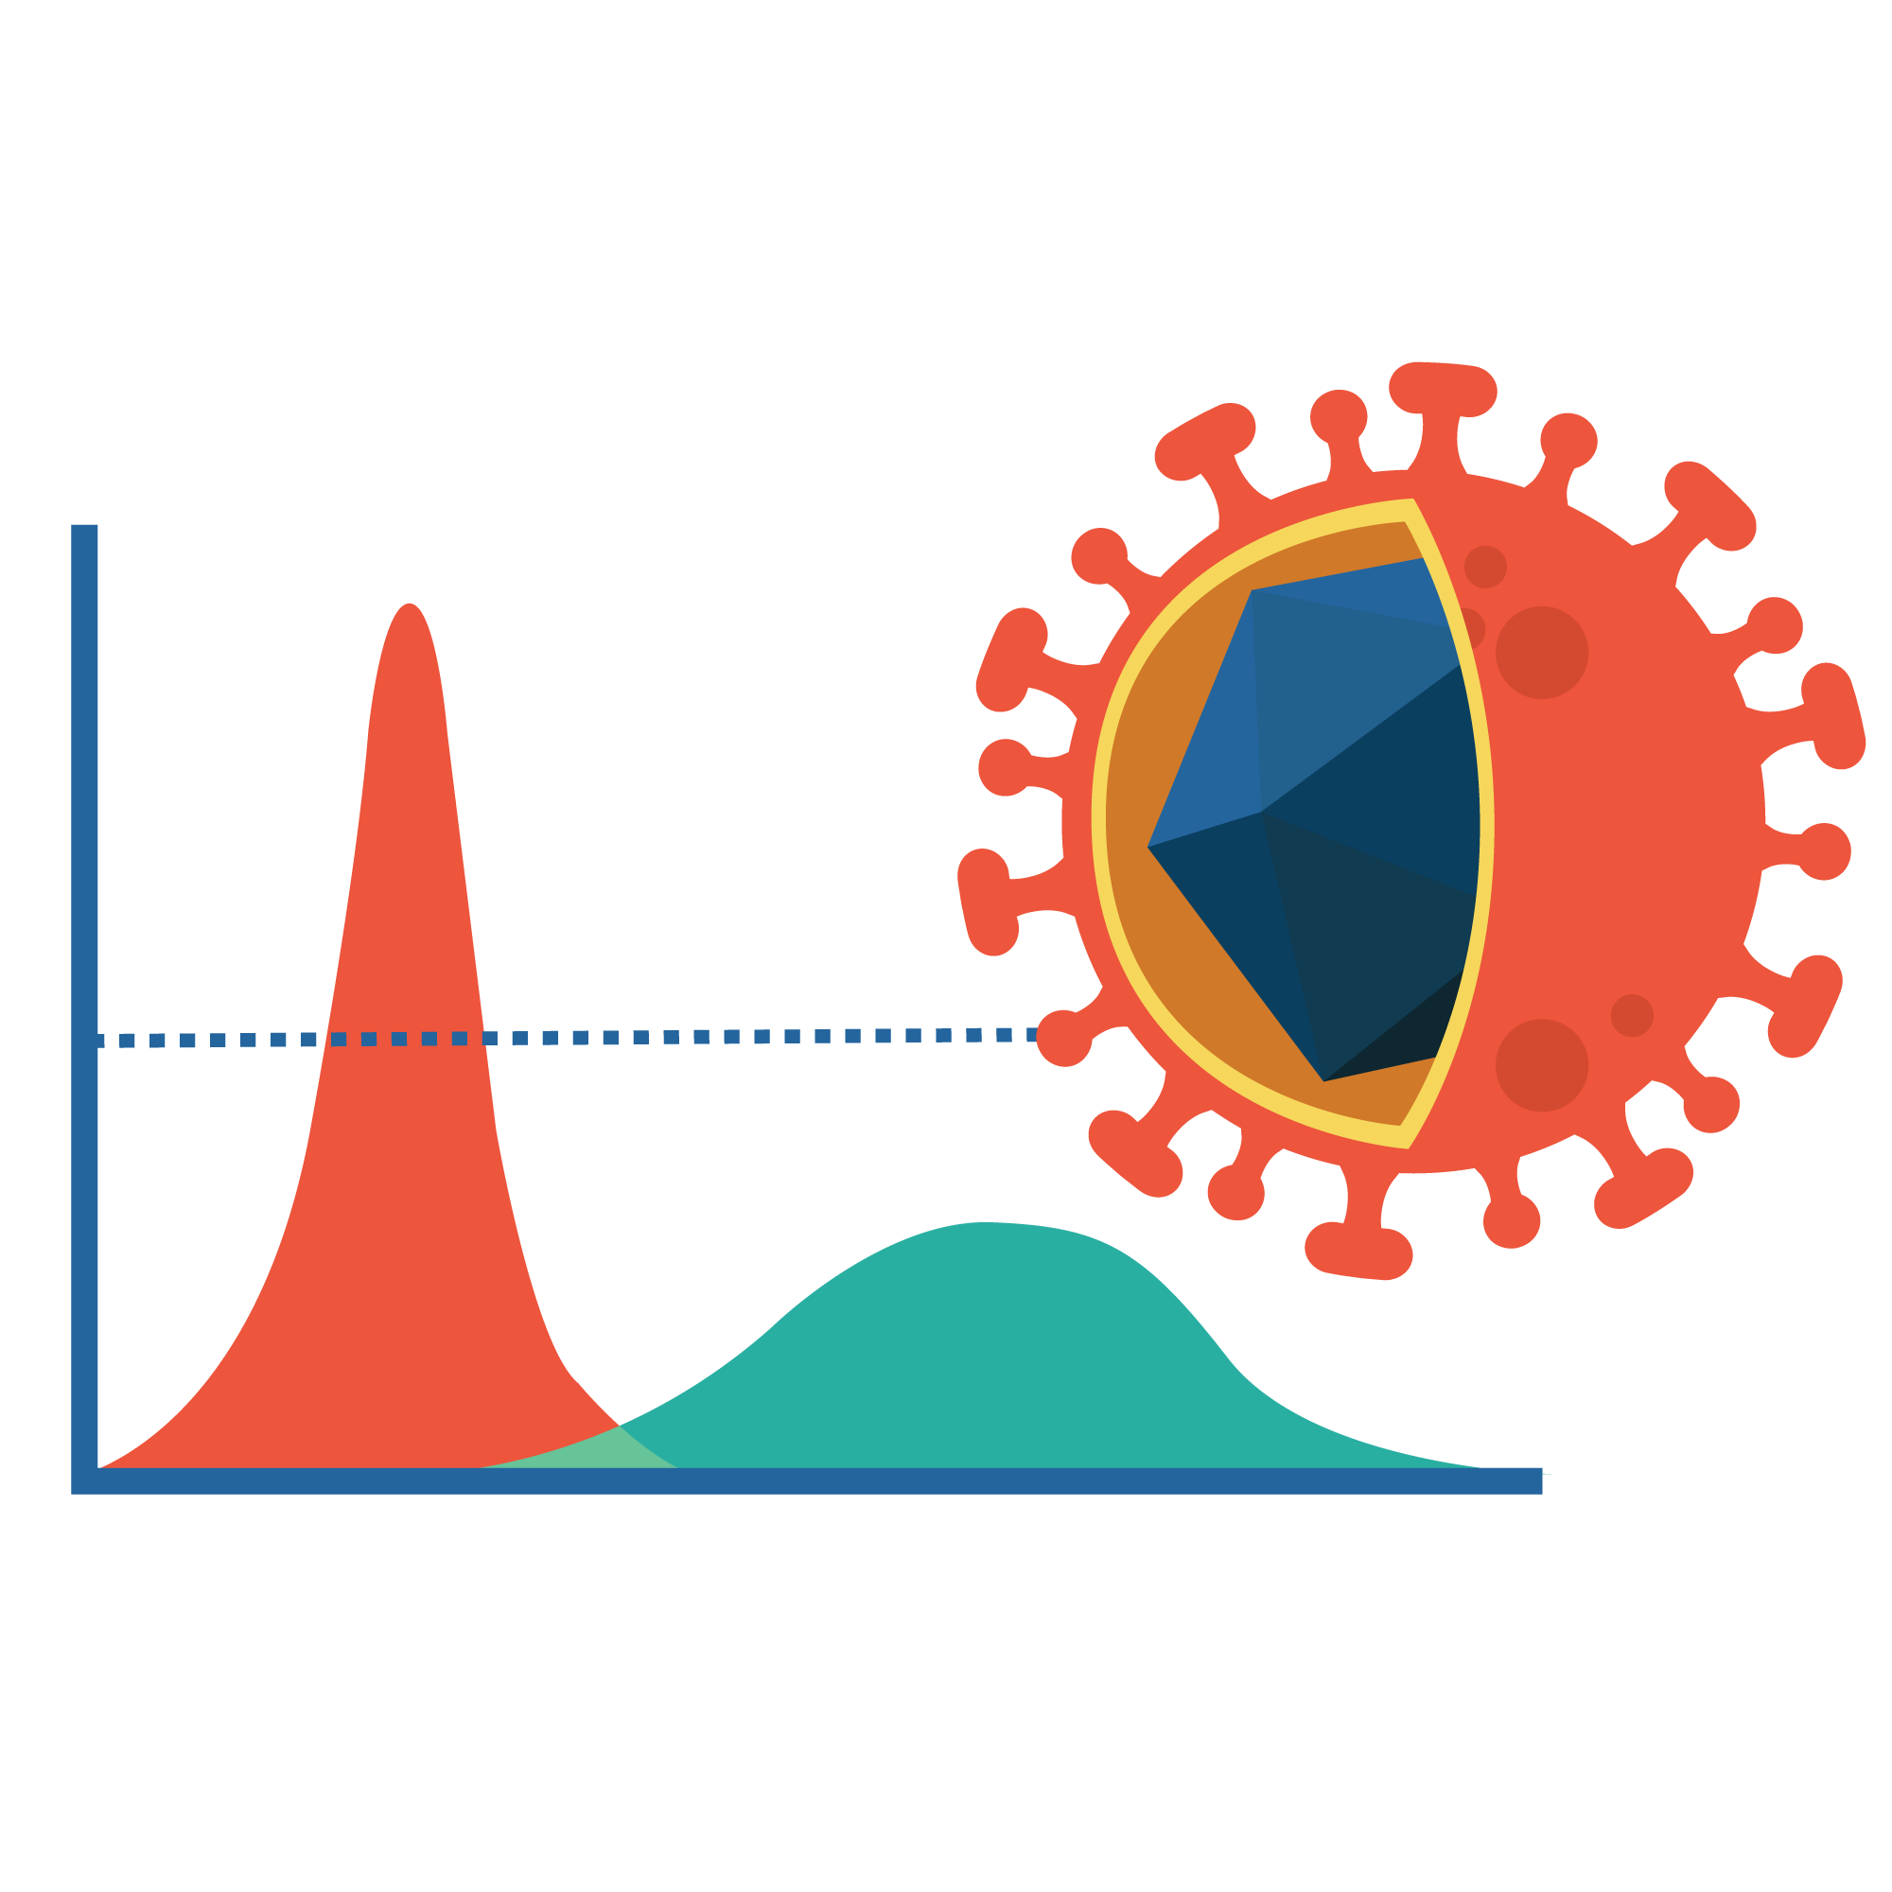



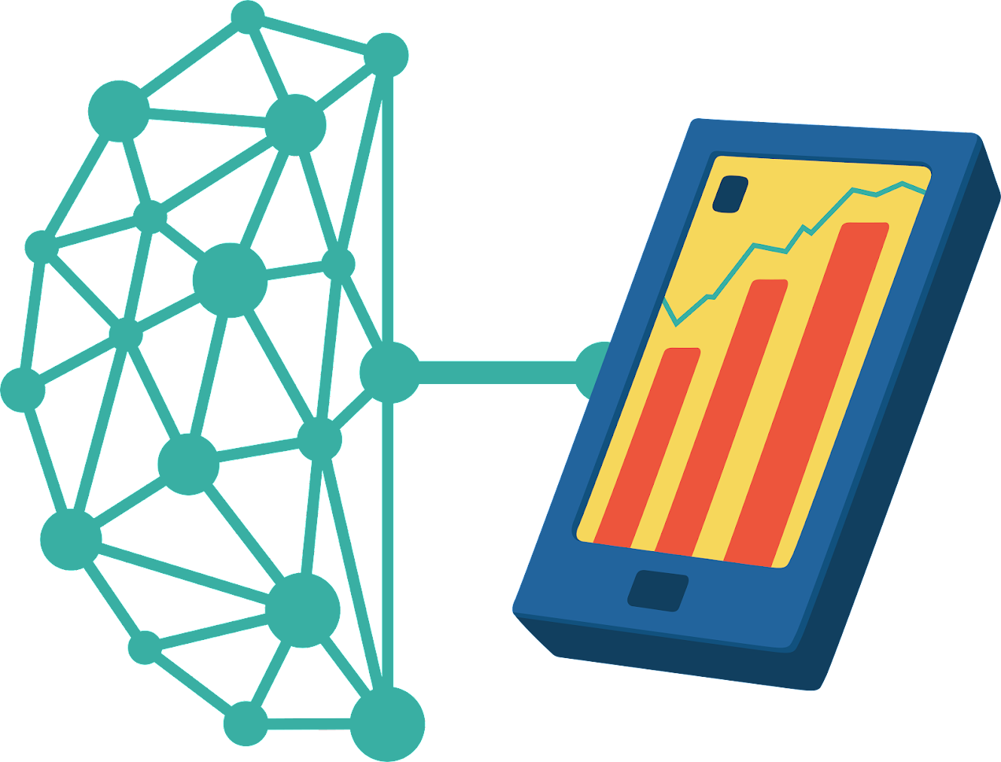
PCHRD HEALTH RESEARCH PRIORITIES
Tuklas Lunas
(Drug discovery and development)
Diagnostics
Disaster Risk Reduction and
Climate Change Adaptation
Mental Health
Functional Foods
Re-emerging and
Emerging Infectious Diseases
Nutrition and
Food Quality
and Safety
OMIC Technologies for health
Biomedical Devices Engineering for Health
Digital Frontier Technologies for Health

Slide 8
Digital Health Program
The PCHRD R&D Program Information, Communication and Technology for Health (ICT for Health) has been expanded to the Digital and Frontier Health Technologies Program (Digital Health Program).
It aims to contribute to the attainment of an efficient, equitable, and affordable healthcare system and patient management of R&D-based innovative healthcare interventions that makes use of artificial intelligence and taps on emerging fields of information and communication technologies in digital health.
Digital Frontier Technologies for Health
04

Slide 9
Research Priority Areas
Digital Health refers to innovations and technologies that makes use of connectivity and interoperability platforms and softwares which can be used in healthcare interventions to prevent and/or manage diseases and other health risks, promote wellness, and improve overall quality of life.
Frontier Health Technologies, on a broader scope, refers to advanced and revolutionary solutions and innovations which makes use of artificial intelligence, big data, machine/deep learning, and other elements of the 4th Industrial Revolution to develop a technology-driven future for the medical/healthcare sector.
1
2
05
Notes:
Digital Health - This may also include the use of information and communication technologies in medicine and health systems, and other scope such as telehealth/telemedicine, mobile health, wearable devices, medical sensors, etc.
Frontier Health Technologies, on a broader scope, refers to advanced and revolutionary solutions and innovations which makes use of artificial intelligence, big data, machine/deep learning, and other elements of the 4th Industrial Revolution to develop a technology-driven future for the medical/healthcare sector.
32.39M TOTAL AMOUNT OF FUNDING IN 2022
the program is expected to process proposals including the following: 1) Artificial intelligence in developing screening and diagnostic software, for enhanced efficiency of healthcare service delivery, and for information dissemination; and 2) Big data analytics (or health data analytics) to influence evidence-based decisionmaking, or policy translation for targeted health intervention, with targeted registries as an output, and for information dissemination purposes.

Slide 10





Intellectual Property and Technology Management
Programs and services that will move your health technology from the lab to market launch
pchrd.dost.gov.ph
03
Notes:
The Council recognizes the difficulty of bringing R&D outputs to the market, especially for those related to health. To boost technology transfer, our Intellectual Property and Technology Management or IPTM unit implements programs and services to support the market launch of health research outputs.
Under the IPTM, we offer three programs: the IPROTECH, Teki in Health, and the Startup Research Grant (SGP).

Slide 11

Assistance Given:
Development of an institutional IP policy
Establishment of institutional technology transfer processes
Securing IP protection
Securing IP valuation and FTO reports
Created to address the intellectual property-related needs of health researchers or innovators
Drafting licensing agreements
04
Notes:
The Intellectual Property Protection and Management of Health Research Outputs Program or IPROTECH was created to address the intellectual property-related needs of health researchers or innovators. Under this program, assistance for the following activities:
Development of an institutional IP policy;
Establishment of institutional technology transfer processes;
Securing IP protection;
Securing valuation and freedom to operate (FTO) reports; and
Drafting licensing agreements.

Slide 12
Who can apply for the IPROTECH?
1
Regional
Health Research and Development Consortia Member Institution
2
Institutions who have generated health technologies that were funded, supported, or monitored by DOST-PCHRD
05
Notes:
The following may avail the services under IPROTECH:
Regional Health Research and Development Consortia (RHRDC) members; and
Institutions who have generated health technologies that were funded, supported, or monitored by DOST-PCHRD.

Slide 13

There are three types of assistance:
In assisting researchers:
Business Incubation for Health Research Technologies
In assisting health research institutions
Technology Transformation and Empowerment of Knowledge Generators and Innovators
Community-based incubation for delivery of healthcare innovations
HeaRTNovation Hubs: Innovation hubs for health research technologies
Created to assist researchers and research institutions who plan to have their health or health care innovations utilized
08
Notes:
We also have the or TEKI in Health Program which provides assistance to researchers and research institutions who plan to have their healthcare innovations utilized through community adoption or creation of spin-off companies.
There are three types of assistance:
Business Incubation for Health Research Technologies;
Community-based incubation for delivery of healthcare innovations; and
The HeaRTNovation Hubs, technology incubation/innovation hubs for health research technologies, which we launched with the support from the NEDA.

Slide 14
HeaRTNovation Hubs: Innovation hubs for health research technologies
aims to provide an environment that will support innovators from health institutions in developing their technologies and in linking them with potential partners for eventual transfer, adoption, or commercialization
Filipino-owned hospitals, academic or health institutions, and member institutions of Regional Health Research and Development Consortia (RHRDCs) may apply for the grant
Ongoing capacity building of health innovation officers and proposal development
09
Notes:
The HeaRTNovation Hubs or the H-hubs was launched to provide an environment that will support innovators from health institutions in developing their technologies and in linking them with potential partners for eventual transfer, adoption, or commercialization. Filipino-owned hospitals, academic or health institutions, and member institutions of Regional Health Research and Development Consortia (RHRDCs) may apply for this grant.

Slide 15
Technology Transformation and Empowerment of Knowledge Generators and Innovators
Business Incubation for Health Research Technologies
Community-based incubation for delivery of healthcare innovations
HeaRTNovation Hubs: Innovation hubs for health research technologies
Customer discovery assistance;
Rapid prototyping and testing;
Business Plan/Business Model Canvas (BMC) Preparation;
Entrepreneurial training/counseling;
Legal Counseling;
Sponsorship to pitching events; and
Introduction to networks.
Entrepreneurship mentoring;
Documentation of best practices;
Legal counseling;
Business Development and marketing assistance; and
Introduction to networks.
HeaRTNovation hubs establishment assistance;
Portfolio assessment;
Customer discovery assistance;
Entrepreneurial training;
Rapid prototyping and testing;
Business Plan/Business Model Canvas (BMC) Preparation;
Advisory on regulatory procedures (for health product registration);
Advisory on Health Technology Assessment (HTA);
Intellectual Property Counseling; and
Introduction to networks.
Notes:
These are the services being offered under each teki hub.
Business incubation-based hubs may avail of the following:
Customer discovery assistance;
Rapid prototyping and testing;
Clinical testing;
Business plan/Business model canvas preparation;
Advisory on regulatory procedure;
Entrepreneurial training;
Legal counseling;
Space rental; and
Introduction to networks.
On the other hand, community-based hubs may avail of the following services:
Entrepreneurship mentoring;
Documentation of best practices;
Legal counseling;
Business development and marketing assistance; and
Introduction to networks
Lastly, H-hubs may avail of the following:
HeaRTNovation hubs establishment assistance;
Portfolio assessment;
Customer discovery assistance;
Entrepreneurial training;
Rapid prototyping and testing;
Business Plan/Business Model Canvas (BMC) Preparation;
Advisory on regulatory procedures (for health product registration);
Advisory on Health Technology Assessment (HTA);
Intellectual Property Counseling; and
Introduction to networks.

Slide 16

For R&D activities focused on:
Overcoming R&D roadblocks
Strengthening intellectual property
Establishing initial market traction
Refining business model
Aims to support research activities of startups in the health sector
Scaling up production
06
Notes:
Republic Act No. 11337 or the Innovative Startup Act aims to strengthen the Philippine startup ecosystem. In support of the operationalization of this Act, the DOST-PCHRD launched the Startup Research Grant or SGP, which provides funding to the R&D activities of eligible startups for the improvement of their core technology, enhancement of their product's market potential, and the refinement of their existing products, processes, or services. Eligible startups should be at least 1 up to 7 years SEC-registered, Filipino-owned and has health products/services in their business portfolio.

Slide 17

1
Innovative Tools for Improved Health Care Provider-Patient Experience
3
Innovative Technologies for
Health Care
Facilities
CALL SCOPE
2
Systems for Health Service Delivery
Systems/tools that will improve health care provider-patient experience (e.g. appointment systems, specialist search, resource mapping/tracking, homecare monitoring)
Technologies for health facilities, such as biomedical devices, diagnostic kits, supply chain management, smart and resilient health facilities
Efficient and inclusive health service delivery systems such as online referral systems, ePharmacy, teleconsultations
Notes:
The grant covers:
Innovative Tools for Improved Healthcare Provider-Patient Experience - Systems/tools that will improve health care provider-patient experience (e.g. appointment systems, specialist search, resource mapping/tracking, homecare monitoring)
Systems for Health Service Delivery - Efficient and inclusive health service delivery systems such as online referral systems, ePharmacy, teleconsultations; and
Innovative Technologies for Healthcare Facilities - Technologies for health facilities, such as biomedical devices, diagnostic kits, supply chain management, smart and resilient health facilities.

Slide 18
Eligibility Requirements
STARTUP
RESEARCH TEAM
Filipino-owned
SEC-REGISTERED
Legal personality to issue receipt
At least 1 year in operation
Provide 20% counterpart funding
Health-related products and/or services
No outstanding accountabilities with DOST
Filipino Project Leader
Capable to conduct R&D
No ongoing project with
DOST
No pending administrative or criminal cases
No outstanding accountabilities with DOST

Slide 19
Benefits to Startups
Access to the DOST/Council’s GIA Program
Access to follow-up financial assistance for scale-up and expansion offered by other DOST offices and agencies
Access to the science and technology network of the DOST and the Philippine National Health Research System
Access to DOST Testing Laboratories and Research Facilities

Slide 20






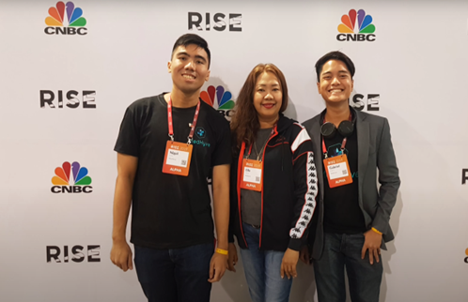



8 SGP GRANTEES
PhP 33.87M
Notes:
To date, the Council has already supported a total of six (6) health startups and has released a total of PhP 32.3M grant fund.
Please note that grantees of the SGP should be at least 1 year SEC-registered, Filipino-owned and have health technologies as their product.

Slide 21
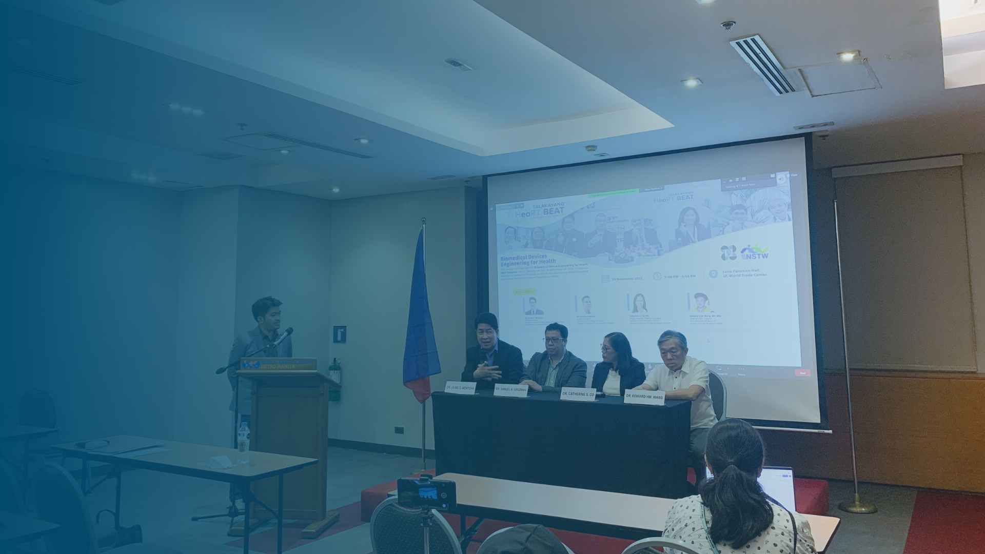
Research Dissemination
Assistance to researchers who intend to get their research results communicated to target users
pchrd.dost.gov.ph
11
Notes:
The Council also puts emphasis on the dissemination of health research outputs among target users. In line with this, assistance is given to researchers who intend to communicate their research outputs.

Slide 22
LOCAL
Support to Paper Presentation
Php 50,000.00 per project per year is granted for a presentation in a local scientific conference.
given to paper presentation of projects supported by DOST-PCHRD in scientific meetings locally and abroad
INTERNATIONAL
Only one paper per project per year will be supported for a presentation in an international scientific conference.
13
Notes:
Researchers who will present their projects in scientific meetings locally and abroad can also avail of funding support.
For local presentations, only Php 50,000 per project per year can be granted. For international presentations, only one paper per project per year will be supported.

Slide 23
STUDENT ORGANIZATIONS
Support to Scientific Event
Student organizations recognized by its institution may apply for this service with a maximum amount of Php 100,000.00 subject to evaluation.
covers activities such as seminars, conferences, fora, and workshops for dissemination of health research aligned with the latest priority areas of DOST-PCHRD
INSTITUTIONS
Other institutions may apply for this support subject to evaluation.
14
Notes:
Scientific events such as seminars, conferences, fora, and workshops can also be supported. The topic of the events should be aligned with the priority areas of the DOST-PCHRD.
Student organizations who are recognized by their institutions may apply for a maximum amount of Php 100,000 subject to evaluation. Meanwhile, institutions may apply also subject to evaluation.

Slide 24
JOURNAL PUBLICATION
publication of article in peer-reviewed journal derived from research that is aligned with the current priority areas of DOST-PCHRD
Support to Publication
MATERIALS DEVELOPMENT
provides support to journal publication, materials development, and printing of publications.
development and printing of publications including but not limited to books and monographs derived from DOST-PCHRD-supported R&D projects
PRINTING
printing of publications derived from health research aligned with the current priority areas of DOST-PCHRD
15
Notes:
We also provide support to publication for projects that are aligned with our research priority areas:
Journal publication - publication of articles in peer-reviewed journals;
Materials development - development of publications such as books or monographs; and
Printing of publications

Slide 25
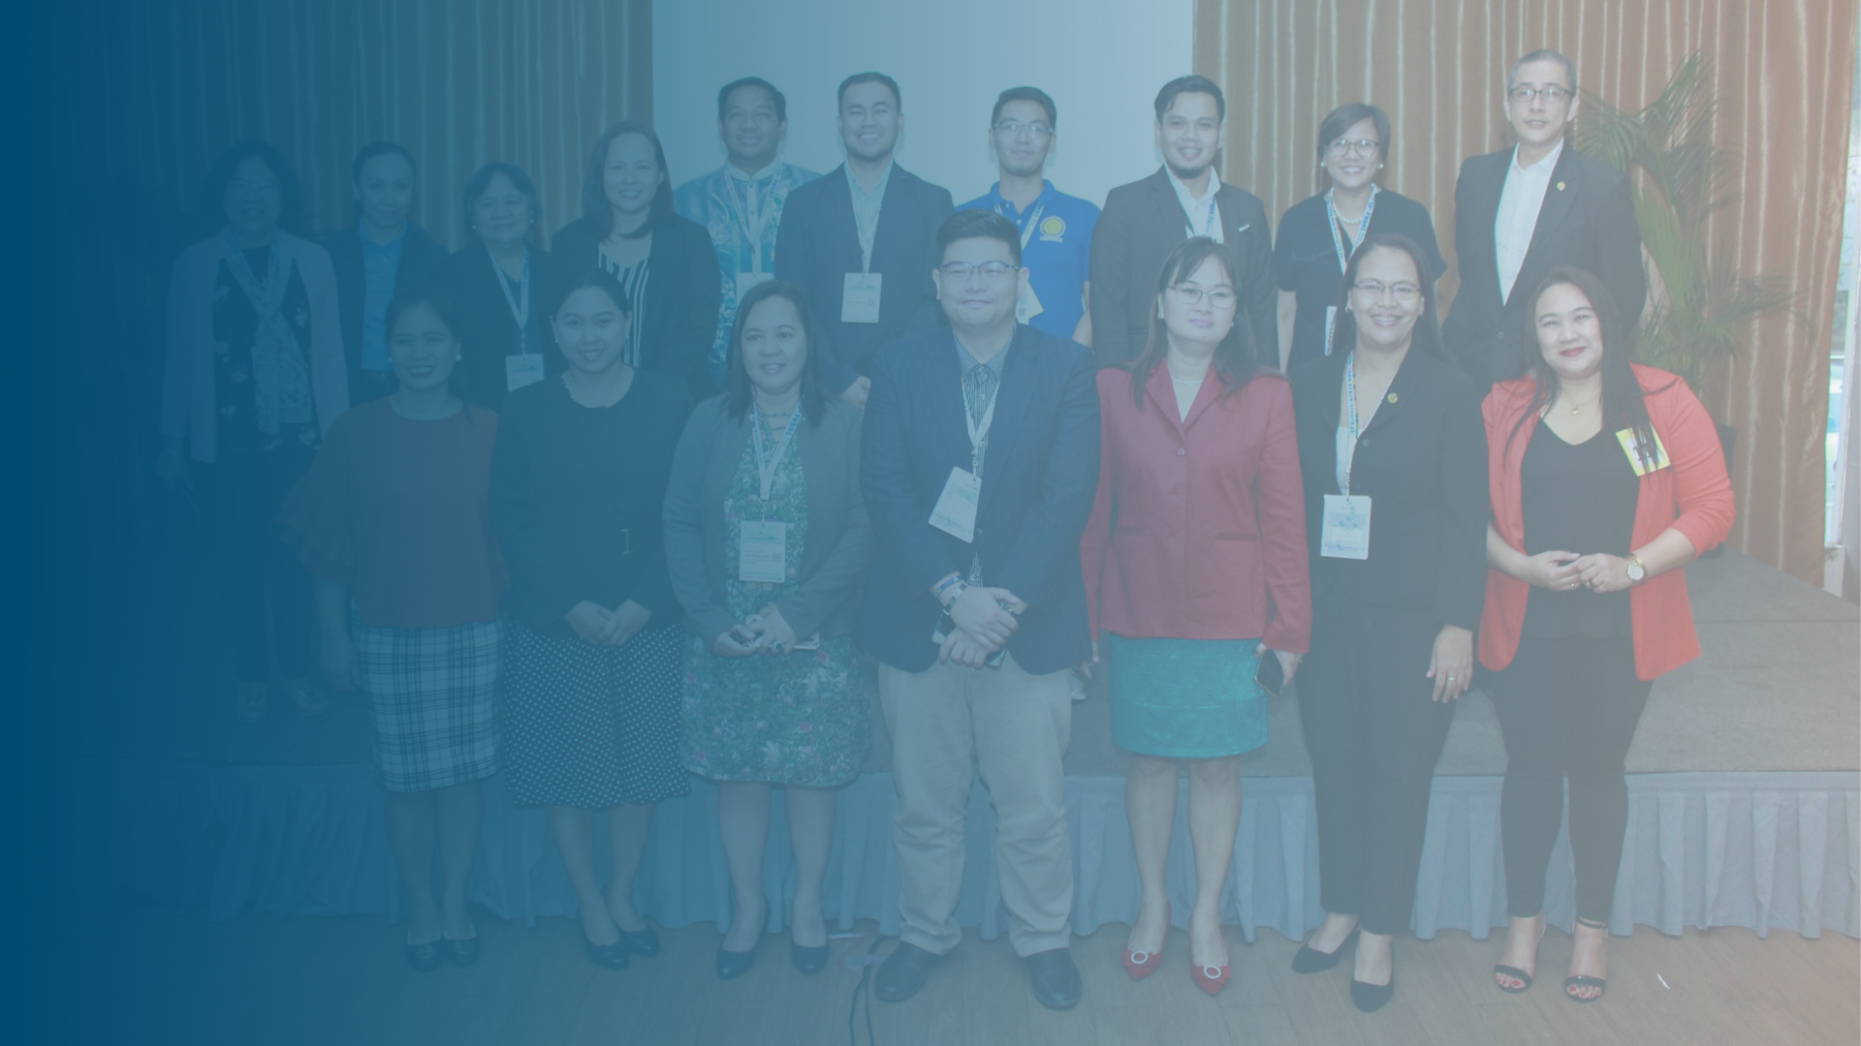
Translation of Research to Policy
To ensure that research is utilized for evidence-based and informed policymaking
pchrd.dost.gov.ph
16
Notes:
To ensure that research is utilized for evidence-based and informed policymaking, we also provide support to the translation of PCHRD completed research to policy, for those with policy implications.

Slide 26
1
Provide policy inputs and recommendations
2
Facilitate development of policy instruments from DOST- PCHRD-assisted projects
3
Conduct policy dialogues and congress briefings
4
Conduct capacity building activities on research to policy translation
5
Provide grants for translation of research to policy
17
Notes:
To facilitate this, we:
Provide policy inputs and recommendations on draft legal instruments;
Facilitate development of policy instruments for PCHRD-funded completed projects with policy implications;
Conduct policy dialogues and congress briefings
Conduct capacity building activities on research to policy translation
Provide grants for translation of research to policy for PCHRD completed projects.

Slide 27
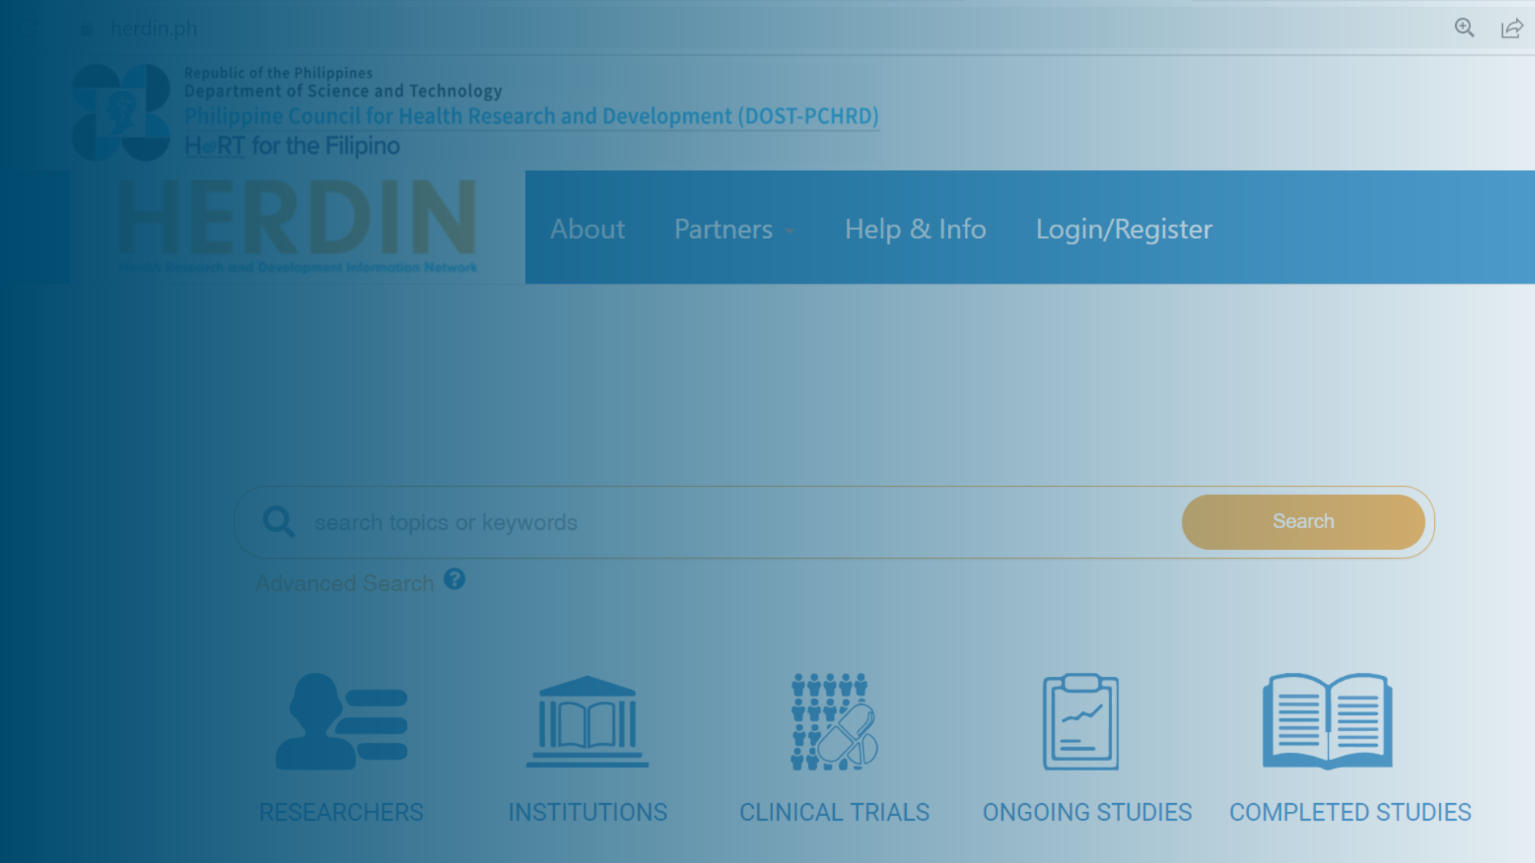
Information Products and Services
To enable wider dissemination and access to health research information
pchrd.dost.gov.ph
19
Notes:
Lastly, we also offer information products and services to enable wider dissemination and access to health research information.

Slide 28

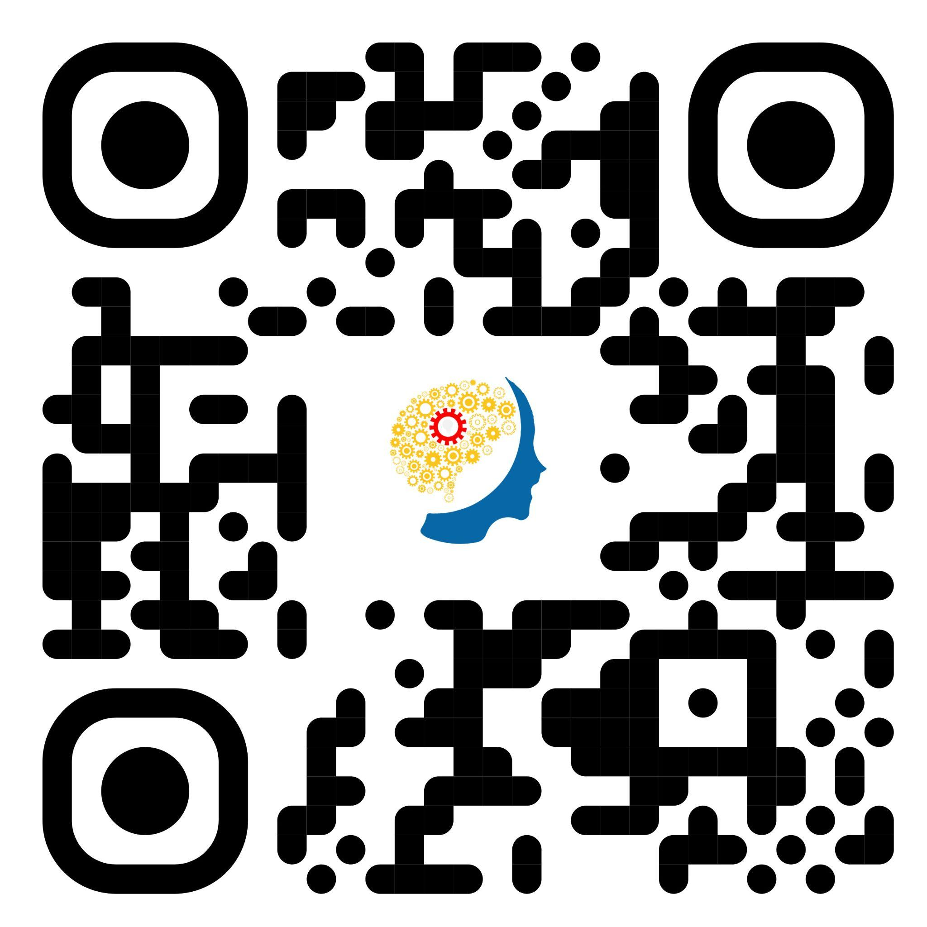
Email Address:
info@pchrd.dost.gov.ph
Share your
Partner with us!
Website:
pchrd.dost.gov.ph
Facebook:
/dostpchrd
21
Notes:
These are only examples of our programs.
I hope that through my presentation today, more researchers will be encouraged to share their heart for the Filipino people by innovating with us.
If you have further questions or if you are interested to avail our services, you may reach us through the following links.

