Slide 1
Implementing HL7 as Part of the National Health Data Repository Framework
Jovita V. Aragona
Senior Vice President & CIO
PhilHealth
25 August 2023

Slide 2
Republic Act 11223 – Universal Health Care Act
Section 31, Republic Act 11223 “Universal Health Care Act”: All public and private, national and local health-related entities shall be required to submit health and health-related data to PhilHealth including, among others, administrative, public health, medical, pharmaceutical and health financing data.
Section 31.1, Implementing Rules and Regulations of Republic Act 11223: “For the purpose of these Rules, health and health-related data collectively refer to a set of specific variables or parameters that relates to individual and population health and well-being, including, but not limited to, administrative, public health, medical, pharmaceutical and health financing data. Such data shall be submitted to PhilHealth by all health-related entities through a National Health Data Repository, in compliance with guidelines that shall be jointly developed by DOH and PhilHealth, in consultation with the Department of Information and Communications Technology (DICT) and the National Privacy Commission (NPC)

Slide 3
What is a National Health Data Repository (NHDR)?
Single point-of-submission, single source of truth, evidenced-based, and authoritative repository of the country’s health and health-related data in a central database.
Data platform for a unified, end-to-end central repository of all health and health-related data.
Serves as the basis for health policy and standards; health program planning and implementation; decision-making; development of health programs, interventions, and services; health systems strengthening; and performance monitoring and evaluation.

Slide 4
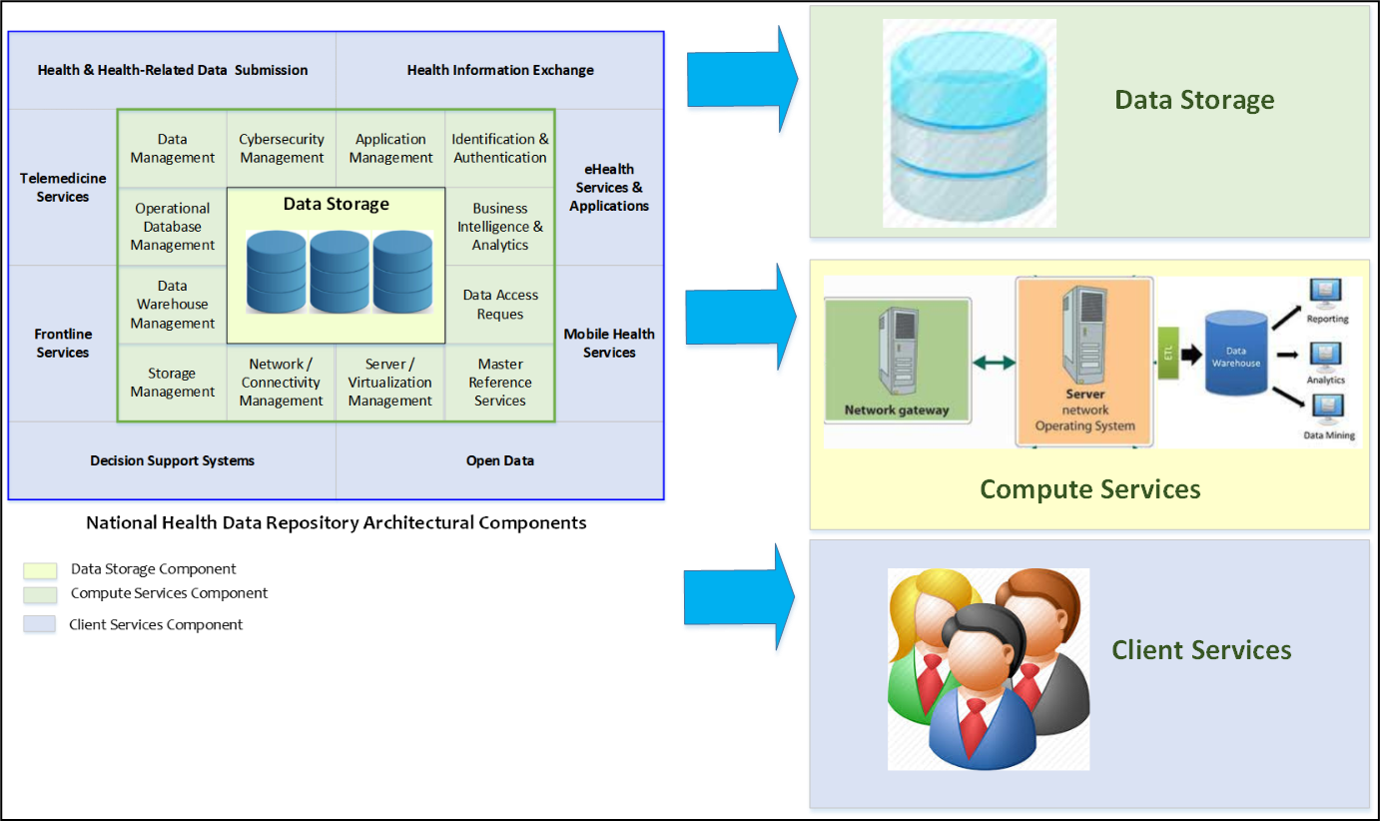
Is the NHDR just a storage of health and health-related data?
Architectural Components
The NHDR is not just a storage of health and health-related data.

Slide 5
Architectural Components

Slide 6
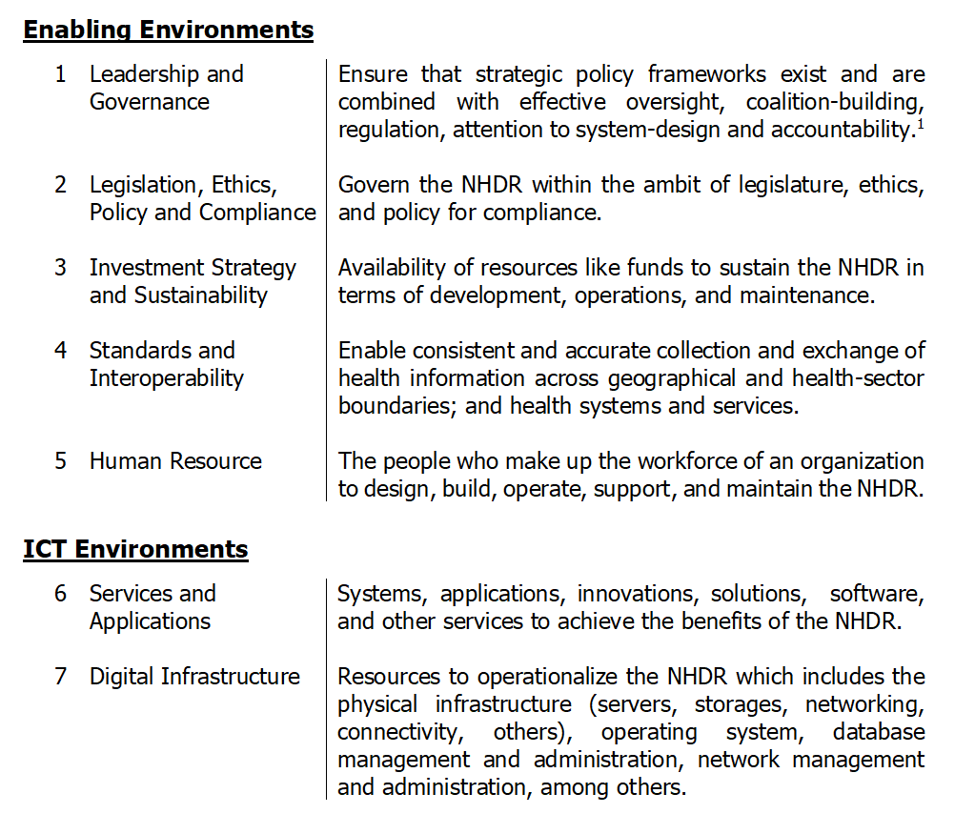
NHDR Framework
Seven Building Blocks

Slide 7
Dataset Submission
Who are going to submit data to the NHDR?
What kind of data are to be submitted to the NHDR?
What data standards are to be used?
How will the data be submitted to the NHDR?

Slide 8
1. Who are going to submit data to the NHDR?
Health-Related Entities include but not limited to, health care facilities, national and local government agencies involved in the provision of health services, and agencies involved in the collection of health data.

Slide 9
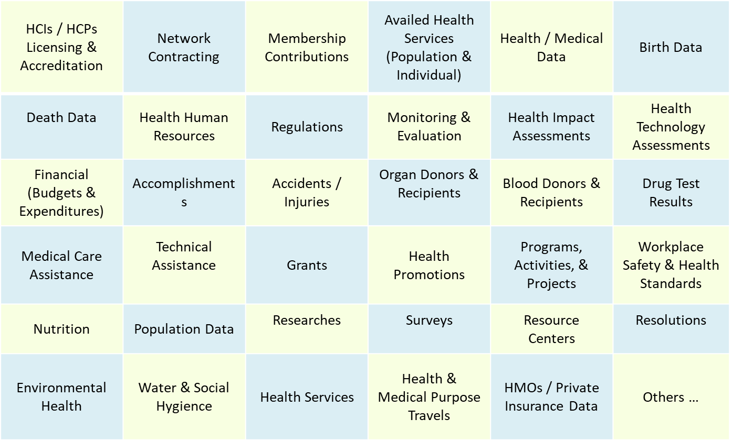
2. What kind of data are to be submitted to the NHDR?
Sample Health & Health-Related Data
Health & Health-Related Data collectively refers to a set of specific variables or parameters that relates to individual and population health and well-being, including but not limited to administrative, public health, medical, pharmaceutical and health financing data.

Slide 10
3. What data standards are to be used?
All health and health-related data that will be submitted and processed through the NHDR shall conform to the standards and rules set forth under this policy, the DOH and PhilHealth Joint Administrative Order # 2021-0002 on the Mandatory Adoption and Use of National Health Data Standards for Interoperability, and other subsequent issuances.
Examples:
Data Contents of Electronic Health Record
Semantic & Syntactical: Diseases = ICD-10; Client Identifier = PhilHealth ID Number; Clinical Health Terminology = SNOMED C; Date and Time = ISO 8601; Drug Classification and Dosing = ATC DDD 2015; Drug Establishment Identifier = DOH-FDA; Geographic Areas = 2015 PSGC; Health Facility Identifier = DOH-NHFR; Medical Imaging & Communication = DICOM 2011; Medical Laboratory Results & Clinical Observations = LOINC 2.36; Medical, Surgical, & Diagnostic Procedures = CPT 2011
Structural and System Standards: Document Sharing = Cross Enterprise Document Sharing (XDS); Messaging Standards = HL7 FHIR

Slide 11
Mandatory National Health Data Standards for Interoperability
DOH & PhilHealth Joint Administrative Order No. 2021-0002
Mandatory Adoption and Use of National Health Data Standards for Interoperability
Dated 21 April 2021
Eliminate duplication of data collection.
Establish data consistency and improve data quality.
Strengthen coordination and good governance between DOH & PhilHealth.

Slide 12
Mandatory National Health Data Standards for Interoperability
Basis for a common data model that is essential for the integration of a multitude of fragmented data sources that currently provide defined or defined data for the health/UHC indicators.
Reference for sharing of data between province-wide and city-wide health systems especially with reporting of performance against UHC indicators.
Reference for sharing patient records accessible throughout the health system while supporting an accurate, sensitive, and timely epidemiologic surveillance system.
Fast Healthcare Interoperability Resources

Slide 13
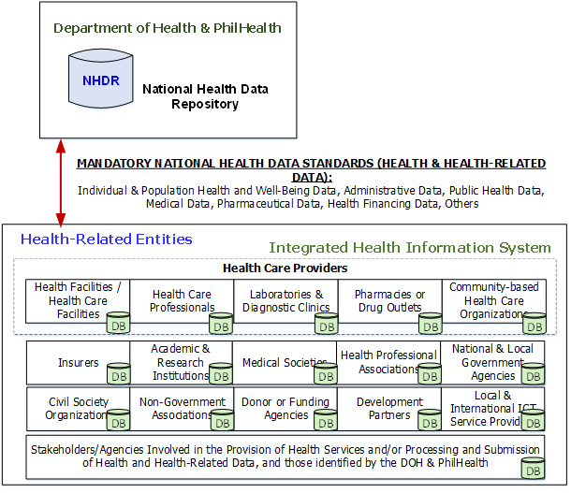

4. How will the data be submitted to the NHDR?
Section 36 of RA 11223: “All health service providers and insurers shall each maintain a health information system consisting of enterprise resource planning, human resource information, electronic health records, and an electronic prescription log consistent with DOH standards, which shall be electronically uploaded on a regular basis through interoperable systems.”

Slide 14
Centralized Data Submission Model
Dataset Submission
(Centralized Model)
Dataset Submission
(Decentralized Model)

Slide 15
Mandatory National Health Data Standards – Health Record
DOH & PhilHealth
Processed Data
Transmit Processed Data to the NHDR
Examples:
DOH licensing data, PhilHealth Accreditation Data

Slide 16
P
R
O
C
E
S
S
F
L
O
W
S

Slide 17
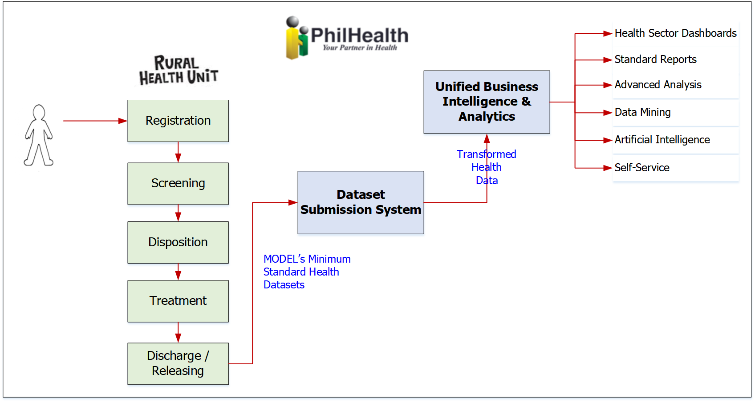
P
R
O
C
E
S
S
F
L
O
W
S

Slide 18
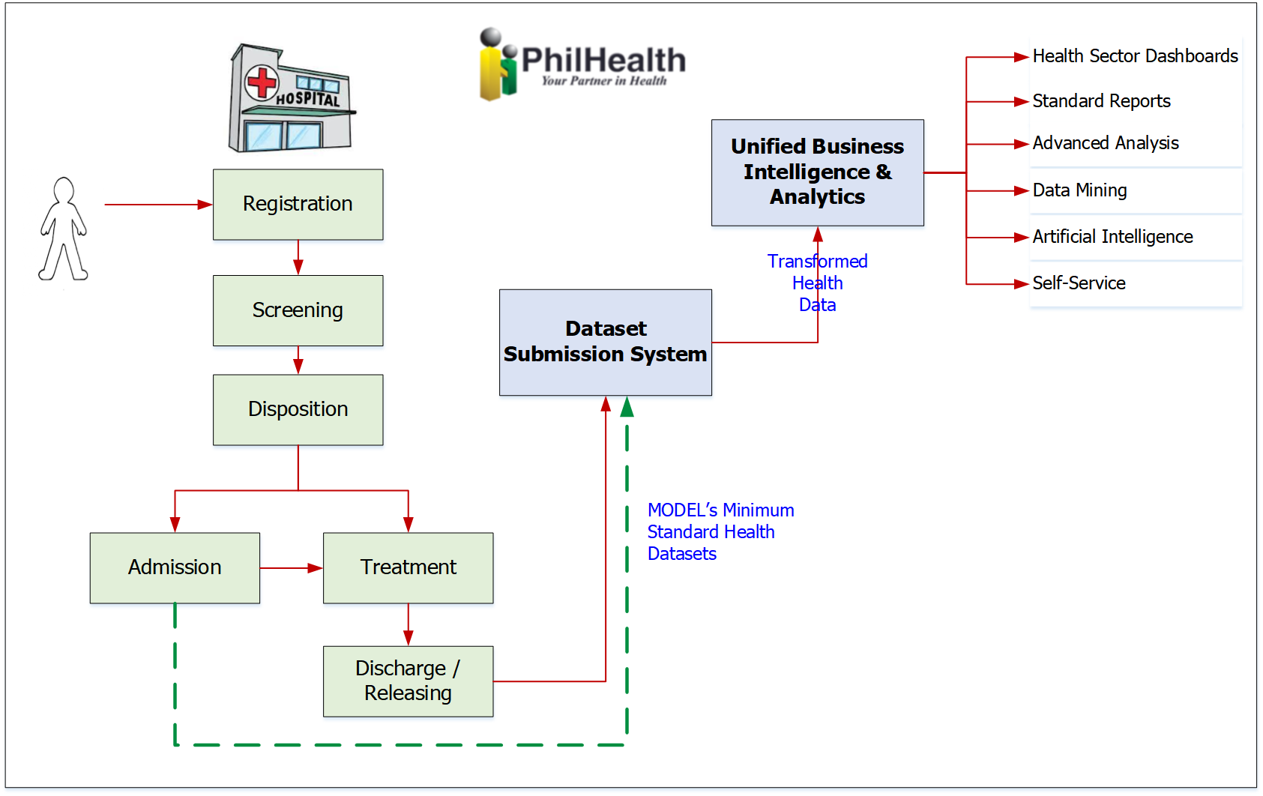
P
R
O
C
E
S
S
F
L
O
W
S

Slide 19
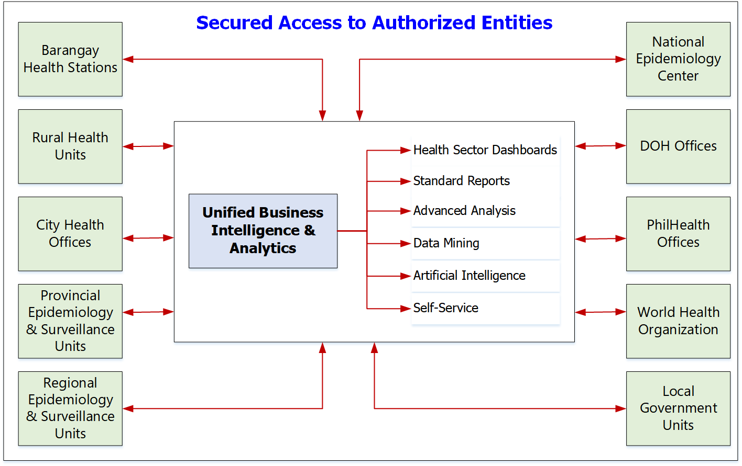
S
E
C
U
R
E
D
A
C
C
E
S
S

Slide 20


Business Intelligence & Analytics
Place Analysis:
Where are the rates of diseases highest or lowest?
Where did the disease occur?
Which area has the highest rate of disease?
Statistical Analysis:
Incident Rate – Morbidity
Crude Death Rate
Neonatal, Infant, and Maternal Mortality Rate
Crude Birth Rate
Surveillance:
Is there an increase in the number of cases above the threshold?
Time Analysis:
When did the disease occur?
What is the trend or pattern of the disease?
Integration:
How many of the death cases of children are fully immunized?
How many of the maternal mortality cases received complete vaccination during pregnancy?
Person Analysis:
What age and/or gender are getting the most of the disease?
Self-service BI:
Can I access the data and create a set of BI dashboards on my own as a Program Manager to do further analysis, with minimal IT intervention?

Slide 21
What are some of the expected benefits of the NHDR?
DOH and PhilHealth
High HCI Data Quality Levels w/ Leading-Edge Global Health Data Standard (FHIR)
Trusted & Timely Partner Data (e.g. Birth & Death Data w/ Automated Data Flow from PSA)
AI-Optimized Platform for Advanced Analytics
Smooth Flow-Submission of Data w/ Best-Practice Healthcare Technologies
Benefits of Cloud & Elastic IT Infra Managed by Outsourced IT Providers
HCI & Partner Access to Data & Reports
DOH and PhilHealth to Focus on Core-Competencies
Shift of DOH and PhilHealth IT Role to Service Management

Slide 22
What are some of the expected benefits of the NHDR?
Clients/Patients
Improve the ability of clients to access health care services
Enable management of one’s complete health record
Support early detection and treatment of preventable communicable and non-communicable diseases.
Improve care coordination
Reduce costs like repeated laboratory tests
Healthcare Providers
Improve access to health information at the point of care
Improve exchange of patient information with other healthcare providers
Monitor and track their patients more effectively
Reduce paperwork

Slide 23
What are some of the expected benefits of the NHDR?
Health/Medical Researchers
Greater access to evidence-based information
Improve access to networks and resources
Government
Improve determination on health action plans, issues, and challenges
Make informed decisions
Enhance analysis of disease patterns and trends
Deliver more reliable, responsive and timely health reporting
Health-related Businesses/Entities
Provide health content as a commodity
Facilitate research and development
Enable broad and cost-effective marketing for health products and services

Slide 24
Target Timeline
2022 | 2023 | 2024 | 2025 | 2026
 |  |  |  | Full Deployment
 |  |  | Phased Deployment
 |  | Development
 | Procurement – Outsourcing
Use Case Development | Use Case Development
Standards Setting

Slide 25
Thank You.

