Slide 1
Introduction to hl7
Enabling Interoperability of Health Information Systems
Raymond Francis R. Sarmiento, M.D.
Chair, HL7 Philippines
August 26, 2023

Slide 2
Disclaimer
All statements issued are those of the presenter alone.
This presentation does not necessarily reflect the position of the Philippine government or any of my other affiliations.

Slide 3
Disclosure
I declare no conflict of interest with any proprietary entity producing health care goods or services consumed by, or used on, patients, clinicians, or other consumers.
I declare no financial relationships with the manufacturer(s) of any commercial product(s) and/or provider(s) of commercial services.

Slide 4
Competing interests
Director, National Telehealth Center, University of the Philippines Manila – National Institutes of Health, Philippines
Chair, Health Informatics for Development Working Group, International Medical Informatics Association (IMIA)
Member, WHO Global Working Group on Regulatory Considerations on Artificial Intelligence for Health

Slide 5
Learning objectives
By the end of this presentation, the attendee should be able to:
Describe what HL7 is and its limitations;
Describe the timeline of events on HIE standards adoption and use;
Explain the importance of using a standard to facilitate health information exchange;
Define select HL7 terms, rules, common messages, and data types; and
Describe what happens given an HL7 message syntax and its content.

Slide 6
HL7 international
founded in 1987
an ANSI-accredited standards developing organization (SDO)
global authority on standards for interoperability of health information technology and deeply involved in worldwide efforts to improve healthcare through information technology
founding member of the Joint Initiative Council, an international council on global health informatics standardization that is committed to developing a single standard for a single purpose
has an agreement with the International Organization of Standardization (ISO) through which HL7 submits its ANSI-approved or Draft Standards for Trial Use (DSTU) standards directly to ISO for approval
Reference: https://bit.ly/2X3K5mw
Notes:
Many healthcare facilities have installed healthcare information technology; however these systems have been developed with proprietary vendor specifications. In recent years, there has been the need to share patient data. HL7 is a standards developing organization, as well as a comprehensive framework and related standards for the exchange of electronic health information. The mission of HL7 is to provide interoperability standards that improve care delivery, optimize workflow, reduce ambiguity and enhance knowledge transfer.

Slide 7
Limitations of hl7
The list below is some of the functionality that is not provided or supported:
  Security/Access Control – HL7 does not provide for the enforcement of a user’s security policies. In addition, HL7 does not specify a specific encryption method.
  Privacy/Confidentiality – HL7 does not address this issue and makes no assumption about how the data will be used at the source or destination of a message.
  Accountability/Audit trails – HL7 does not attempt to define possible transaction processing features needed in a user’s environment.
Notes:
It is important that everyone is aware of the scope of HL7 prior to implementing the standard, along the associated hardware and software. HL7 is not the “end all, be all” solution. It purposely does not address security and privacy. It is the responsibility of the sending and receiving facilities/applications comply with issues such as authentication, access control, encryption, etc. These are addressed in standards/regulations like National Institute of Standards and Technology (NIST) standard and The Health Insurance Portability and Accountability Act (HIPAA) to name a few.

Slide 8
The health standards timeline
HL7 v2
1980s - Today
CDA
2000s - Today
HL7 FHIR
2012 - Today
HL7 v3
1990s - Today
XDS
2000s - Today

Slide 9
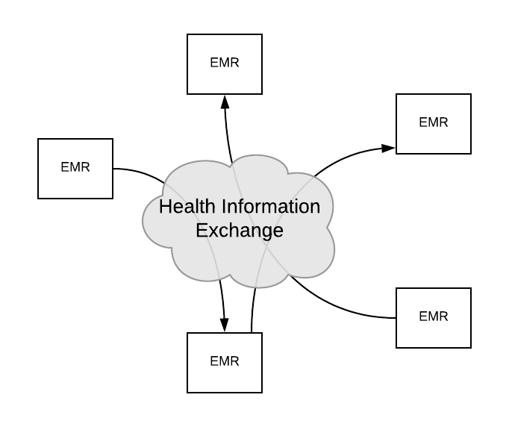
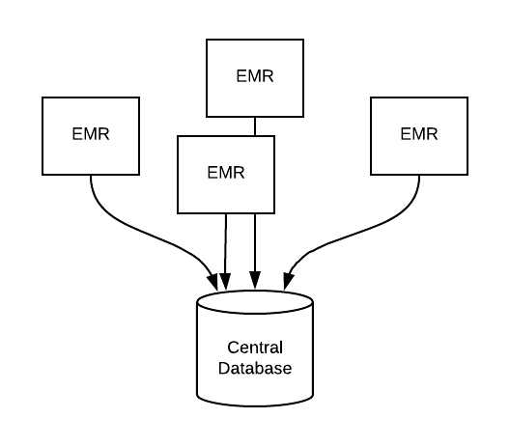
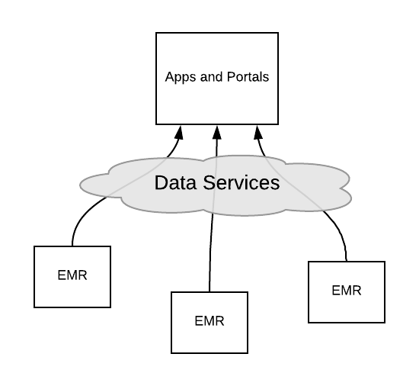
Healthcare Architecture Models
Document exchange (USA) | Central repository (Canada) | App model (SMART on FHIR)
Notes:
Health data is complicated
Healthcare workflows are complicated
Healthcare is about humans, and humans are complicated
There is no right way to build interoperable health systems

Slide 10
Building Interoperable EHRs
Document Exchange Model
Focuses on pushing documents from one provider to another
  Discharge Summary
  Continuity of Care Document
  Clinical Notes
  Letters and reports
Widely implemented in US (HIE)
Limited practical workflows (e.g. Referral)
Dominant standards: HL7 CDA, Direct, SOAP

Slide 11
Building Interoperable EHRs
Repository Model
Focuses on building a repository that sits between systems
  National/jurisdictional
  Within an organization
Repository collects data as it is produced, and makes it available on demand
Big implementations in Canada, Europe, Australia, etc.
Dominant standards: IHE XDS, HL7 v2 and v3

Slide 12
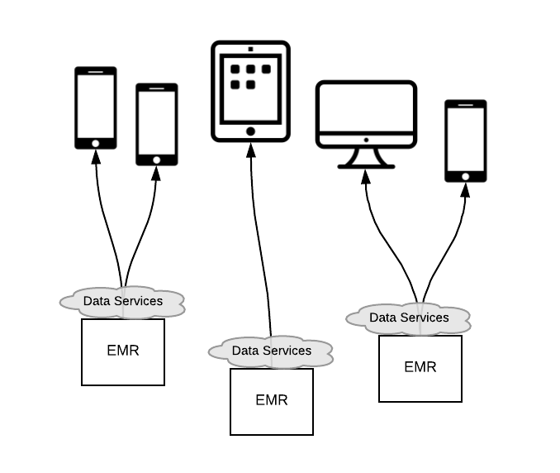
Building Interoperable EHRs
App Model
“Apps” are popular elsewhere, now they are coming to healthcare
Dominant standards: custom APIs, Open mHealth
  Typically purpose built with a narrow focus
  Reduced barrier to entry (every doctor seems to know an app developer)
Notes:
Smart on FHIR:
FHIR + OAuth + context information
Include other applications inside the EHR program
Transparent to the user
EHR needs to include the applications
Application provides FHIR interface for external integration

Slide 13
The Challenges
Data Models
Existing data models are too basic (PDF) or too complicated (CDA)
Data Transport
Different dominant standard for every purpose
Security
Often an afterthought, often only system-level
Workflow
Humans are complicated!

Slide 14
definitions
HL7 – an application protocol for electronic data exchange in healthcare environments
Data Type – a restriction on the contents of a field
Field – a string of characters defined by one of the HL7 data types
Field Separator – this character separates two adjacent data fields within an HL7 segment
Message – the atomic unit of data transferred between systems, consisting of segments in a defined sequence

Slide 15
definitions
Message Type – the specific purpose
Order – a request for material or service
Observation – performance of the service including result data
Segment – a logical grouping of data fields identified by three letter identification (MSH, PID, OBX, …)
Trigger Event – a real world event that initiates an exchange of messages. There is a one to many relationship between message type and trigger event.
Notes:
The key point on this slide is the trigger event. For example, when someone is brought into an emergency department and the decision is made to admit this person into the hospital, this real world event would initiate an electronic message being sent to admit this patient.

Slide 16
rules
Message Header Segment (MSH) is required and always first
There may be more than one type of segment and can be nested
  [ ] – Optional segment
  { } – Repeating segment
Optionality
R – Required | RE – Required but may be empty
O – Optional | C – Conditional depending on trigger event or some other field
X – not used with this trigger event | B – Backwards compatible with previous HL7 versions
Notes:
The Message Header Segment or MSH segment is required for all messages and defines the intent, source, destination, and specific attributes of the message, like delimiters and version number.
Messaging or Implementation Guides establish an agreement on what messages will be sent and received. One of the parameters that this document establishes is the optionality of segments and fields.

Slide 17
rules
Recommended message delimiters (field 2 of MSH)
There is a one to many relationship between message type and trigger event.
  ADT – (A01, A02, A03, A04, A05, …)
  Trigger events are specific to message type
Delimiter | Value
Field Separator | |
Component Separator | ^
Subcomponent Separator | &
Repetition Separator | ~
Escape Character | \
Notes:
Although you can specify different delimiter for segments and fields, it is highly recommended that you use the default value. Using an inappropriate value can have a negative effect on the content of a segment or an entire message.
In addition, a message type like Admission, Discharge and Transfer (ADT) messages can have many trigger events, for example A01 – Admit, A02 – Transfer, A03 – Discharge, A04 – Register, A05 – Pre-admit, etc.

Slide 18
rules
Acknowledgement messages are sent to indicate if receiving application was able to:
  Parse message
  Decode message
  Assume responsibility for the message
  Process message contents
  Successfully commit to storage
Notes:
Acknowledgement messages confirm the message is received and that it is in the agreed upon format. Otherwise, the receiving application will return an error message which will be sent to the sending application. Depending on the type of acknowledgement, the receiving application will do some or all of these functions.

Slide 19
rules
Null versus Empty
  Null is used when data is present but without a value “ “
  The field is left blank when there is no data
    Example: PID | | |54321|9876-3|Doe^John|”“|…
Receiving systems:
  Will ignore the data within segments, fields, etc that are present but not expected
  Will treat expected segments that are not present as a segment with all fields not present
  Will treat expected fields and components that are not included as not present
Notes:
Some fields are left blank when there is no data sent or expected. For fields where data is expected but the sender does not have a value, null is used.
As mentioned on the previous slide, applications confirm receipt. This happens through rules which are established to clarify how the receiving system will handle messages with expected and unexpected content.

Slide 20
Common message types
Type | Abbreviation
Admission, Discharge, Transfer | ADT
General Clinical Order Message | OMG
Imaging Order | OMI
Laboratory Order Message | OML
Pharmacy/treatment Order Message | OMP
General Order Message | ORM
Unsolicited Observation/Result | ORU
Unsolicited Vaccination Record Update | VXU
Notes:
There are dozens of message types. Listed here are some common message types. Please take note that there are message types for various situations. The message types in red are the ones associated with meaningful use. ADT messages will be used for surveillance messages. ORU messages will be used for electronic laboratory reporting messages, and VXU messages will be used for immunization messages.

Slide 21
Common data types
Type | Abbreviation | Definition
Coded Element | CE | Used to transmit codes and associated text
Composite Quality with units | CQ | Specifies the numeric quantity or amount, and the units in which the quantity is expressed
Extended Address | XAD | Specifies the address of a person, place, or organization plus associated information
Extended Person Name | XPN | Specifies the complete name of a person plus associated information
Numeric | NM | A number (integer)
String Data | ST | Any displayable/printable ACSII characters intended for strings less than 200 characters
Text Data | TX | Longer string data intended for display purposes
Time Stamp | TS | Specifies a point in time including time zone
Notes:
There are also dozens of data types. This list identifies more common data types. The coded element data type is used for capturing data that represent coding systems like LOINC (used for laboratory and other clinical observations) and SNOMED (which is a list of comprehensive clinical terminology).

Slide 22
Example: immunization message syntax
VXU^V04 Unsolicited Vaccination Update Optionality Comment
MSH Message Header Segment R Every message begins with MSH
[ { SFT } ] Software O
PID Patient Identification Segment R Every VXU has a PID segment
[ PD1 ] Additional Demographics RE PID may have a PD1 segment
[ { NK1 } ] Next of Kin/Associated Parties RE PID may have an NK1 segment
[ --- PATIENT begin
PV1 Patient Visit RE PID may have a PV1 segment
[ PV2 ] Patient Visit – Additional Info O
] --- PATIENT end
[ { GT1 } ] Guarantor O
[ { --- INSURANCE begin
IN1 Insurance O
[ IN2 ] Insurance Additional Info O
[ IN3 ] Insurance Add'l Info - Cert. O
}] --- INSURANCE end
[{ --- ORDER begin
ORC Common Order RE
[{ --- TIMING begin
TQ1 Timing/Quantity O
[ { TQ2 } ] Timing/Quantity Order Sequence O
}] --- TIMING end
RXA Pharmacy Administration Segment R ORC must have a RXA segment
[ RXR ] Pharmacy Route RE RXA may have an RXR segment
[ { --- OBSERVATION begin
OBX Observation/Result RE RXA may have an OBX segment
[ { NTE } ] Notes (Regarding Immunization) RE OBX may have an NTE segment
}] --- OBSERVATION end
}] --- ORDER end
Notes:
This is the syntax that is included in a messaging or implementation guide. Please note which segments (identified by the three-letter ID) are optional and which ones can repeat. As stated earlier, some segments are nested within other segments. In this example, this VXU message only has two required segments, MSH and PID. In addition, if you have a Common Order segment (ORC), you must have a Pharmacy Administration segment (RXA).

Slide 23
Example: surveillance message
In this example, a non-Hispanic white female, 43 years old, visits the emergency department complaining of a stomach ache which she has had since February 15th. She was diagnosed with appendicitis and is admitted as an inpatient.
MSH|^~\&||OTHER REG MED CTR^1234567890^NPI|||201102171658||ADT^A01^ADT_A01|201102171658076|P|2.3.1<cr>
EVN||201102171658<cr>
PID|1||FL01059711^^^^PI||~^^^^^^U|||F||2106-3^White^CDCREC|^^^FL^33821|||||||||||2186-5^Not Hispanic^CDCREC<cr>
PV1||I||E||||||||||7|||||V20220217-00274^^^^VN|||||||||||||||||09||||||||201102171656<cr>
PV2|||78907^ABDOMINAL PAIN, GENERALIZED^I9CDX<cr>
OBX|1||8661-1^CHIEF COMPLAINT^LN||^^^^^^^^STOMACH ACHE<cr>
OBX|2|NM|21612-7^AGE PATIENT QN REPORTED^LN||43|a^YEAR^UCUM|||||F|||201102171531<cr>
OBX|3|NM|11289-6^BDY TEMP 1ST ENCTR ^LN||99.1|[degF]^FARENHEIT^UCUM||A|||F|||201102171658<cr>
OBX|4|NM|59408-5^SAO2% BLDA PULSEOX^LN||95|%^PERCENT^UCUM||A|||F|||201102171658<cr>
OBX|5|TS|11368-8^ILLNESS/INJURY ONSET DATE/TIME^LN||20110215||||||F|||201102171658<cr>
DG1|1||78900^ABDMNAL PAIN UNSPCF SITE^I9CDX|||A<cr>
DG1|2||5409^ACUTE APPENDICITIS NOS^I9CDX|||W<cr>
Notes:
In this example, a non-Hispanic white female, 43 years old, visits the emergency department complaining of a stomach ache, which she has had since February 15th. She was diagnosed with appendicitis and is admitted as an inpatient.
This HL7 message represents this scenario. Please note the highlighted text. The red text corresponds to the description above. In the MSH segment, it states that this patient is getting admitted. In the PID segment, it states that the patient is a non-Hispanic, white female. In the PV1 segment, it states that her patient class is “Inpatient” designated with the “I”. In the first OBX statement, the patient complained of a stomach ache. In the second OBX segment, it states that her age is forty three. In the fifth OBX segment, it states when she first noticed her symptoms. And finally in the second DG1 segment, it states her diagnosis is acute appendicitis.
Please note when segments repeat, the segment identification must be present.

Slide 24
THANK YOU!
Enabling Interoperability of Health Information Systems
Raymond Francis R. Sarmiento, M.D.
Chair, HL7 Philippines
August 26, 2023

